Slide 1

Setting the Table for a Healthy Food System in Indian Country
Grantee Orientation
December 16, 2021
Notes:
Good Afternoon. Thank you for joining us today. My name is Rana LaPine, I’m Kanien’keha:ka (or Mohawk), and I’m a Program Officer at First Nations Development Institute.
The Setting the Table for a Healthy Food System in Indian Country grant falls within our Nourishing Native Food and Health program.
During today’s orientation I will provide you with a brief insight into our organization, review the grant requirements, provide a few helpful tips about our granting process, and give you the opportunity to ask any questions about your grant.

Slide 2

Our Mission
First Nations Development Institute invests in and creates innovative institutions and models that strengthen asset control and support economic development for American Indian people and their communities.
Notes:
First Nations development Institute was established in 1980 as a Native nonprofit. Our mission to invest in and create innovate institutions and models that strengthen asset control and support economic development for American Indian people and their communities.

Slide 3
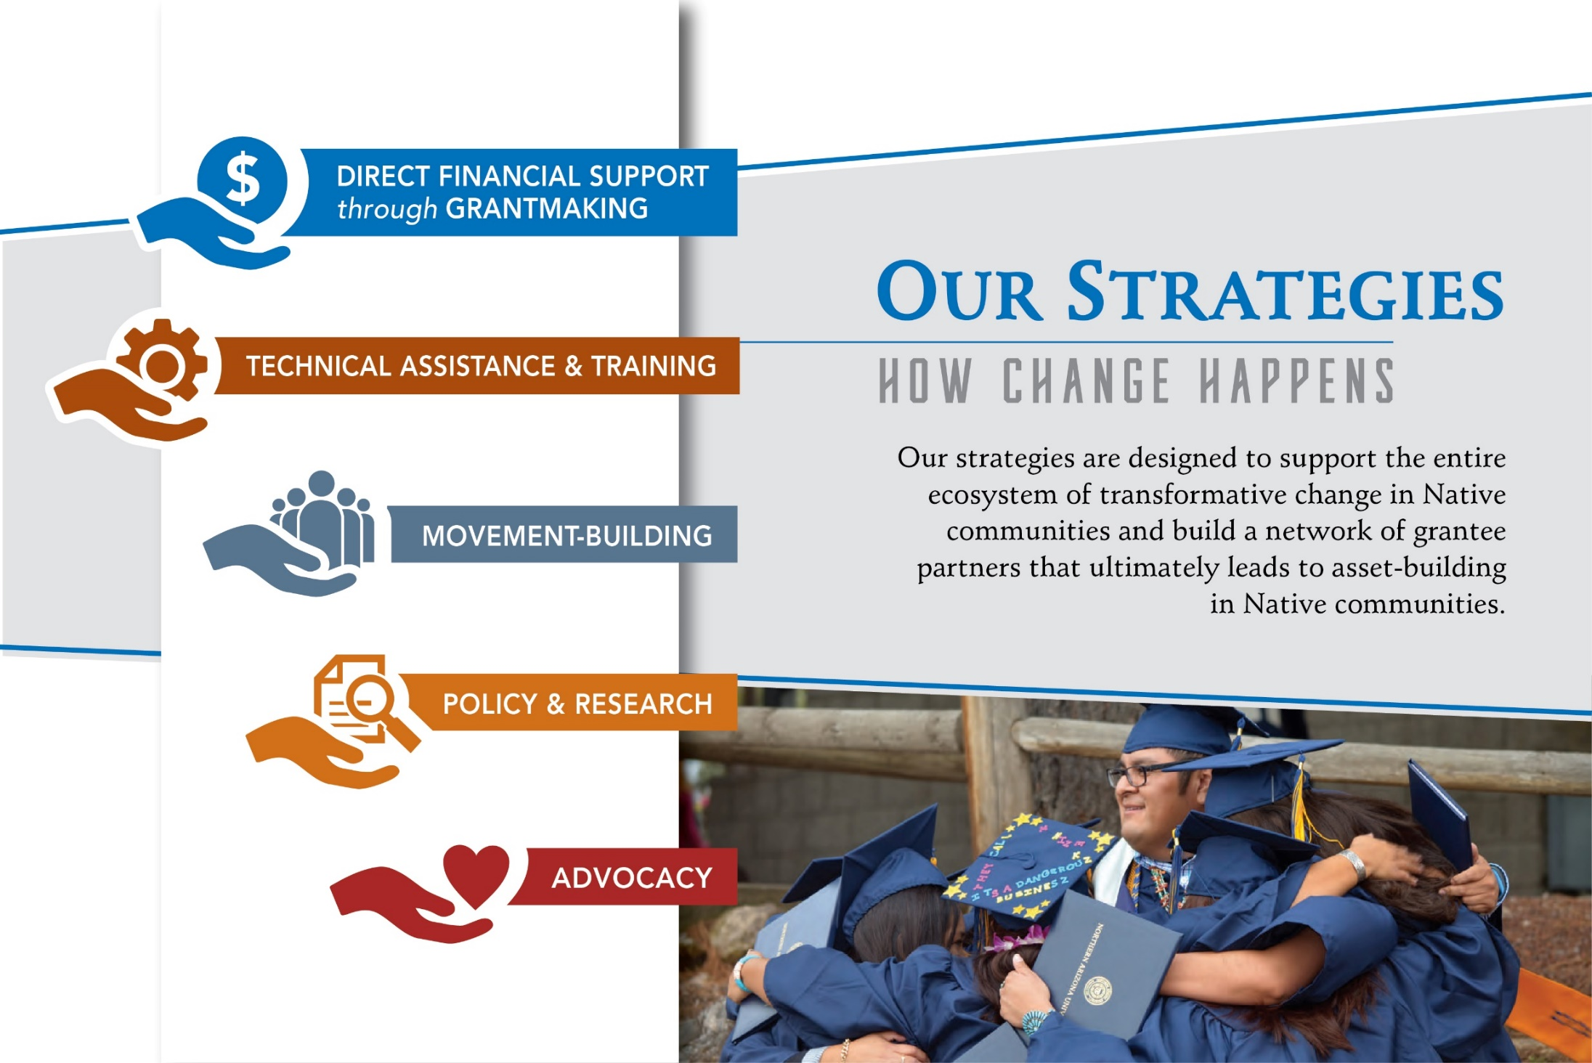
Notes:
To support positive change in Indian Country, First Nations aligns grantmaking, technical assistance and training, movement building, policy & research and advocacy. Our ultimate goal for grantee partners is to create, develop, and control assets in their Native community.

Slide 4
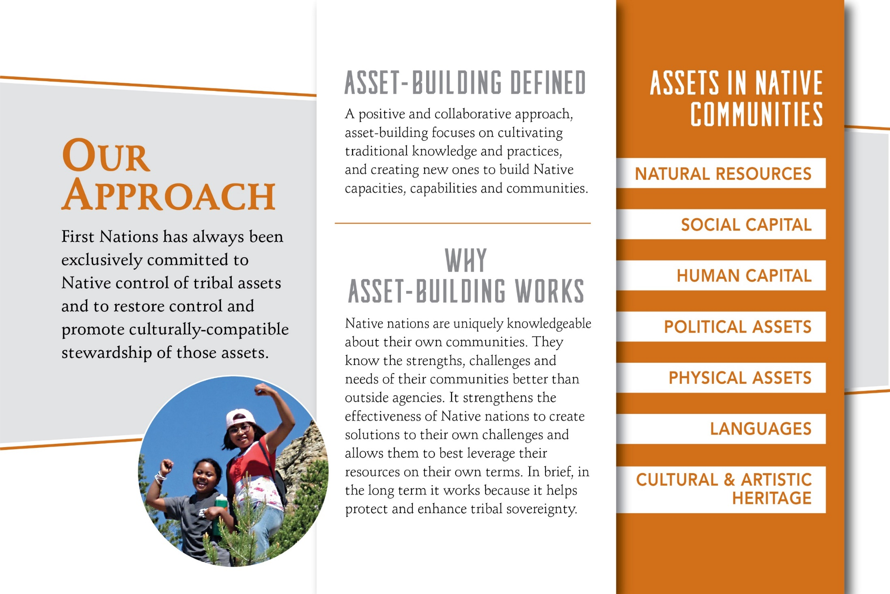
Notes:
First Nations has taken a broad approach to assets building. We refer to assets in Native Communities as Financial Assets, Physical Assets, Natural Assets, Institutional Assets, Human Capital as an asset, Cultural Assets, Social Capital as an asset, and Political Assets. By including human, social, cultural, political and intuitional assets into our perspective we are aligning to a more cultural-centered worldview.
Native nations are uniquely knowledgeable about their own communities. They know the strengths, challenges and needs better than any outside agency. So, it makes the most sense to us for Native nations to create their own solutions and leverage their resources on their own terms as they protect and enhance tribal sovereignty.

Slide 5
First Nations Project Team
A-dae Romero Briones
Director of Programs - NAFSI
Jacque Demko
Grants Officer
Rana LaPine
Lead Program Officer
Jenny Stephens Data Administrator
Ethan Gallegos
Program Coordinator
Notes:
I’d like you to meet our Project Team.
Starting at the top left we have A-dae Romero Briones who is the Director of Programs – and oversees the Nourishing Native Food and Health program
That’s me in the middle. I will be your Program Officer and main point of contact for your grant.
Jacque Demko is here with us today. She is your resource for our grant portal and tech issues.
Jenny Stephens is our Data Administrator. You’ll submit your grant agreement to her.
And Ethan Gallegos is our Project Coordinator he helps us behind the scenes as well. Today is he’s helping with tech support.

Slide 6
A Food Pantry Grant for Native Communities funded by the Walmart Foundation
Grant Partnership and Purpose
Address Food Insecurity
Strengthen Indigenous Food System
Build Organization Capacity
Setting the Table for a Healthy Food System in Indian Country
This project aims to strengthen Native-run food pantries and food banks directly served through this grant and through capacity building, in turn increasing their services and the quantity/quality of food provided to Native community members.
Notes:
The Northern Plains Food Storage Grant targets food pantries and food banks serving Native communities. This grant is made possible through generous funding from the Walmart Foundation. We are thankful for their generous support and partnership.
This grant design has two main portions: 1) regranting through these grants, 2) a half-day virtual convening to allow for peer learning, sharing of models, and networking
First Nations will also evaluate these grants and develop a publish reports to present outputs, outcomes, lessons learned, and convening findings as documents by a third-party evaluator team.

Slide 7
Grantees
Tribe/Organization | City | State
FAST Blackfeet | Browning | Montana
Hopi Relief | Scottsdale | Arizona
Hualapai Tribe | Peach Springs | Arizona
Inter-Tribal Council of Nevada | Reno | Nevada
Knik Tribe | Palmer | Alaska
Native American Advancement Foundation | Tucson | Arizona
Native American Community Board | Lake Andes | South Dakota
Native Conservancy | Cordova | Alaska
Oneida Nation of Wisconsin | Oneida | Wisconsin
Pleasant Point Passamaquoddy Tribal Government | Perry | Maine
Pueblo Resurgents | Isleta | New Mexico
Sust’ aina ble Molokai | Kaunakakai | Hawai’i
We Care Shi Cheii doo Shi Masani | Pinon | Arizona
Notes:
I want to take a moment to congratulate our grantees. And encourage you to reach out to one another outside of this grant project to share your work and build your network. Each grantee has a wealth of knowledge and is passionate about what they do.

Slide 8
Grant Funding Schedule
Grants Funded
13 grants awarded averaging $34,564 each, for a total of $449,338.
Grants Term
December 1, 2021 – June 1, 2023 (18 months)*
Disbursement Schedule
December, 2021 -$16,500 upon signed grant agreement
August, 2022 - $16,500 upon verbal report & expenditure report June, 2023 - $2,000 upon final report
Notes:
Here is an overview of the funding information along with the disbursement schedule. We awarded 13 grants of up to $35,000 for a total of $449,338. The grant term will be from December 1, 2021 to June 1, 2023. Please look at your grant agreement as your own grant period may vary based on your application
There are three disbursements – two of $15-$16,500 upon the grant agreement submission and later the interim/expenditure report and a final payment of $2,000 upon receipt and approval of a final report.

Slide 9
Grant Requirements
Interim Progress Report (Verbal)
Final report
Half-day virtual convening
Notes:
Explain research paper

Slide 10

Publicizing Your Project
Announce Your Grant
Grantees are required to share the news of their award through various media outlets.
We request that NAFSI grantees note that this project is funded by First Nations Development Institute.
Announcement due on or before June 15, 2023.
Methods of Communication
A press-release, letter, story, or article
videotape or documentary
photograph or story boards
Social Media announcement
Opportunity to Publish a Featured Story in Our E-newsletter “This Week at First Nations”.
Submit a separate well-written feature article of between 500 and1,500 words that describe your project, its purpose and its successful completion. Utilize quotes or experiences from various project participants, and include relevant photographs or graphics.
(Optional)
Notes:
Publicizing Your Project
Please take the time to share the news of your award through media outlets by June 15 , 2023, or the end of the grant period. This is a requirement. We ask that you note the project is funded by First Nations Development Institute. I’ve listed the examples of communication methods which you can select from. Feel free to add to or use multiple methods it’s totally up to you. You’ll want to keep the documentation for your records and reporting.
You are also invited to publish in our E-Newsletter called “This Week at First Nations”. It goes out to the wider Indian Country audience. I’ve added the details to the slide. This is optional, however, it’s very good way to use First Nations network to get your project out there and raise awareness.

Slide 11








Grant Modifications
Program
If you need an extension for your project.
If you have changes to the timeline of an objectives.
If you have revisions to an objective.
Budget
If you have changes that exceed 10% of the grant.
Send an email request modification to your Program Officer within the grant period.
Notes:
Grant Modifications
There are two types of Modifications – Program Modifications and Budget Modifications.
A Program Modification may be needed if you would like to extend your project, adjust the timeline of an objective or revise and objective.
A budget Modification may be needed if you would like to adjust your budget beyond 10% of the total award amount.
If you think you need a modification or you know you need a modifications please send me an email with an update or request.

Slide 12
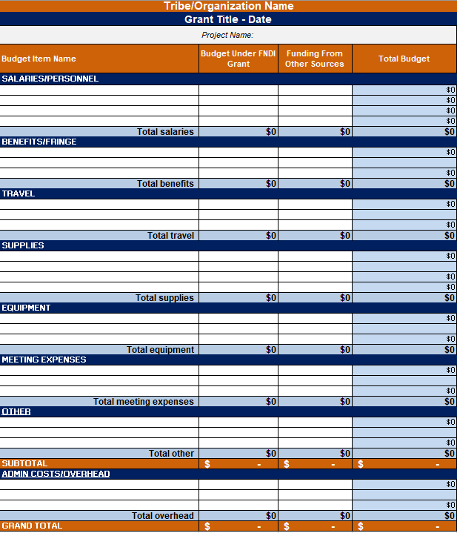
Grant Budget
Best Practices
Track your spending monthly.
All approved expenses must be spent within the grant period.
Plan to a 90-day countdown and review the budget with your team.
Report on your budget to actual expensing using your approved budget and the excel template with the final report.
Notes:
Grant Budgets
Grant budgets are a helpful tracking tool. We encourage you to track your monthly spending.
Compare what you’ve budgeted to what you’ve actually spent.
Plan to have a 90 day countdown and review the budget with your team so you can catch any expenses or budget lines that need attention.
We will provide a budget template for the final report (shown here). To submit your fully spent budget.

Slide 13
Grant Checklist
Important Date | Item | Where/Submit Info | Instructions
December 16, 2021 | Grant Orientation | Zoom | Attend orientation webinar or watch video recording.
January 1, 2021 | Grant Agreement | Email to Jenny Stephens jstephens@firstnations.org | Send a scan or mail back 2 copies with original signatures & initials
August 1, 2022 | Interim Report | Zoom & Online Portal | First Nations will reach out via email for planning
TBD | Half-day Virtual Convening | TBD | A half-day virtual convening. More details to come.
June 1, 2023 | Grant Closes
June 15, 2023 | Final Report | Upload in portal | Final report will be sent at least 2 weeks in advance via email

Slide 14
Portal run-through
Notes:
Jacque walks them through the online system

Slide 15
When To Contact First Nations
If you have staff turnover – especially project coordinator.
If you don’t receive your check within 30 days.
If you are having problems meeting your objectives.
If you are having issues with your interview or reporting.
If you are having financial issues.
If you have to revise your budget and objectives.
If you want to share good news or progress!
Notes:
If you have any questions please do not hesitate to contact our staff.
Especially if there’s been staff turnover – say your project coordinator swaps out. Do let us know.
If you don’t receive your check when you’re expecting one.
If your having problems meeting your objectives. We understand things come up and can help you to adjust.
If you’re having issues with your on-site visit, financial issues, or budget changes. Please keep us in the loop.
Or, if you have something newsworthy to share! That’s always good to.

Slide 16

Contact Us
First Nations Development Institute
2432 Main Street, 2nd Floor
Longmont, Colorado 80501
Tele: 303.774.7836
Fax: 303.774.7841
www.firstnations.org
Program Team *Rana LaPine Lead Program Officer rlapine@firstnations.org
Jacque Demko Grants Officer jdemko@firstnations.org
A-dae Briones Program Director abriones@firstnations.org
Jenny Stephens Data Administrator jstephens@firstnations.org
Ethan Gallegos Program Coordinator egallegos@firstnations.org
*primary contact
Notes:
Our main-office is in Longmont, Colorado. Our contact info here and on our website.
Also listed is each team member email. My name again is Rana LaPine and I will be your primary contact, but feel free to email any of us and we can direct your question to the best person.
Thank you for attending this webinar. Again it will be available on our website in the knowledge center if you need it as a reference along with this PowerPoint.

Slide 17
Questions
This webinar will be recorded and can be accessed on our website under the First Nations Knowledge Center at https://www.firstnations.org/webinars/grantee-orientation-webinars/
Notes:
At this time I would like to go over the questions that we have received. Please submit all questions through the Question box and we will go through them as time permits.

