Slide 1

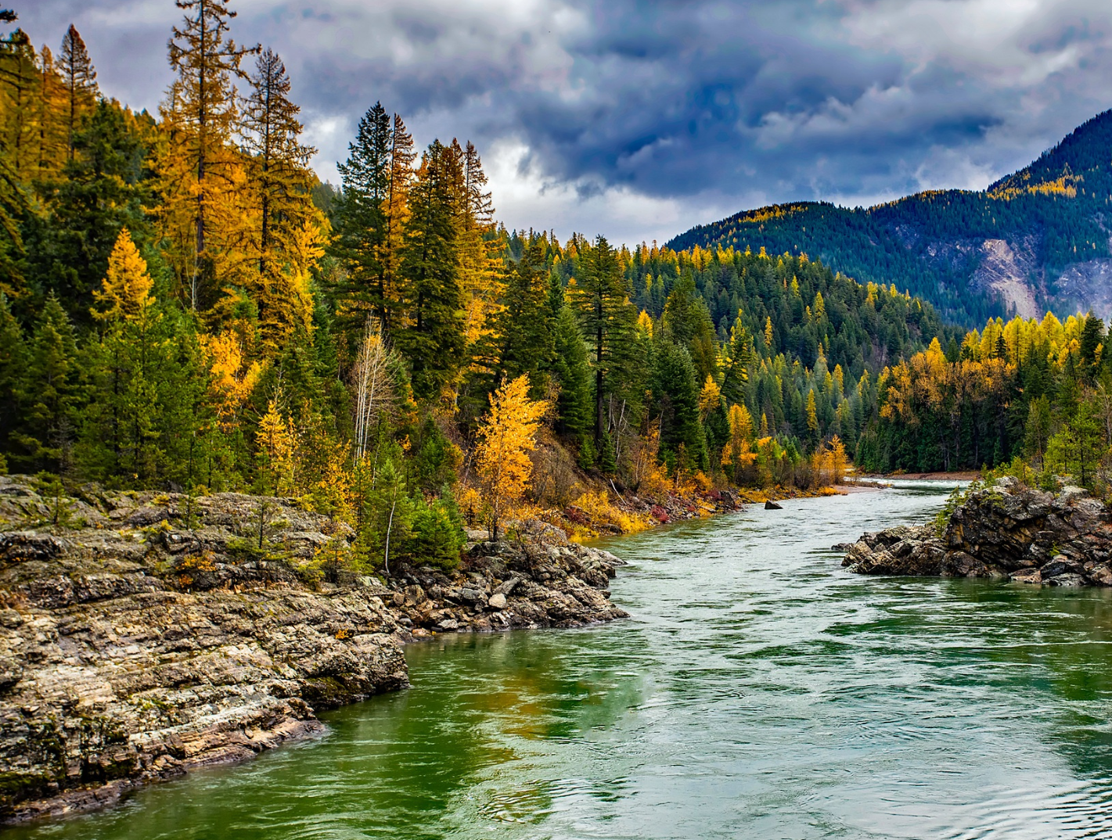

Strengthening Tribal Co-management and Co-stewardship
Q&A WEBINAR

Slide 2

WEBINAR MANAGEMENT
All attendees will be muted throughout this webinar.
If you have questions, please enter them in the question box or raise your hand using the reactions button.

Slide 3
WEBINAR TOPICS
Introduction – FNDI & SNL
Question & Answer
Overview of Grant Opportunity
Walk-through of online application process

Slide 4
ABOUT FIRST NATIONS DEVELOPMENT INSTITUTE
Native-Led Nonprofit
Founded in 1980
Based in Longmont, Colorado
1993: Grantmaking Program Launched
Grantmaking to date: 3,385 grants, $80 million
Constituent Base: Tribal Programs, Native-Led Nonprofits & Community Orgs
48 Staff Members

Slide 5
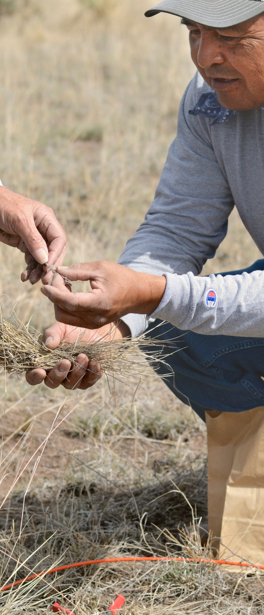
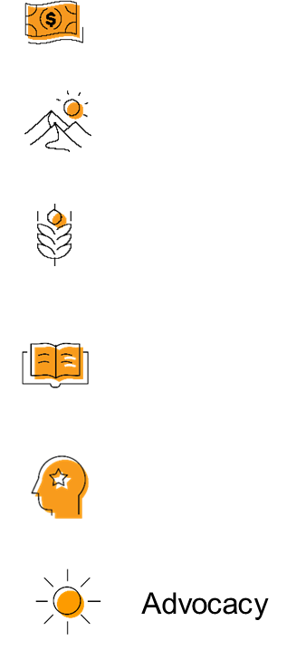

OUR STRATEGIES
DIRECT FINANCIAL SUPPORT THROUGH GRANTMAKING
TECHNICAL ASSISTANCE & TRAINING
CONVENINGS & WEBINARS
RESEARCH ON BEST PRACTICES & MODELS
COALITION BUILDING & FELLOWSHIPS
ADVOCACY

Slide 6
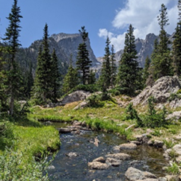
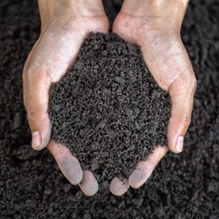
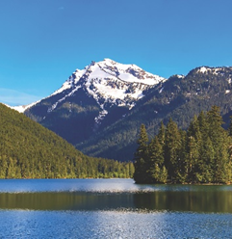
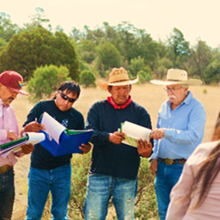
STEWARDING NATIVE LANDS
ENVIRONMENTAL SOVEREIGNTY & JUSTICE
ECOLOGICAL STEWARDSHIP
COMMUNITY PATHWAYS
CLIMATE
Protecting communities and lands from harmful practices, projects, and policies
Sustainably managing and restoring lands for our communities and future generations
Addressing ongoing and anticipated impacts of climate change to preserve lands and cultural lifeways
Upholding traditions and amplifying knowledge

Slide 7
GRANT INFORMATION
First Nations expects to award 5 grants up to $75,000 each to support projects that aim to grow Tribal co-management and co-stewardship planning and related capacity building.

Slide 8
GRANT INFORMATION
Grant Award Ceiling: $75,000
Grant Term: 5/1/2024 – 11/30/2024
Grant Period: 7 months
Application Deadline: April 18th, 2024, 5 pm MT
Award/Declination Information: May 6th, 2024

Slide 9
GRANT INFORMATION
Co-stewardship, according to the DOI, refers to collaborative or cooperative arrangements between Department bureaus/offices and Tribes/Native Hawaiian organizations that have shared interests in managing, conserving, and preserving lands and waters.
Co-management refers to the sharing of power and responsibility between a government and another entity. This tends to be more robust, long-term, and formal role within managing lands.
*both terms can be used and applied in different ways*

Slide 10
ELIGIBILITY
Federal- and state-recognized tribal governments and departments

Slide 11
SELECTION PRIORITY
Selected grantees under this opportunity must use funding to support work that is building necessary capacity to negotiate, implement, and monitor co-management and co-stewardship agreements with a federal or state agency

Slide 12
SELECTION CRITERIA
Advance co-management or co-stewardship agreements in a way that aligns with Tribal values and interests.
Build capacity for co-management or co-stewardship efforts.
Enhance the health and biodiversity of ecosystems.
Incorporate methods to track, measure, and share impact.
Can help launch new models across different land management agencies.

Slide 13
ALLOWABLE ACTIVITIES
Tribal capacity building
Departmental and programmatic development and advancement
Co-management and co-stewardship planning and development

Slide 14
PROPOSAL REQUIREMENTS
  A concise description of the proposed project including details about planning. Include information about what your co-management or co-stewardship objectives and goals are; the federal agency, state or local government, that will co-steward/co-manage; and the geographic region of the project.
  An overview of the activities that will be executed during the project, how they will be implemented, and how they will advance Tribal priorities.
  A plan of how to plan to track and measure the project impact.
  At least two specific objectives to be accomplished with the funding.

Slide 15
PROPOSAL ATTACHMENTS
Tribal programs and governments should submit a list of their Tribal Council in lieu of a Board of Directors.
Tribal programs and governments may submit proof that they are a federal- or state-recognized tribe.
Budget: An estimated budget for the proposed project with a detailed cost breakdown.

Slide 16
ONLINE APPLICATION SYSTEM
All applicants must complete First Nations’ online grant application, including submission of necessary attachments, no later than THURSDAY, APRIL 18, 2024, at 5 p.m. Mountain Daylight Time.
  Should you encounter any technical issues please contact grantmaking@firstnations.org ASAP and prior to the 5pm deadline.
Some of our most rural and remote applicants may have limited access to high-speed Internet. Any exceptions to use of the online system must be made at least two weeks in advance of the deadline by submitting an email request to grantmaking@firstnations.org. Please include your name, contact information, and indicate you are applying for the Strengthening Tribal Co-management/Co-stewardship grant opportunity. If you do not have access to email you can call our office at (303) 774-7836 and ask to speak with a member of the Grantmaking Department.

Slide 17
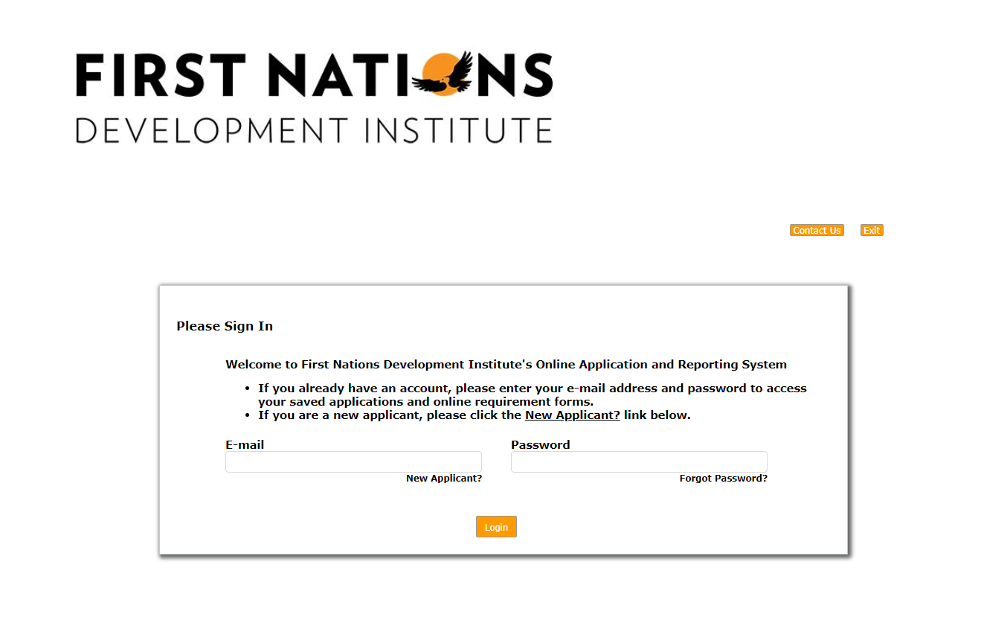
APPLICATION WALK-THROUGH
Application: https://us.grantrequest.com/application.aspx?sid=1243&fid=353849

Slide 18

QUESTIONS

Slide 19

CONTACT
BRETT TREADWAY
btreadway@firstnations.org
MARSHA WHITING
mwhiting@firstnations.org
GRANTMAKING TEAM
  grantmaking@firstnations.org

Slide 20







THANK YOU
NATIONAL HEADQUARTERS
First Nations Development Institute 2432 Main Street
Longmont, CO 80501
CONTACT
Tel: 303.774.7836
Fax: 303.774.7841 info@firstnations.org
CONNECT
firstnations.org
fndi303
First Nations Development Institute
FirstNationsDevelopmentInstitute
@FNDI303

