Slide 1
Protecting Sacred Places – Shortcomings and Available Tools
Native American Rights Fund

Slide 2
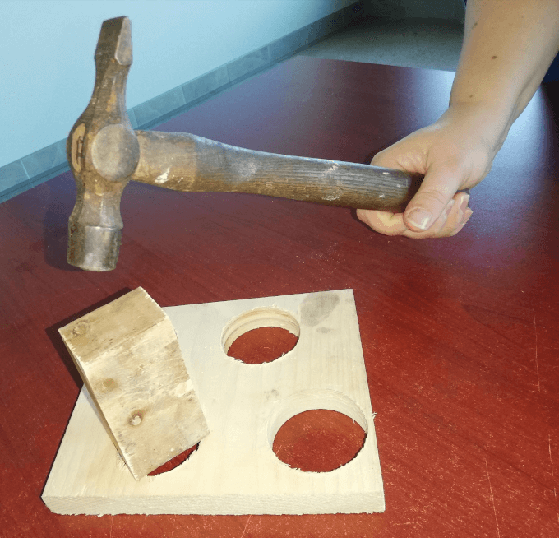

Slide 3
Available Tools to Protect Sacred Places
Tribal Nation Law
Treaties
1st Amendment
RFRA
NHPA
NEPA
NAGPRA
CWA
ARPA
ESA
Antiquities Act
Breach of Trust (but not really)
AIRFA
EO 13007 and other Agency Guidance
Co-Management
New Federal/State Legislation
International Law

Slide 4
Limits on Available Tools
CWA (limited to waters of the United States and water in general)
ESA (limited to protecting endangered species as listed)
Antiquities Act (limited to historic and scientific objects as proclaimed by President)
AIRFA (no teeth, Lyng, 485 U.S. at 455, but useful for advocacy)
EO 13007 (no teeth, but useful for advocacy)
Co-Management (limits on enforceability and strength)
New Federal/State Legislation (Congress)

Slide 5
Limits on Available Tools
Tribal Nation Law (jurisdictional scope)
Treaties (scope)
Free Exercise/RFRA (governing test, e.g. Lyng, Apache Stronghold, judicial view of burden – square peg, round hole)
NHPA/NEPA (primarily procedural, no requirement to avoid impacts/effects)
NAGPRA (limited to remains and funerary objects on federal land)

Slide 6
Tribal Nation Law*
Title 40, Lummi Code of Laws (Cultural Resource Preservation Code)
Title 5, Muscogee Code Annotated (Ceremonial Grounds/Churches)
4 Navajo Code § 901 et seq. (Navajo Environmental Policy Act)
RST Ordinance 2006-02 (Cultural Resource Management Code)
* These may be out of date or superseded.

Slide 7
Treaties
Article 3 of 1851 Fort Laramie – anti-depredation provision
Article 7 of 1855 Lame Bull Treaty – anti-depredation provision
First Amended Complaint, Rosebud Sioux Tribe and Fort Belknap Indian Community v. Donald Trump, https://www.narf.org/nill/documents/20190508kxl-amended-complaint.pdf
But see Gros Ventre Tribe v. United States, 469 F.3d 801, 812 (9th Cir. 2006) (breach of trust case that analyzes treaty without using cannons).

Slide 8
First Amendment
Laws incidentally burdening religion are ordinarily not subject to strict scrutiny under the Free Exercise Clause so long as they are neutral and generally applicable. Emp. Div., Dep't of Hum. Res. of Oregon v. Smith, 494 U.S. 872, 876 (1990).
But “government regulations are not neutral and generally applicable, and therefore trigger strict scrutiny under the Free Exercise Clause, whenever they treat any comparable secular activity more favorably than religious exercise.” Tandon v. Newsom, 141 S. Ct. 1294, 1296 (2021).
And the Government fails to act neutrally when it proceeds in a manner “intolerant of religious beliefs or restricts practices because of their religious nature.” Fulton v. City of Philadelphia, 141 S. Ct. 1868, 1877 (2021).
A policy is “not generally applicable if it invites the government to consider the particular reasons for a person's conduct by providing ‘a mechanism for individualized exemptions.’” Id.

Slide 9
First Amendment
Ninth Circuit, however, concluded that a disposition of government real property is not subject to strict scrutiny when it has “no tendency to coerce individuals into acting contrary to their religious beliefs,” does not “discriminate” against religious adherents, does not “penalize” them, and does not deny them “an equal share of the rights, benefits, and privileges enjoyed by other citizens.” Apache Stronghold v. United States, No. 21-15295, 2024 WL 884564, at *13 (9th Cir. Mar. 1, 2024) (citing Lyng); but see id. at *94 (Murguia, J., dissent) (concluding Lyng does not add anything to the Smith test, which RFRA overruled).

Slide 10
RFRA
A prima facie claim is established when a plaintiff shows: (1) their activity is an exercise of religion and (2) the government action substantially burdens their religious exercise.
Once the plaintiff establishes a prima facie case, the burden shifts to the government to prove that the restriction furthers a compelling government interest by the least restrictive means. 42 U.S.C. § 2000bb-1.

Slide 11
Apache Stronghold v. United States: Procedural History
Historically Congress protected Oak Flat despite mining interest in the area
2014: Congress authorizes transfer of Oak Flat to Resolution Copper
Jan. 4, 2021: Forest Service announces immediate transfer
Jan. 12, 2021: Apache Stronghold sues and seeks preliminary injunction
March 2021: District Court denies premlinary injunction
March 2021: Apache Stronghold seeks emergency relief from Ninth Circuit
June 2022: Ninth Circuit declines to protect Oak Flat
November 2022: Ninth Circuit grants rehearing en banc
March 2024: Ninth Circuit again declines to protect Oak Flat
April 2024: Apache Stronghold seeks rehearing en banc before entire Ninth Circuit
May 2024: Ninth Circuit denys rehearing request
September 2024: Apache Stronghold petition for cert due
October 2024: Amici briefs due

Slide 12
Ninth Circuit En Banc Panel Decision
A majority concluded that the transfer of Oak Flat is a substantial burden under RFRA's "plain meaning.“
A separate majority rejected the plain meaning and held that the transfer does not constitute a “substantial burden” according to an atextual interpretation of “substantial burden."

Slide 13
RFRA
9th Cir. also concluded that Apache Stronghold’s RFRA claim failed because RFRA did not override Lyng, but rather must be interpreted consistent with Lyng. Apache Stronghold v. United States, No. 21-15295, 2024 WL 884564, at *20 (9th Cir. Mar. 1, 2024).
Because Apache Stronghold’s Free Exercise claim failed under Lyng, its RFRA claim necessarily failed as well. Id.

Slide 14
NHPA
National Historic Preservation Act (“NHPA”) of 1966 established a federal policy of preserving historic places at the federal, state, and local level.
In 1992, the Act was amended to include sites of cultural and religious significance to Tribal Nations on the National Register of Historic Places.

Slide 15
NHPA
The NHPA protects places listed on, or eligible for inclusion on, the National Register. 54 U.S.C. § 300101.
To be eligible for inclusion on the National Register, the place must be associated with significant events, people, or architecture, or the place must have the potential to yield information relating to prehistory or history. 36 C.F.R. § 60.4.
This includes property that is “of traditional religious and cultural importance to” Native Nations. 54 U.S.C. § 302706(a).
Medicine Wheel and White Eagle Park are examples of TCPs.

Slide 16
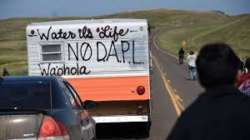
NHPA
The NHPA requires that a federal agency consider the adverse effects of an “undertaking” when a federal or federally assisted “undertaking” may have an effect on a historic property. 54 U.S.C. § 306108.
Section 106 review seeks to identify historic properties potentially affected by the undertaking, assess its effects and seek ways to avoid, minimize or mitigate any adverse effects on historic properties. 36 C.F.R. § 800.1.
Requires consultation with Tribal Nations on affected properties.
Courts often refer to this type of provision as a “stop, look, and listen” provision, similar to NEPA. Standing Rock Sioux Tribe v. U.S. Army Corps of Engineers, 205 F. Supp. 3d 4, 8 (D.D.C. 2016) (denying motion for PI for NHPA violations).

Slide 17
NEPA
Requires environmental impact statements (EIS) for federal actions, necessitating detailed studies of anticipated impacts on the human environment, including impacts on tribal interests and resources. 42 U.S.C. § 4332(C); 40 C.F.R. § 1502.16(a)(5).
NEPA requires federal agencies to create a record mapping the impact of proposed actions on Indigenous religious practices and sacred sites.

Slide 18
NEPA
An agency must take a hard look at impacts on treaty rights, but often may do so by analyzing the effects on a specific resource identified in the treaty. Standing Rock Sioux Tribe v. U.S. Army Corps of Engineers, 255 F. Supp. 3d 101, 131 (D.D.C. 2017).
NEPA's requirements are “procedural,” not dictating any outcome. Id. at 113.
And even when there is a violation, there may not be a remedy. See Standing Rock Sioux Tribe v. United States Army Corps of Engineers, 985 F.3d 1032, 1054 (D.C. Cir. 2021) (concluding there was a NEPA violation, vacating the permit, but not requiring operations of pipeline to stop).

Slide 19
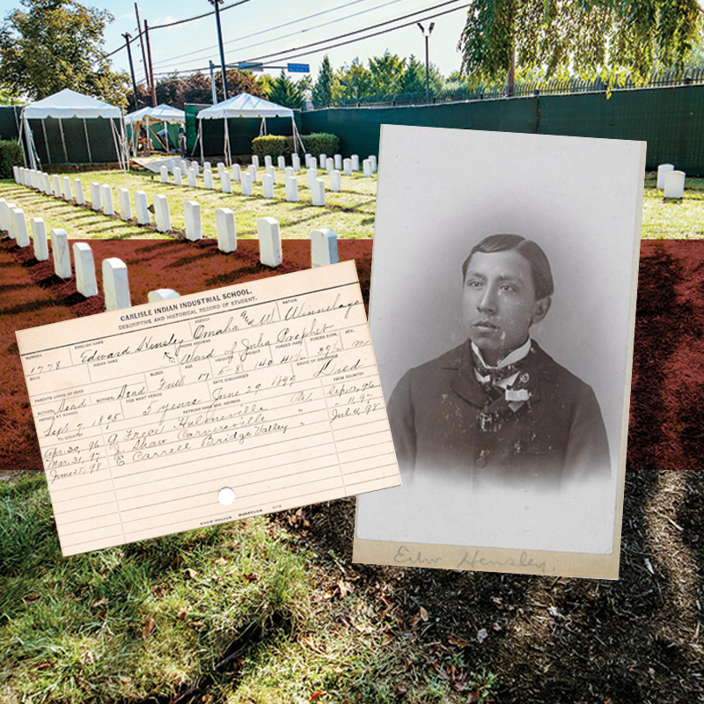
NAGPRA
NAGPRA expressly provides rules that address ownership or control of cultural items that are discovered in the future on federal and tribal land. 25 U.S.C.A. § 3001.
In the case of human remains and associated funerary objects, any lineal descendants have the initial right of ownership or control. Id. at 3002.
If lineal descendants of the human remains and associated funerary objects cannot be ascertained or when unassociated funerary objects, sacred objects, and items of cultural patrimony are involved, ownership or control is determined in a statutory order of priority, which includes in Tribal Nations. Id.

Slide 20
CWA
The Clean Water Act (CWA) establishes the basic structure for regulating discharges of pollutants into the waters of the United States and regulating quality standards for surface waters. 33 U.S.C. §1251 et seq.
The CWA made it unlawful to discharge any pollutant from a point source into navigable waters, unless a permit was obtained.
Tribal Nations can obtain treatment as state (TAS) status for implementing and managing the CWA, which allows Tribes to set and have enforced their own water quality standards. E.g. City of Albuquerque v. Browner, 97 F.3d 415 (10th Cir. 1996).

Slide 21
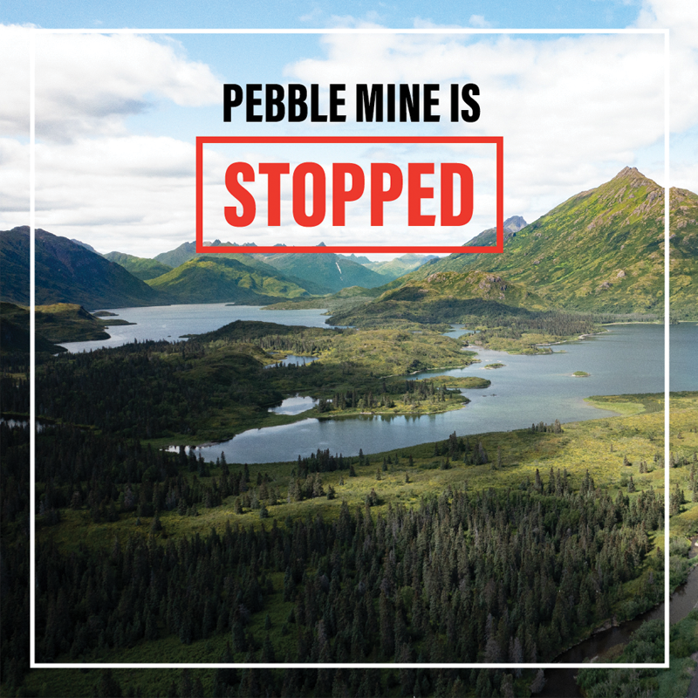
CWA
Bristol Bay was a place protected by the denial of a CWA 404 permit.
Section 404(c) authorizes EPA to restrict, prohibit, deny, or withdraw the use of an area as a disposal site for dredged or fill material if the discharge will have unacceptable adverse effects on municipal water supplies, shellfish beds and fishery areas, wildlife, or recreational areas.

Slide 22
ESA
The Endangered Species Act (ESA), 16 U.S.C. 1531 et seq.:
Establishes protections for fish, wildlife, and plants that are listed as threatened or endangered.
Provides for adding species to and removing them from the list of threatened and endangered species, and for preparing and implementing plans for their recovery.
Provides for interagency cooperation to avoid take of listed species and for issuing permits for otherwise prohibited activities.

Slide 23
ESA
Federal agencies must ensure that any action that it takes is not likely to jeopardize the continued existence of a listed species or destroy or adversely modify its habitat. 16 U.S.C. § 1536(a)(2).
If an action “may affect” a listed species or critical habitat, the agency typically must engage in a formal consultation process with either the United States Fish and Wildlife Service or the National Marine Fisheries Service. 50 C.F.R. § 402.14; 402.01.
The consultation process culminates with the issuance of a written biological opinion.

Slide 24
ESA
Section 9 makes it unlawful for “any person” to “take” any member of an endangered or threatened species. See 16 U.S.C. § 1538(a)(1)(B), (C), (G).
A recent example of ESA litigation is Yurok Tribe v. U.S. Bureau of Reclamation, 654 F. Supp. 3d 941 (N.D. Cal. 2023); see also Klamath Tribes v. United States Bureau of Reclamation, No. 1:22-CV-00680-CL, 2024 WL 472047, at *6 (D. Or. Feb. 7, 2024).
There, the Court held that the ESA preempts state law in the operation of the Klamath Project, and thus Reclamation can release downstream flows to support the coho salmon and Southern Resident Killer Whale as opposed to Klamath Project irrigators.

Slide 25
Antiquities Act
Enacted in 1906, the Antiquities Act was the first U.S. law to provide general legal protection of cultural and natural resources of historic or scientific interest on Federal lands.
The President may, in the President's discretion, declare by public proclamation historic landmarks, historic and prehistoric structures, and other objects of historic or scientific interest that are situated on land owned or controlled by the Federal Government to be national monuments. 54 U.S.C. § 320301(a).
Presidents “may reserve parcels of land as a part of the national monuments.” Id. at § 320301(b).

Slide 26
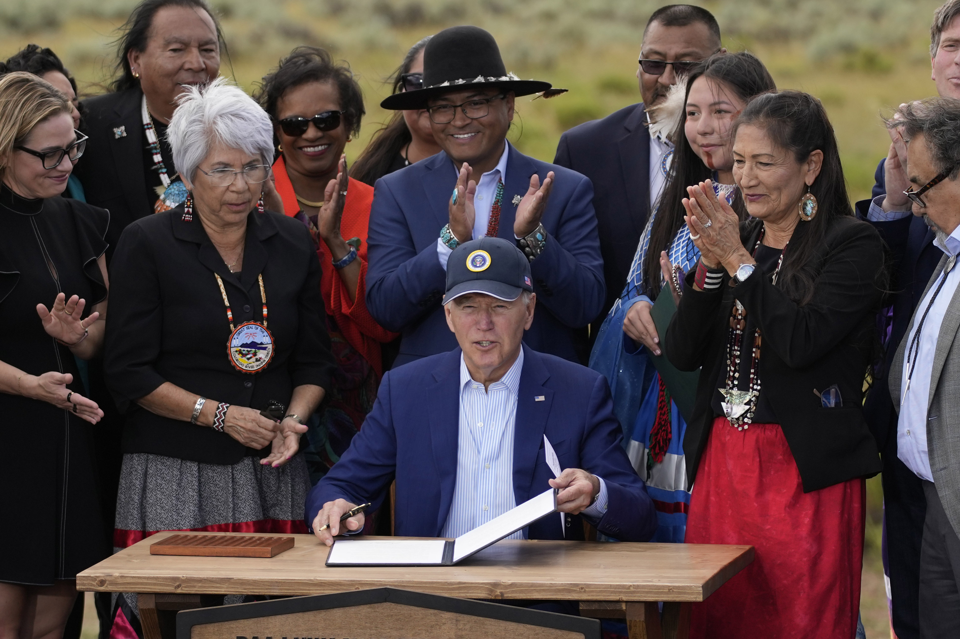
Antiquities Act
Requires advocacy to the administration and Presidential action.
Examples:
Bears Ears National Monument
Baaj Nwaavjo I’tah Kukveni-Ancestral Footprints of the Grand Canyon National Monument
Avi Kwa Ame National Monument
Navajo National Monument

Slide 27
Bears Ears and Co-Management
President Obama first established a Bears Ears Commission comprised of Tribal Nation representatives.
Commission ensures “management decisions affecting the monument reflect tribal expertise and traditional and historical knowledge” and provides “guidance and recommendations” on the management of the monument. 82 FR 1139.
The Secretaries have to “meaningfully engage the Commission” in the development of the management plan and to inform subsequent management of the monument. Id.
Secretaries must “carefully and fully consider integrating the traditional and historical knowledge and special expertise of the Commission” and if they do not they must provide the Commission “with a written explanation of their reasoning.” Id.
President Biden re-affirmed the Commission. 86 FR 57321.

Slide 28
Baaj Nwaavjo I'tah Kukveni—Ancestral Footprints National Monument
President Biden established a Tribal Commission for the Ancestral Footprints Monument. 88 FR 55331.
The Commission shall consist of one elected officer each from any Tribal Nation with ancestral ties to the area in which the Tribal Nation and the Secretaries agree to co-stewardship of the monument through shared responsibilities or administration. Id.

Slide 29
Baaj Nwaavjo I'tah Kukveni—Ancestral Footprints National Monument
The Secretaries shall ensure the protection of sacred sites and cultural properties and sites in the monument and shall provide access to Tribal members for traditional cultural, spiritual, and customary uses. 88 FR 55331.
Such uses shall include the collection of medicines, berries, plants and other vegetation for cradle boards and other purposes, and firewood for ceremonial practices and personal noncommercial use. 88 FR 55331

Slide 30
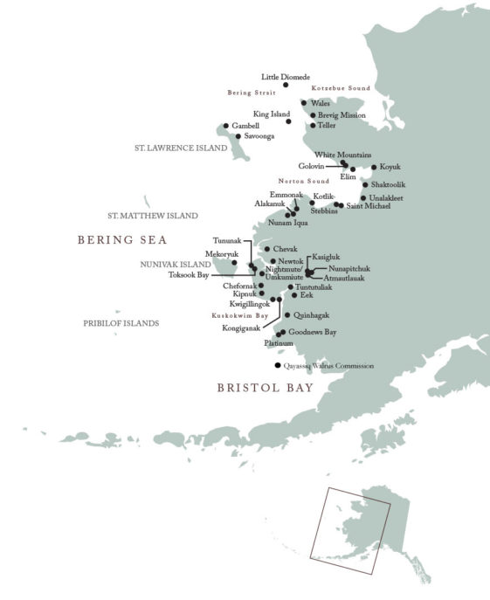

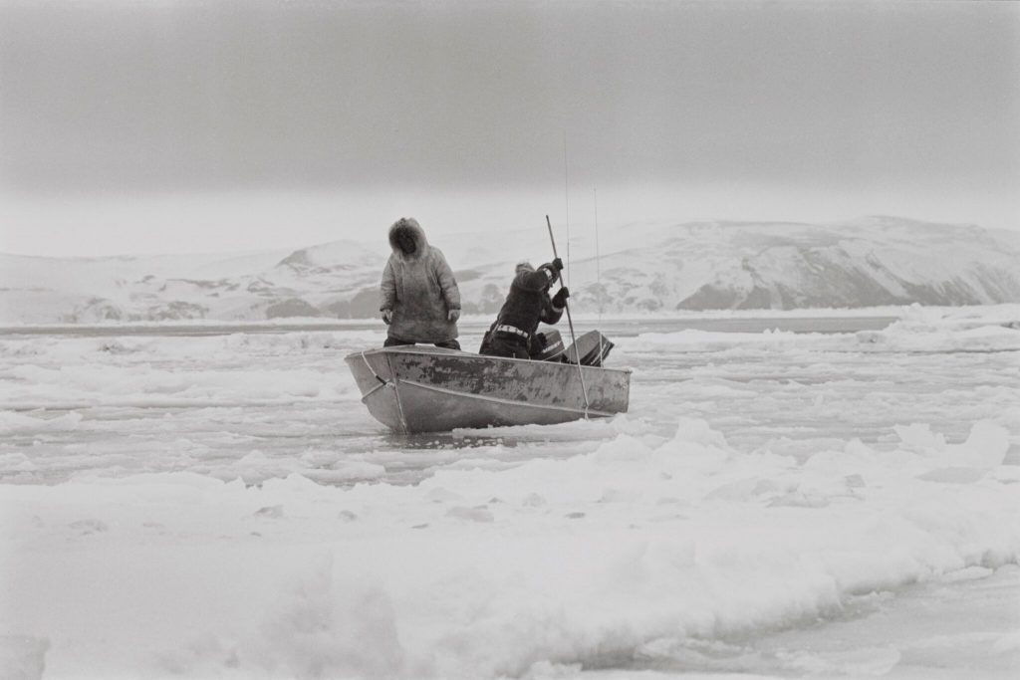

Slide 31
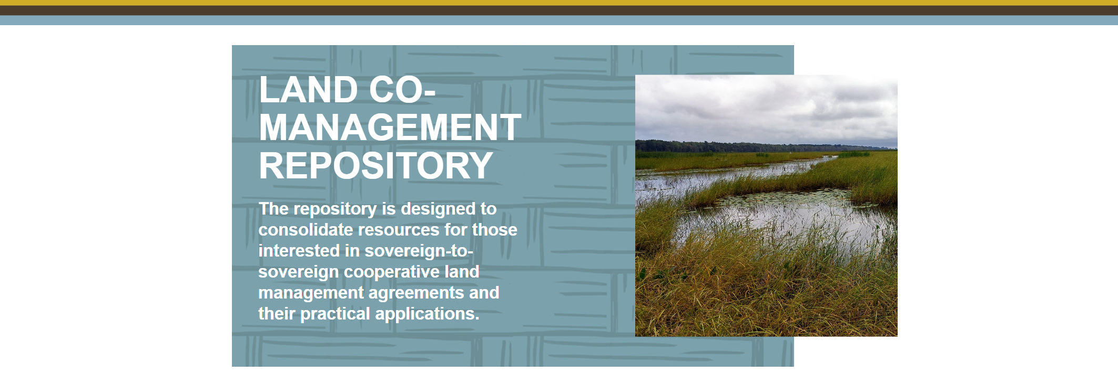
https://narf.org/resources/land-co-management-repository/

Slide 32
Agency Guidance*
Best Practices Guide for Federal Agencies Regarding Tribal and Native Hawaiian Sacred Sites (2023)
MOU Regarding Inter Agency Coordination and Collaboration for Protection of Indigenous Sacred Sites (2021)
Report to Secretary of Agriculture, USDA Policy and Procedures Review and Recommendations: Indian Sacred Sites (2012)
EO 13007 – Indian Sacred Sites; see Te-Moak Tribe of W. Shoshone Indians of Nevada v. U.S. Dep't of the Interior, 565 F. App'x 665, 667 (9th Cir. 2014) (Although E.O. 13007 has no force and effect on its own, its requirements are incorporated into FLPMA by virtue of FLPMA's prohibition on unnecessary or undue degradation of the lands).
EO 14112 – Reforming Federal Funding and Support for Tribal Nations To Better Embrace Our Trust Responsibilities and Promote the Next Era of Tribal Self-Determination
*Not Comprehensive

