Slide 1

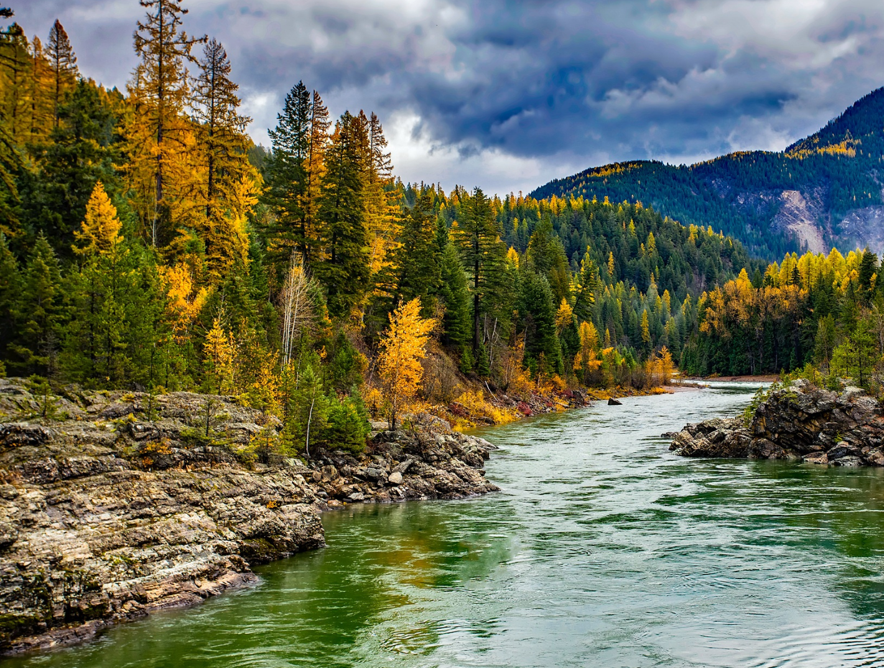

STEWARDING NATIVE LANDS AND THE U.S. FOREST SERVICE PRESENTS
Indigenous stewardship on national forest lands webinar series: Rocky Mountain region

Slide 2

WEBINAR MANAGEMENT
If you have questions, please type them in the question box.
They will be addressed during the Questions section.
All attendees will be muted throughout this webinar.
This webinar is being recorded.

Slide 3

First Nations’ mission is to uplift and sustain the lifeways and economies of Native communities through advocacy, financial support, and knowledge sharing.

Slide 4
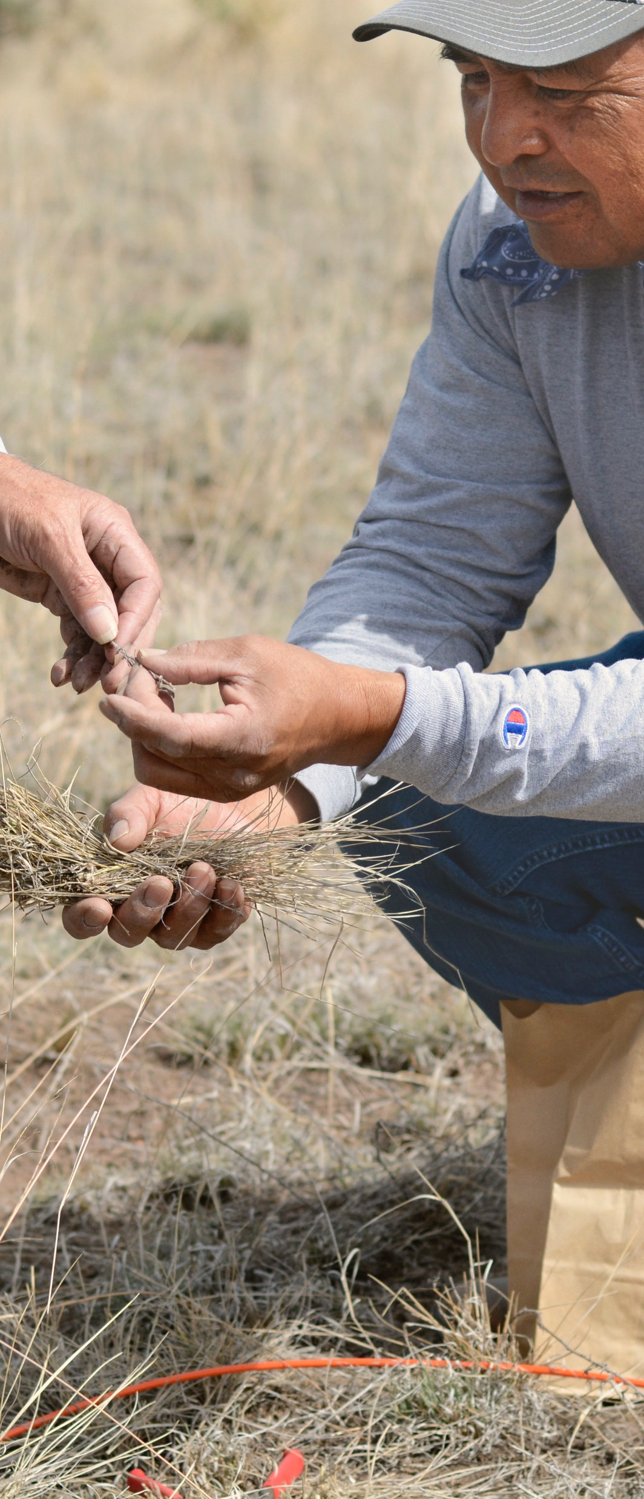
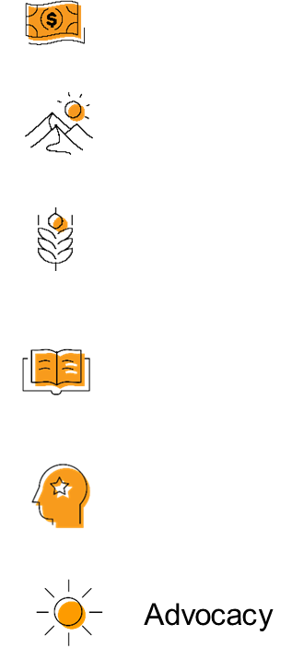

OUR STRATEGIES
DIRECT FINANCIAL SUPPORT THROUGH GRANTMAKING
TECHNICAL ASSISTANCE & TRAININGS
CONVENINGS & WEBINARS
RESEARCH ON BEST PRACTICES & MODELS
COALITION BUILDING & FELLOWSHIPS
ADVOCACY

Slide 5
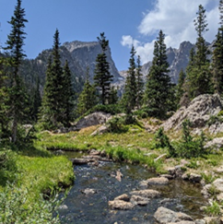

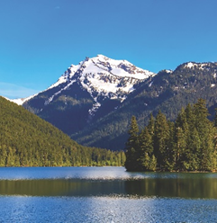
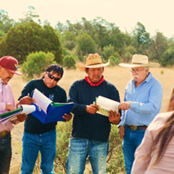
STEWARDING NATIVE LANDS
ENVIRONMENTAL SOVEREIGNTY & JUSTICE
STEWARDSHIP
CLIMATE
COMMUNITY PATHWAYS
Protecting communities and lands from harmful practices, projects, and policies
Restoring healthy relationships between people and land
Addressing ongoing and anticipated impacts of climate change to preserve lands and cultural lifeways
Avenues for intergenerational knowledge transfer

Slide 6

The Mission of the Stewarding Native Lands program is to invest in and center Native peoples in the stewardship of their lands for a generous future.

Slide 7
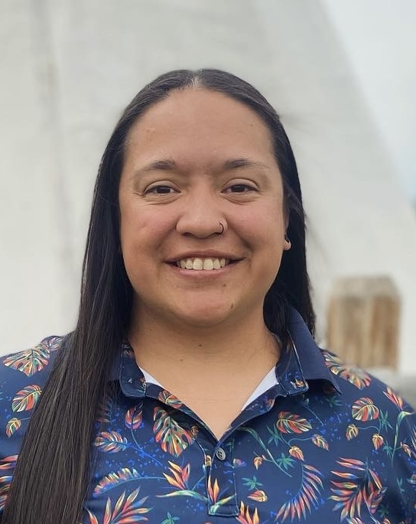
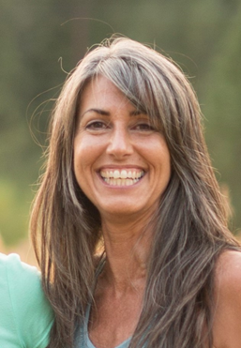
Confederated Salish and Kootenai Tribes
Kathryn “Katie” McDonald
Tribal Relations Specialist, Confederated Salish and Kootenai Tribes
Christine Bradbury
U.S. Forest Service, Tribal Relations Program Manager (Northern Region)

Slide 8
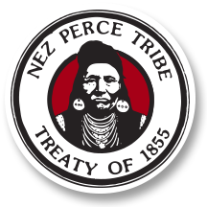

Nez Perce Tribe
Emmit Taylor
Fisheries Watershed Deputy Director, Nez Perce Tribe
Christine Bradbury
U.S. Forest Service, Tribal Relations Program Manager (Northern Region)

Slide 9
Question & Answer

Slide 10

CONTACTS
Brett Treadway (FNDI)
btreadway@firstnations.org / (303)867-8015
Emmit Taylor (Nez Perce Tribe)
emmitt@nezperce.org
Kathryn “Katie” McDonald
Kathryn.McDonald@cskt.org
Christine Bradbury
christine.bradbury@usda.gov

Slide 11
Previous FNDI Webinars
FNDI x USFS INDIGENOUS STEWARDSHIP ON NATIONAL FOREST LANDS WEBINAR SERIES
Great Lakes Region: Leech Lake Band of Ojibwe and Ste. Sault Marie Band of Chippewa Indians
East Region: Great Lakes Indian Fish and Wildlife Commission and Eastern Band of Cherokee Indians
Upcoming:
Webinar #4: Pacific Region Webinar (Date TBD)
Link to recordings, materials, and registration info found here: https://www.firstnations.org/webinars/stewarding-native-lands-webinars/

Slide 12
Other FNDI Co-Stewardship/Co-Management Webinars
FNDI CO-STEWARDSHIP AND CO-MANAGEMENT WEBINAR SERIES
Tribal Co-Stewardship and Co-Management 101
Sovereign-to-Sovereign Agreements Database: A Resource to Grow the Field of Tribal Co-Management
Sacred Site and Cultural Resource Protection Through Tribal Co-Stewardship and Co-Management
Upcoming:
Tribal Co-Stewardship and Cultural Fire (October 24^{th)}
Leveraging 638 Contracts for Tribal Co-Stewardship/Management (November 7th)
LINK TO RECCORDINGS HERE: https://www.firstnations.org/webinars/stewarding-native-lands-webinars/

Slide 13

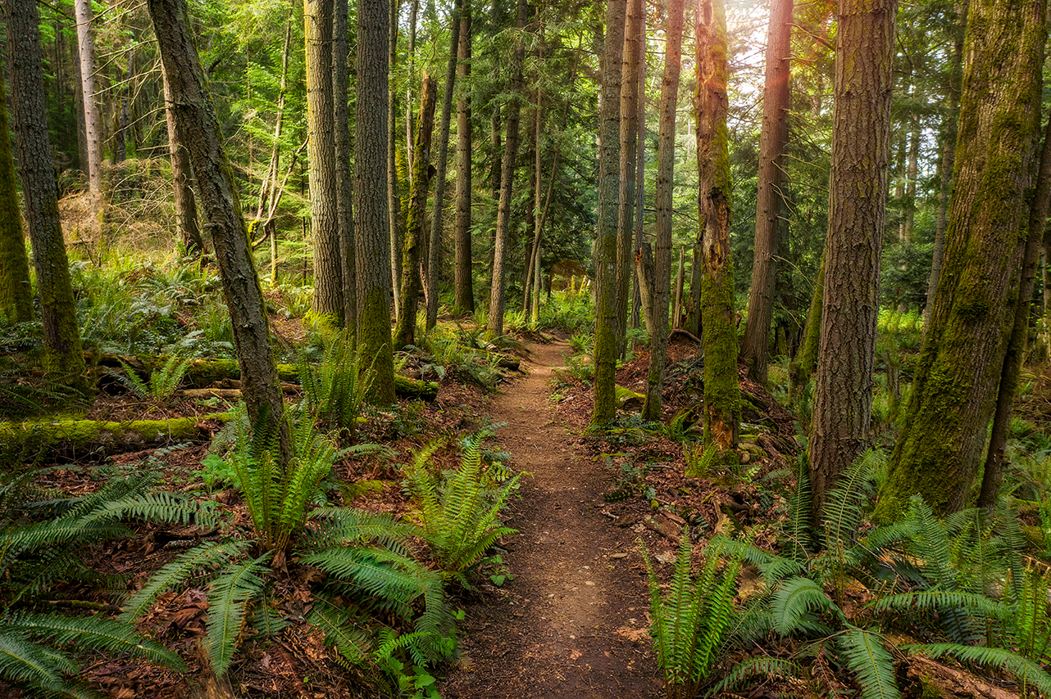
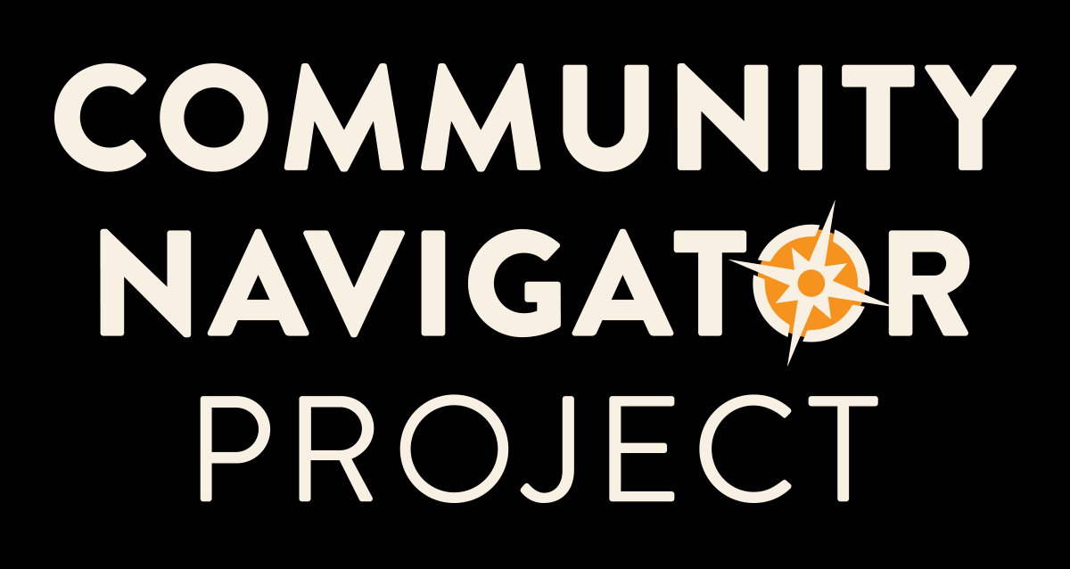

Opportunities: Community Navigator
First Nations will conduct outreach and support engagement of Tribes and Native-led Organizations in U.S. Forest Service IRA and related BIL programs and opportunities.
Technical Assistance
Capacity Support Grants (up to $25,000)
Webinars and Presentations
Publications and Resource Guides
And more
IRA – Inflation Reduction Act
BIL – Bipartisan Infrastructure Law
Leiloni Begaye
Associate Director
First Nations Development Institute
lbegaye@firstnations.org
www.firstnations.org/community-navigator
Notes:
I’d like to highlight our partnership with the Forest Service as a Community Navigator. In this role, we will grow our outreach and technical assistance to tribes in areas in which we are already invested and connected, and will enable greater tribal access to Forest Service programming. The vehicle for this work will be through the Stewarding Native Lands program and will utilize strategies we already have built into our programs and include:
Targeted Technical Assistance – which will be provided to improve tribal access to and capacity building for participation in FS opportunities. This TA can cover needs like feasibility assessments, grant writing, project and grant management training, strategic planning, development of conservation strategies, plans that incorporate diverse funding sources, and more. TA will use site visits and consultants with relevant expertise.
Capacity Support – will provide grants to cover costs associated with building capacity such as strategic planning, feasibility assessments, grant writing, project and grant management training, development of conservation strategies, and more.
Webinars and Presentations – will support outreach and increase awareness of Forest Service opportunities and resources and collaborate with Tribes to develop webinar topics based on emerging needs and feedback.
Publications and Resource Guides - will share lessons learned from our activities. We will also create an evaluation report to understand effectiveness this effort and to provide feedback to the US Forest Service and how to reduce barriers to accessing USFS programs and opportunities.

Slide 14
SAVE THE DATE
Tribal Co-Stewardship and Co-Management Conference
November 19-20, 2024
Gila River Resort, Wild Horse Pass
Chandler, AZ

Slide 15




COMMUNICATIONS
ACCESS THE WEINBAR RECORDING IN FIRST NATIONS KNOWLEDGE CENTER:
Here is where you can find the webinar recording and slides once they are posted: https://www.firstnations.org/fnk
FOLLOW US ON SOCIAL MEDIA
fndi303 First Nations Development Institute
FirstNationsDevelopmentInstitute
@FNDI303

Slide 16



THANK YOU
NATIONAL HEADQUARTERS
First Nations Development Institute 2432 Main Street
Longmont, CO 80501
CONTACT
Tel: 303.774.7836
Fax: 303.774.7841 info@firstnations.org
CONNECT
firstnations.org fndi303 First Nations Development Institute
FirstNationsDevelopmentInstitute
@FNDI303

