Slide 1
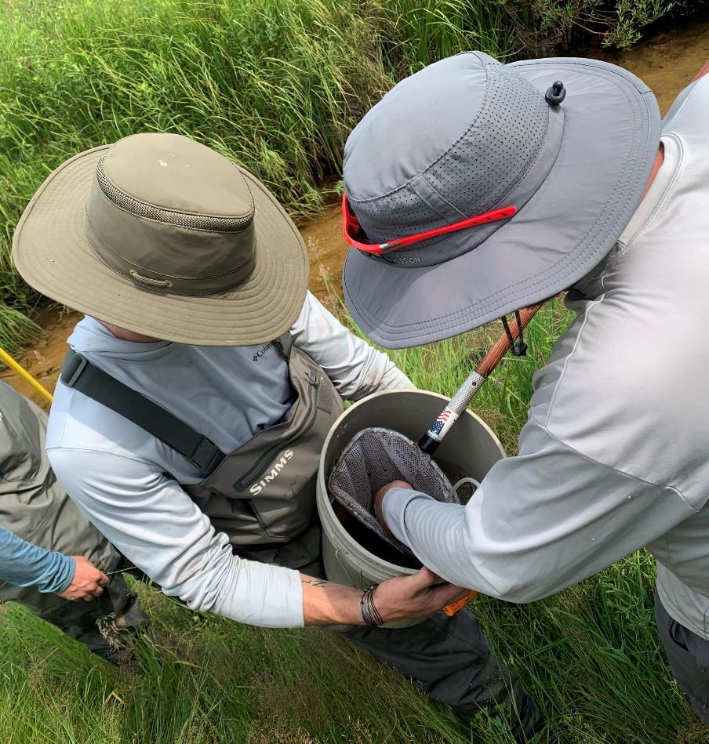
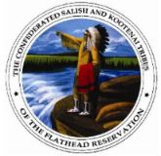


Indigenous Co-Stewardship of the National Forest System

Slide 2
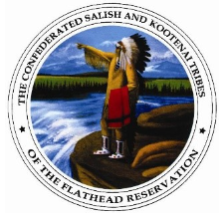

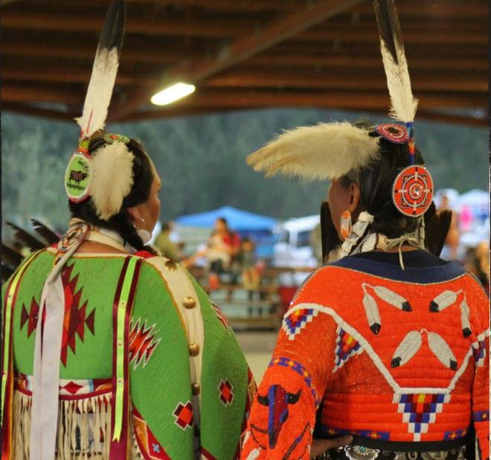
Mission statements
USDA Forest Service:
To sustain the health, diversity, and productivity of the Nation’s forests and grasslands to meet the needs of present and future generations.
Confederated Salish & Kootenai Tribes Forestry Dept:
To promote perpetually productive ecosystems for future generations in accordance with goals of the Confederated Salish, Pend d’Oreille, and Kootenai Tribes. We will prescribe and implement sound silvicultural treatments to promote forest health and return forest lands to near pre-settlement, fire maintained forest structures. Our decisions will be based on Tribal social and economic needs, as well as sound scientific and ecological principles.

Slide 3
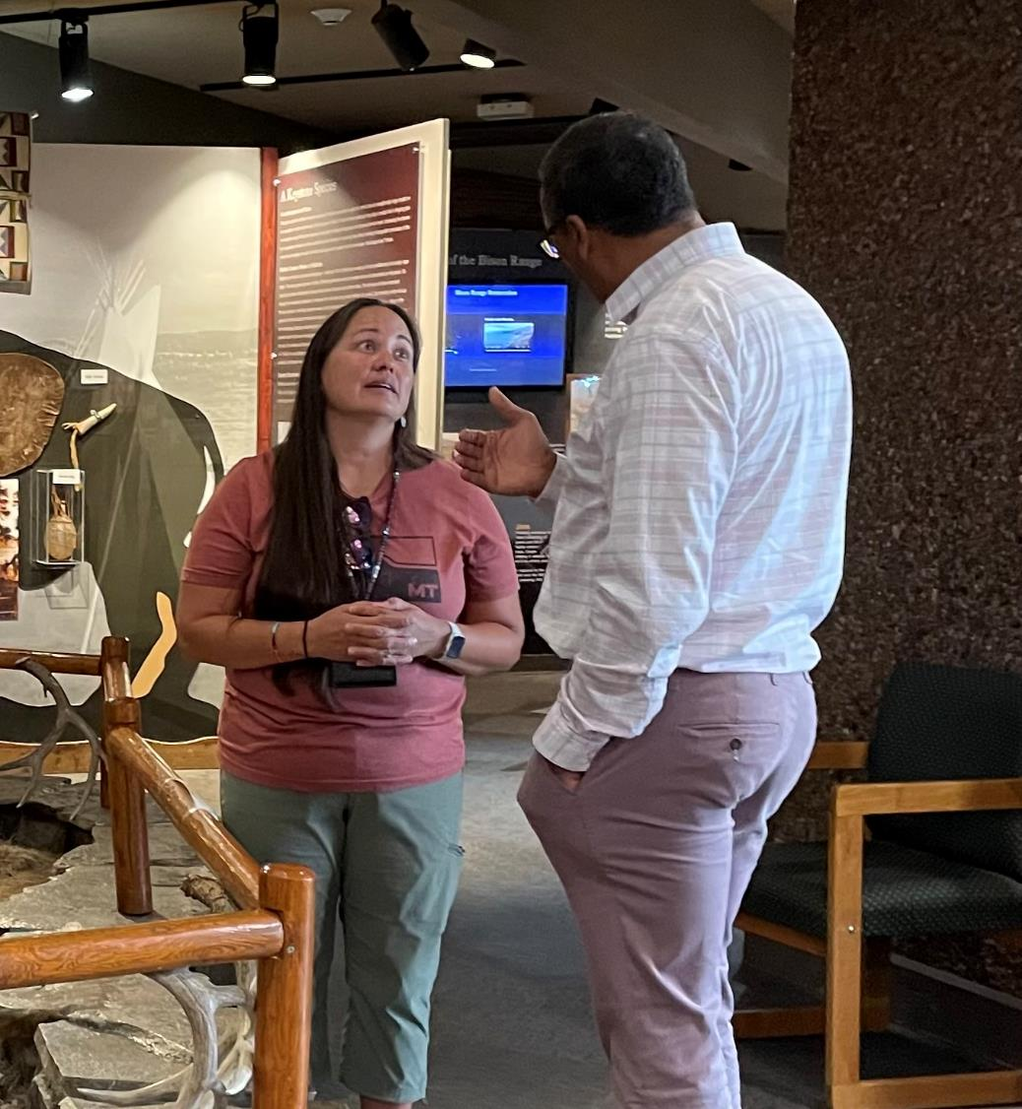
From Trust Responsibilities to trusting relationships

Slide 4
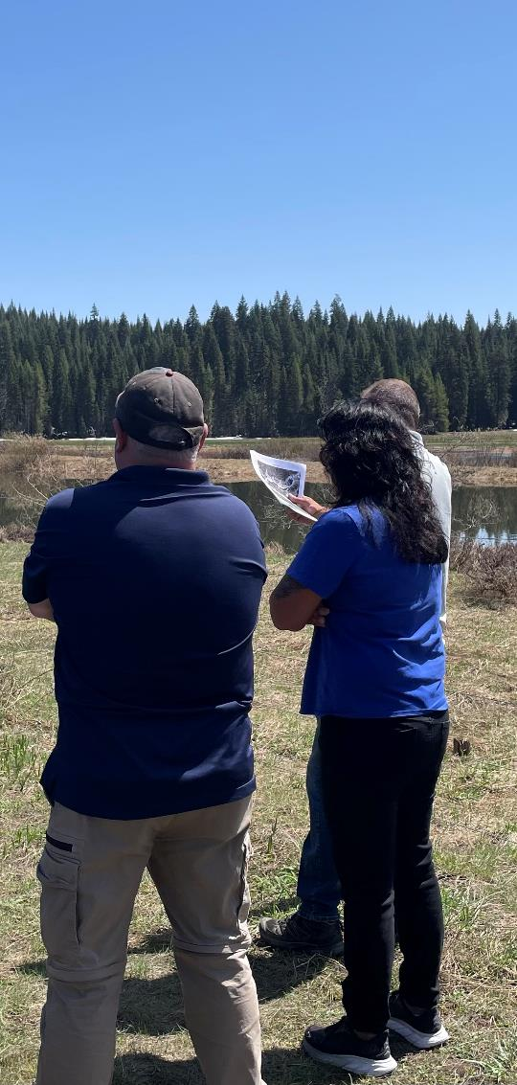
Organizational Culture shift
From…
Outputs to Outcomes
Review to Participation
DIY to Co-Stewardhip
Dismissing to Embracing IK

Slide 5
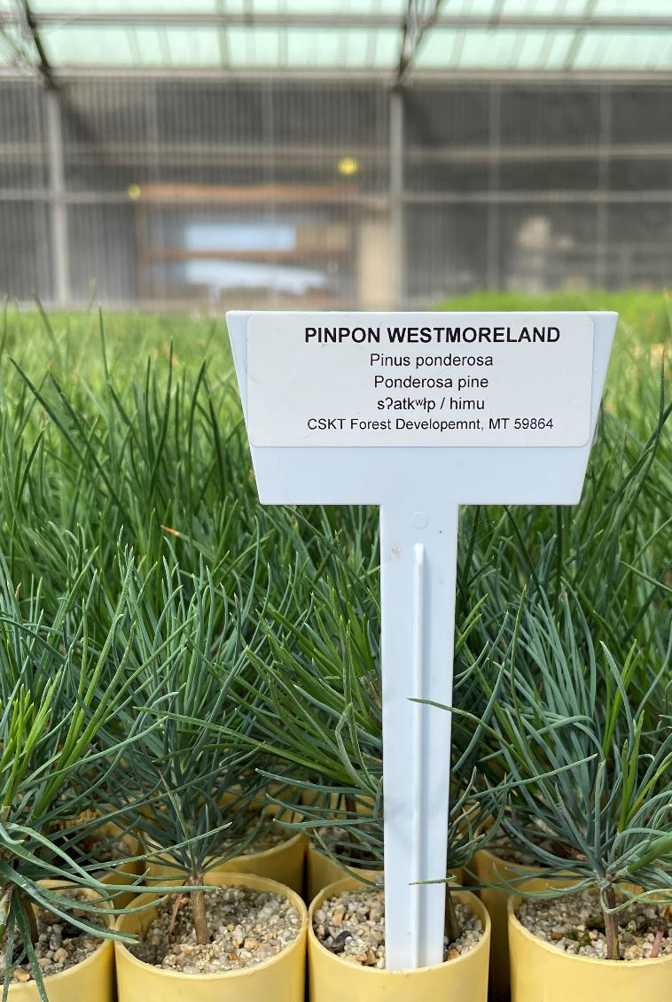
investments
Full-time Tribal Liaison - $250k
CSKT Nursery - $500k
IK Datasets - $120k
Youth Programs
Forest Planning

Slide 6
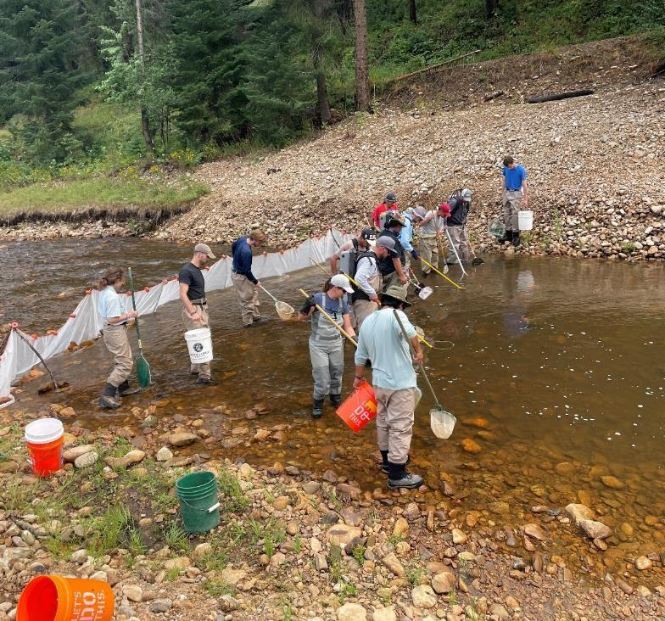
Mission statements
USDA Forest Service:
To sustain the health, diversity, and productivity of the Nation’s forests and grasslands to meet the needs of present and future generations.
Nez Perce Tribe DFRM-Watershed:
To protect and restore watersheds and fisheries resources throughout Nez Perce Territory, which are critical for future generations. This work has its roots in protecting tribal sovereignty and treaty rights reserved under the Treaty of 1855. These activities are accomplished using a holistic approach, which encompasses entire watersheds ridgetop to ridgetop, emphasizing all cultural aspects.

Slide 7
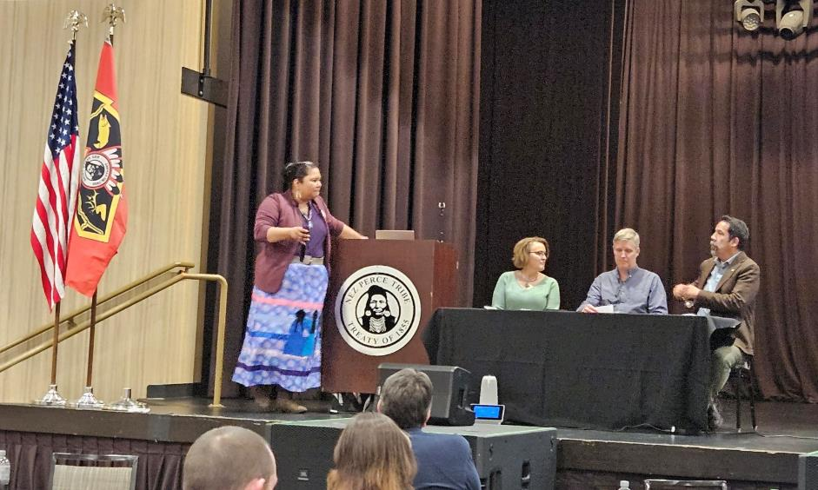
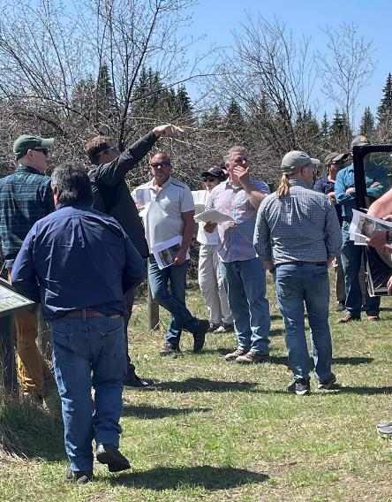
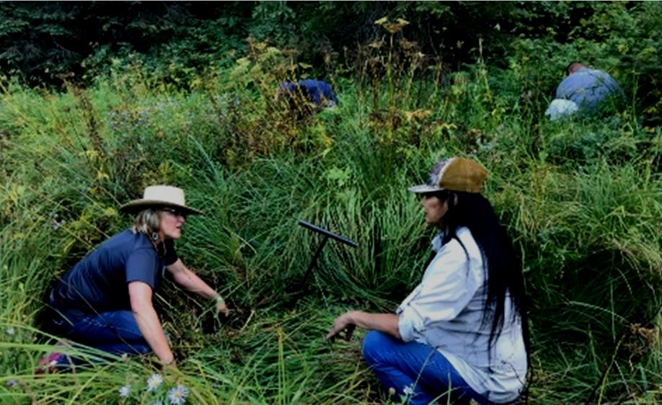
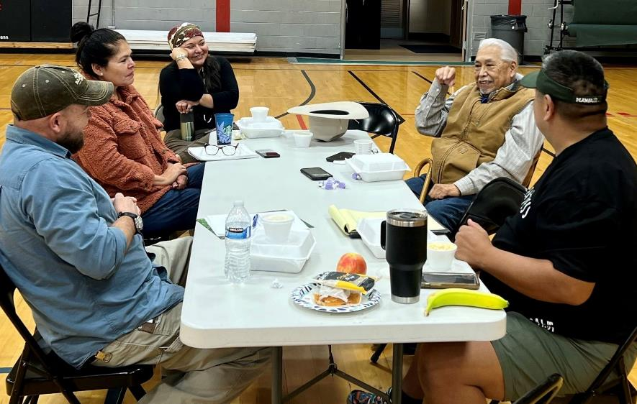
Communication and coordination

Slide 8
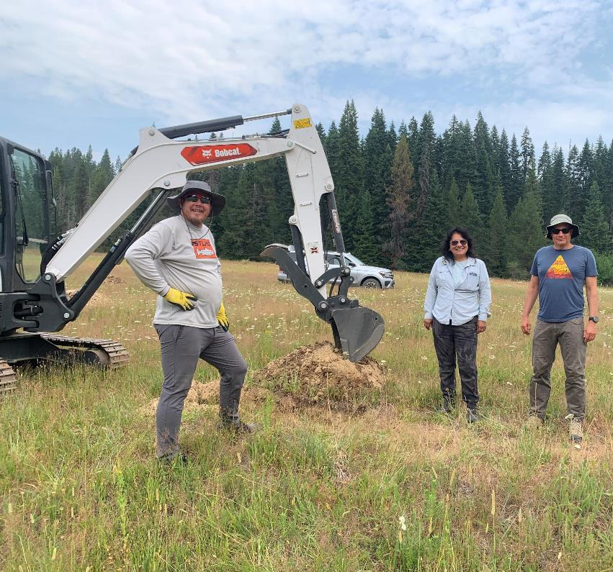
Wildfire Crisis landscape investments
NPT Fisheries-Watershed: $5.9M
Dust abatement on access roads for 4 fuels reduction projects
BDAs, PALs, and LWD to change nature and arrangement of fuels and improvement riparian fuelbreaks in 4 project areas resulting in 10,000 acres of Fuels and 30,000 CCF in FY24-27
NPT Cultural Division: $1.0M
1.7M ac. cultural and archeological surveys and reports for fuels/timber projects and areas. Includes ethnographic information to gather indigenous knowledge and build historical contexts around traditional cultural significance in and around the WCSL
Supports IK dataset work w/CSKT

Slide 9
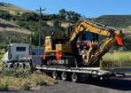
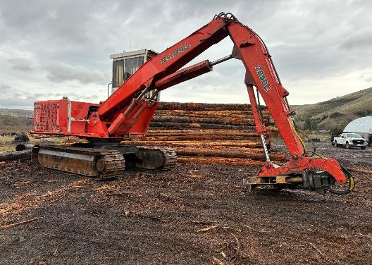
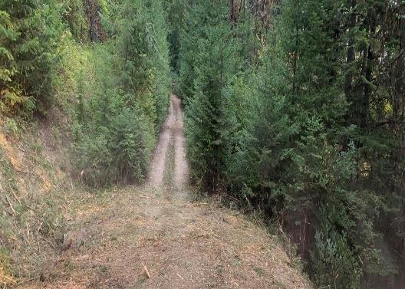
Wildfire Crisis landscape investments
NPT Fire & Forestry Division: $17.5M
Build capacity to engage off-reservation.
Ceded Lands Coordinator
2 field staff
10 Contractors
Purchased lowboy, excavator w/mastication head and log loader for firewood processing yard (matching funds)
4,800 acres of mastication and timber removal for linear fuel break CEs (minimum acreage based on high density fuels cost per acre).
600 acres of Roadside mastication FY24 completed
20 miles of Pre-roading
Future capacity with GNA Timber Sales pending Farm Bill Signature
$5.1M FY25 for Musselshell TFPA Project

Slide 10
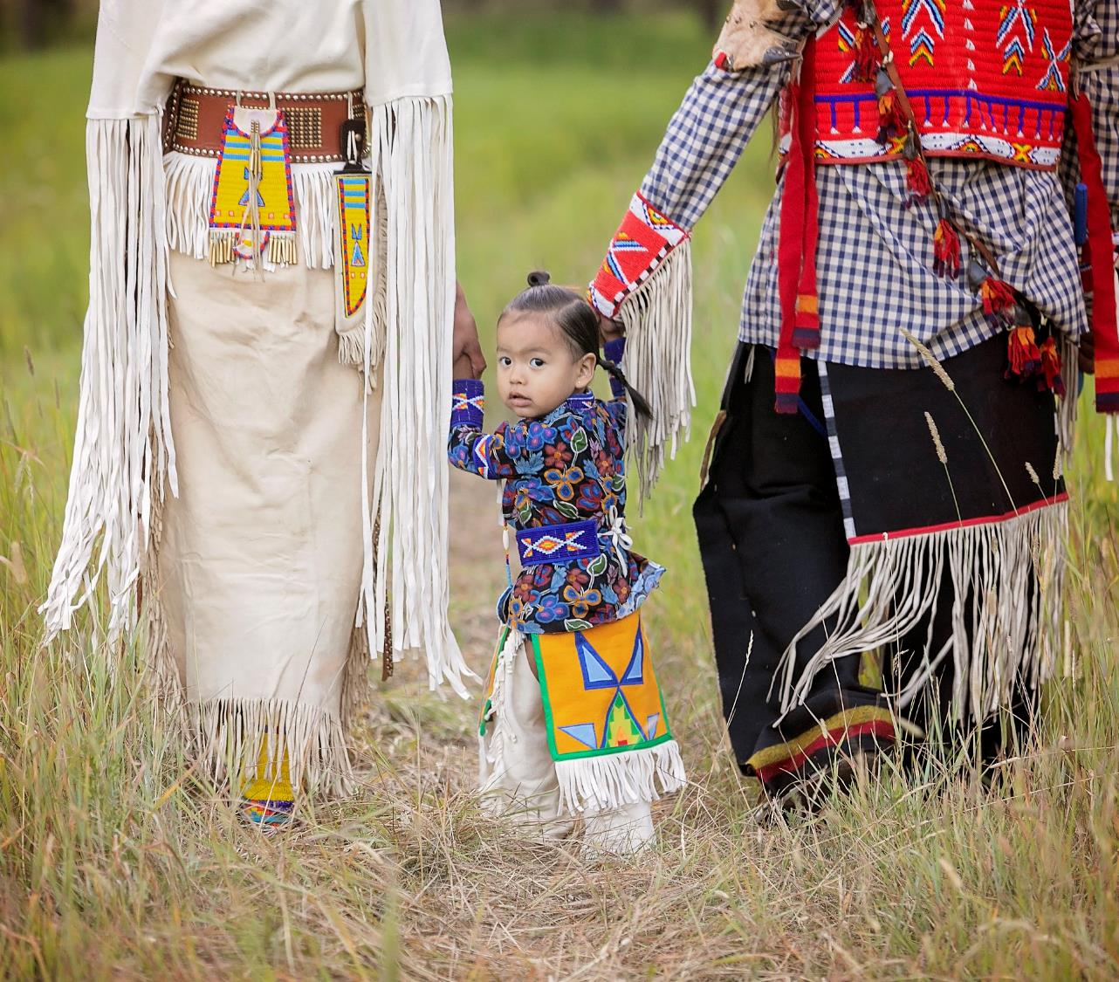
THANK YOU
Christine Bradbury
Northern & Intermountain Regions Tribal Relations Team
208.816.6822
christine.bradbury@usda.gov

