Slide 1

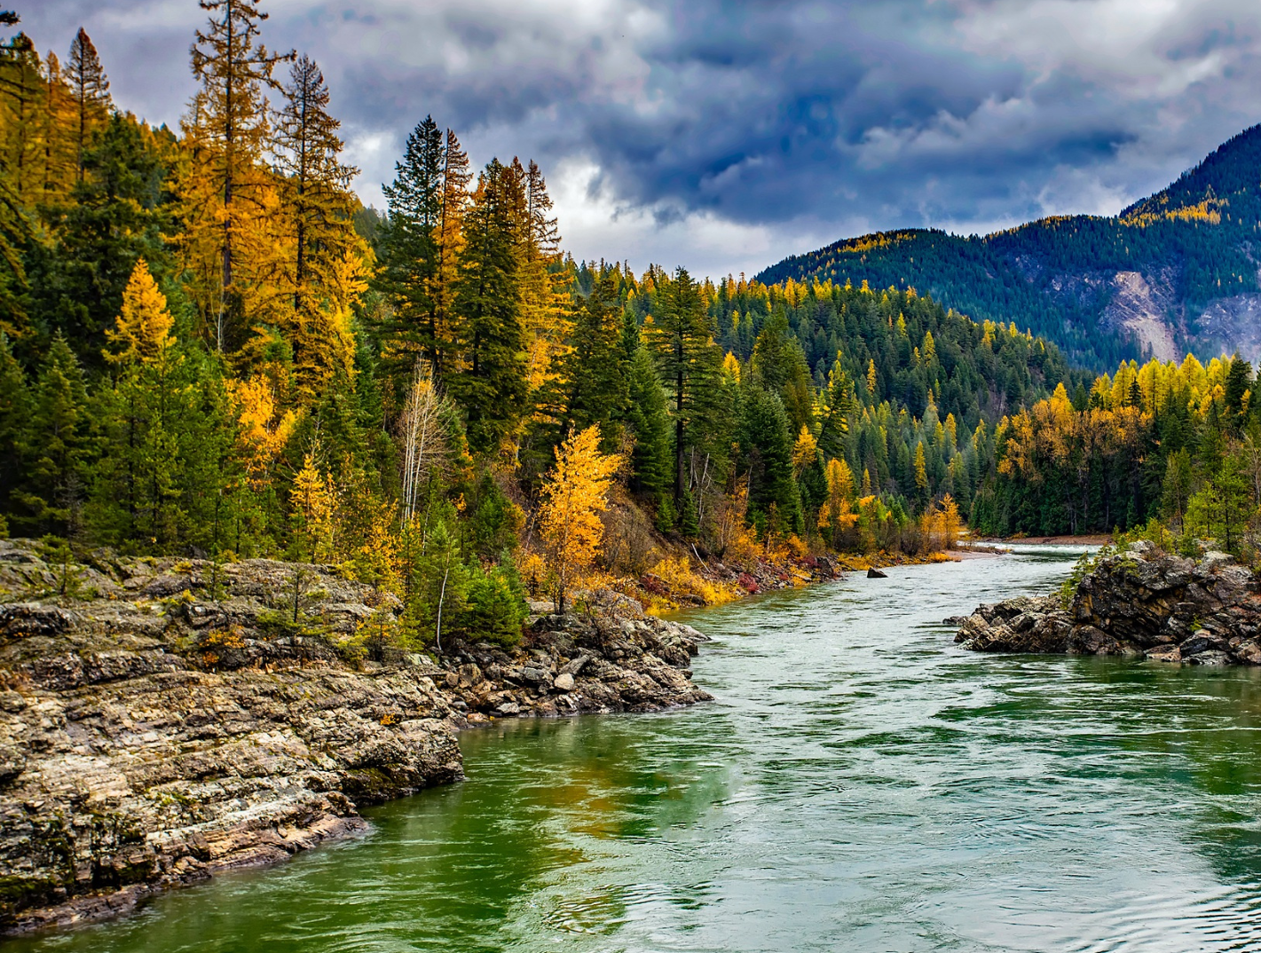

STEWARDING NATIVE LANDS PRESENTS
Tribal Co-Stewardship and Co-Management Webinar #4
Tribal Co-stewardship and cultural fire
Thursday, October 24th, 2024

Slide 2

WEBINAR MANAGEMENT
If you have questions, please type them in the question box.
They will be addressed during the Questions section.
All attendees will be muted throughout this webinar.
This webinar is being recorded.

Slide 3

First Nations’ mission is to uplift and sustain the lifeways and economies of Native communities through advocacy, financial support, and knowledge sharing.

Slide 4
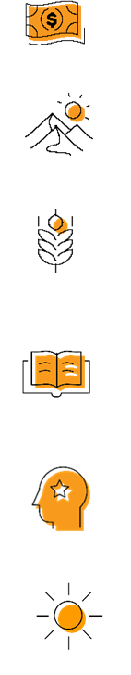
OUR STRATEGIES
DIRECT FINANCIAL SUPPORT THROUGH GRANTMAKING
TECHNICAL ASSISTANCE & TRAINING
CONVENINGS & WEBINARS
RESEARCH ON BEST PRACTICES & MODELS
COALITION BUILDING & FELLOWSHIPS
ADVOCACY

Slide 5
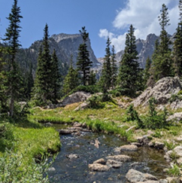
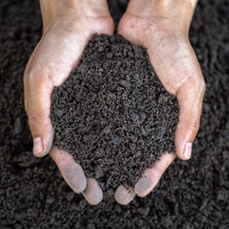
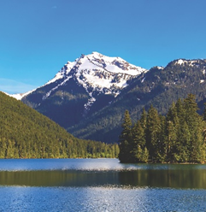
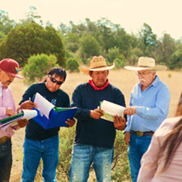
STEWARDING NATIVE LANDS
ENVIRONMENTAL SOVEREIGNTY & JUSTICE
STEWARDSHIP
CLIMATE
COMMUNITY PATHWAYS
Protecting communities and lands from harmful practices, projects, and policies
Restoring healthy relationships between people and land
Addressing ongoing and anticipated impacts of climate change to preserve lands and cultural lifeways
Avenues for intergenerational knowledge transfer

Slide 6

The Mission of the Stewarding Native Lands program is to invest in and center Native peoples in the stewardship of their lands for a generous future.

Slide 7
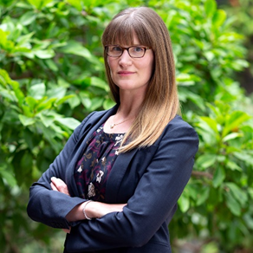
PRESENTER
Sara A. Clark
Shute, Mihaly & Weinberger LLP Partner
Notes:
Noah Lee is the Wilderness Society Fellow at Native American Rights Fund. He is a member of the Ho-Chunk Nation and is based in Madison, WI. At NARF, Noah’s work focuses on understanding how Tribal interests can be safeguarded and furthered within legal frameworks around land stewardship. Prior to joining NARF, he clerked for the California Tribal Families Coalition, an organization committed to advocating for Tribal families under the Indian Child Welfare Act (ICWA). He also previously worked for the Washington Youth Garden at the U.S. National Arboretum, where he oversaw the development of numerous school gardens in Washington, DC. Noah holds a Master’s in Environmental Management from the Yale School of the Environment and a JD from the University of Wisconsin Law School.

Slide 8
QUESTIONS

Slide 9
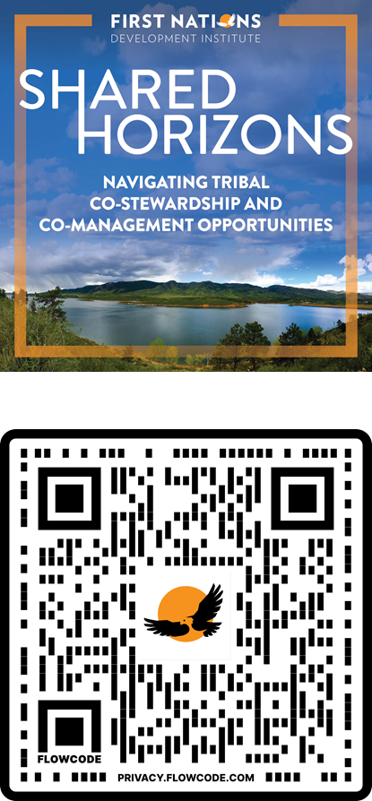


Shared Horizons: Navigating Tribal Co-Stewardship and Co-Management Opportunities Conference
Tribal and federal employees and representatives are invited to attend a national co-learning event, centered on trainings, sharing of ideas and work, and networking opportunities to grow the field of tribal co-stewardship and co-management.
November 19 and 20, 2024
Gila River Resorts & Casinos – Wild Horse Pass
5040 Wild Horse Pass Blvd. Chandler, Arizona 85226
Travel scholarships are available for Tribal representatives or employees.

Slide 10
Upcoming Webinars
FNDI Co-Stewardship and Co-Management Webinar Series
Webinar #5: Leveraging 638 Contracts for Tribal Co-Stewardship, November 7th, 1p.m. MT

Slide 11
Upcoming Webinars
Indigenous Stewardship on National Forest Lands Webinar Series
Webinar #4: Pacific Region (Date TBD)

Slide 12




COMMUNICATIONS
ACCESS THE WEINBAR RECORDING AND RESOURCES IN FIRST NATIONS KNOWLEDGE CENTER
FOLLOW US ON SOCIAL MEDIA
fndi303
First Nations Development Institute
FirstNationsDevelopmentInstitute
@FNDI303

Slide 13

CONTACTS
SARA CLARK
  Clark@smwlaw.com
BRETT TREADWAY
  btreadwau@firstnations.org

Slide 14



THANK YOU
NATIONAL HEADQUARTERS
First Nations Development Institute 2432 Main Street
Longmont, CO 80501
CONTACT
Tel: 303.774.7836
Fax: 303.774.7841 info@firstnations.org
CONNECT
firstnations.org
fndi303
First Nations Development Institute
FirstNationsDevelopmentInstitute
@FNDI303

