Slide 1

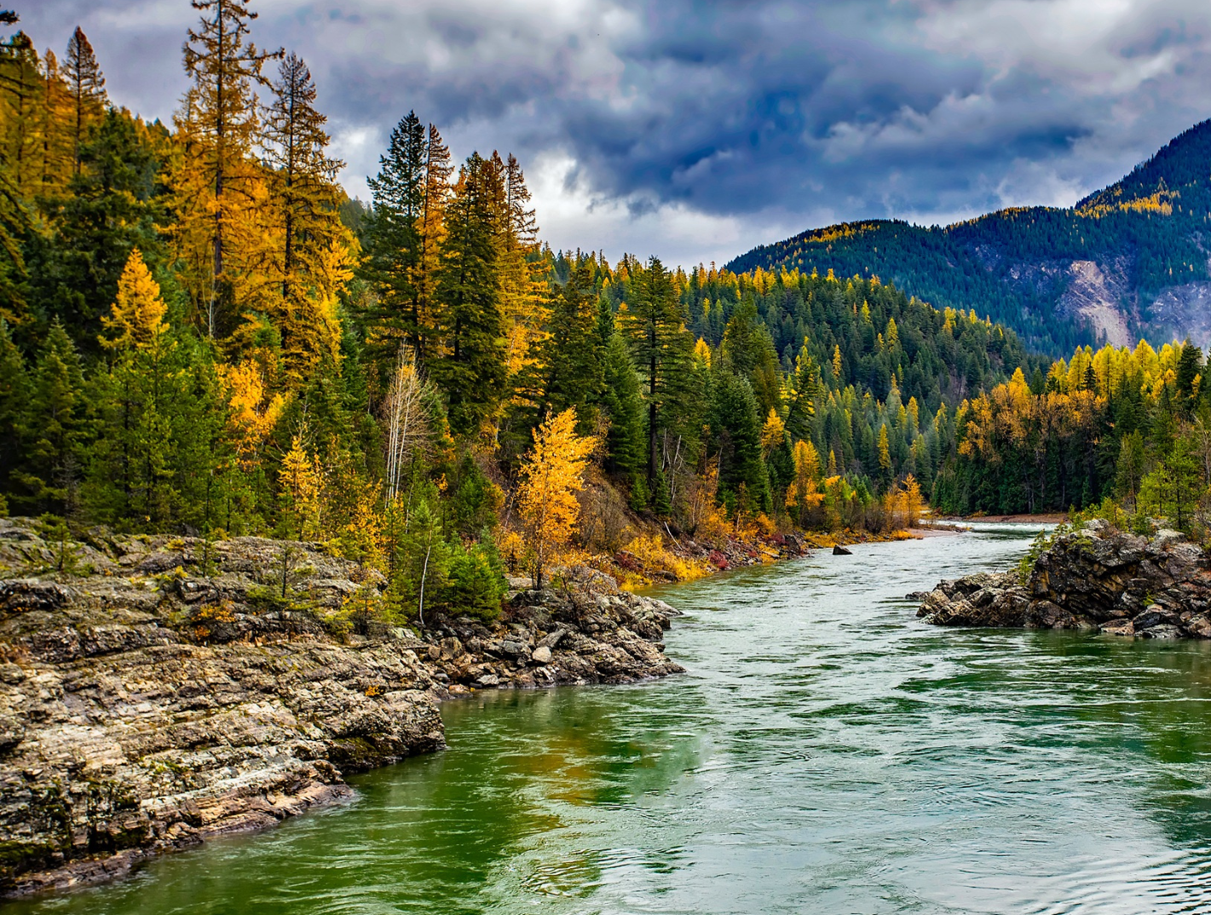

STEWARDING NATIVE LANDS PRESENTS
Support for tribally-led landscape scale Restoration
TUESDAY, OCTOBER 29, 2024

Slide 2

WEBINAR MANAGEMENT
If you have questions, please type them in the question box.
They will be addressed during the Questions section.
All attendees will be muted throughout this webinar.
This webinar is being recorded.

Slide 3

First Nations’ mission is to uplift and sustain the lifeways and economies of Native communities through advocacy, financial support, and knowledge sharing.

Slide 4
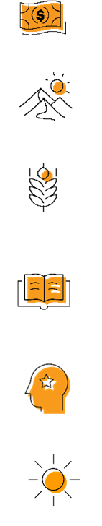
OUR STRATEGIES
DIRECT FINANCIAL SUPPORT THROUGH GRANTMAKING
TECHNICAL ASSISTANCE & TRAINING
CONVENINGS & WEBINARS
RESEARCH ON BEST PRACTICES & MODELS
COALITION BUILDING & FELLOWSHIPS
ADVOCACY

Slide 5
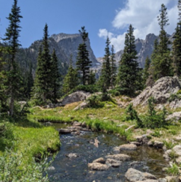

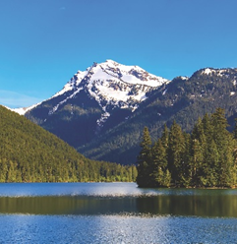
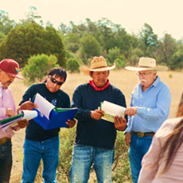
STEWARDING NATIVE LANDS
ENVIRONMENTAL SOVEREIGNTY & JUSTICE
STEWARDSHIP
CLIMATE
COMMUNITY PATHWAYS
Protecting communities and lands from harmful practices, projects, and policies
Restoring healthy relationships between people and land
Addressing ongoing and anticipated impacts of climate change to preserve lands and cultural lifeways
Avenues for intergenerational knowledge transfer

Slide 6

The Mission of the Stewarding Native Lands program is to invest in and center Native peoples in the stewardship of their lands for a generous future.

Slide 7
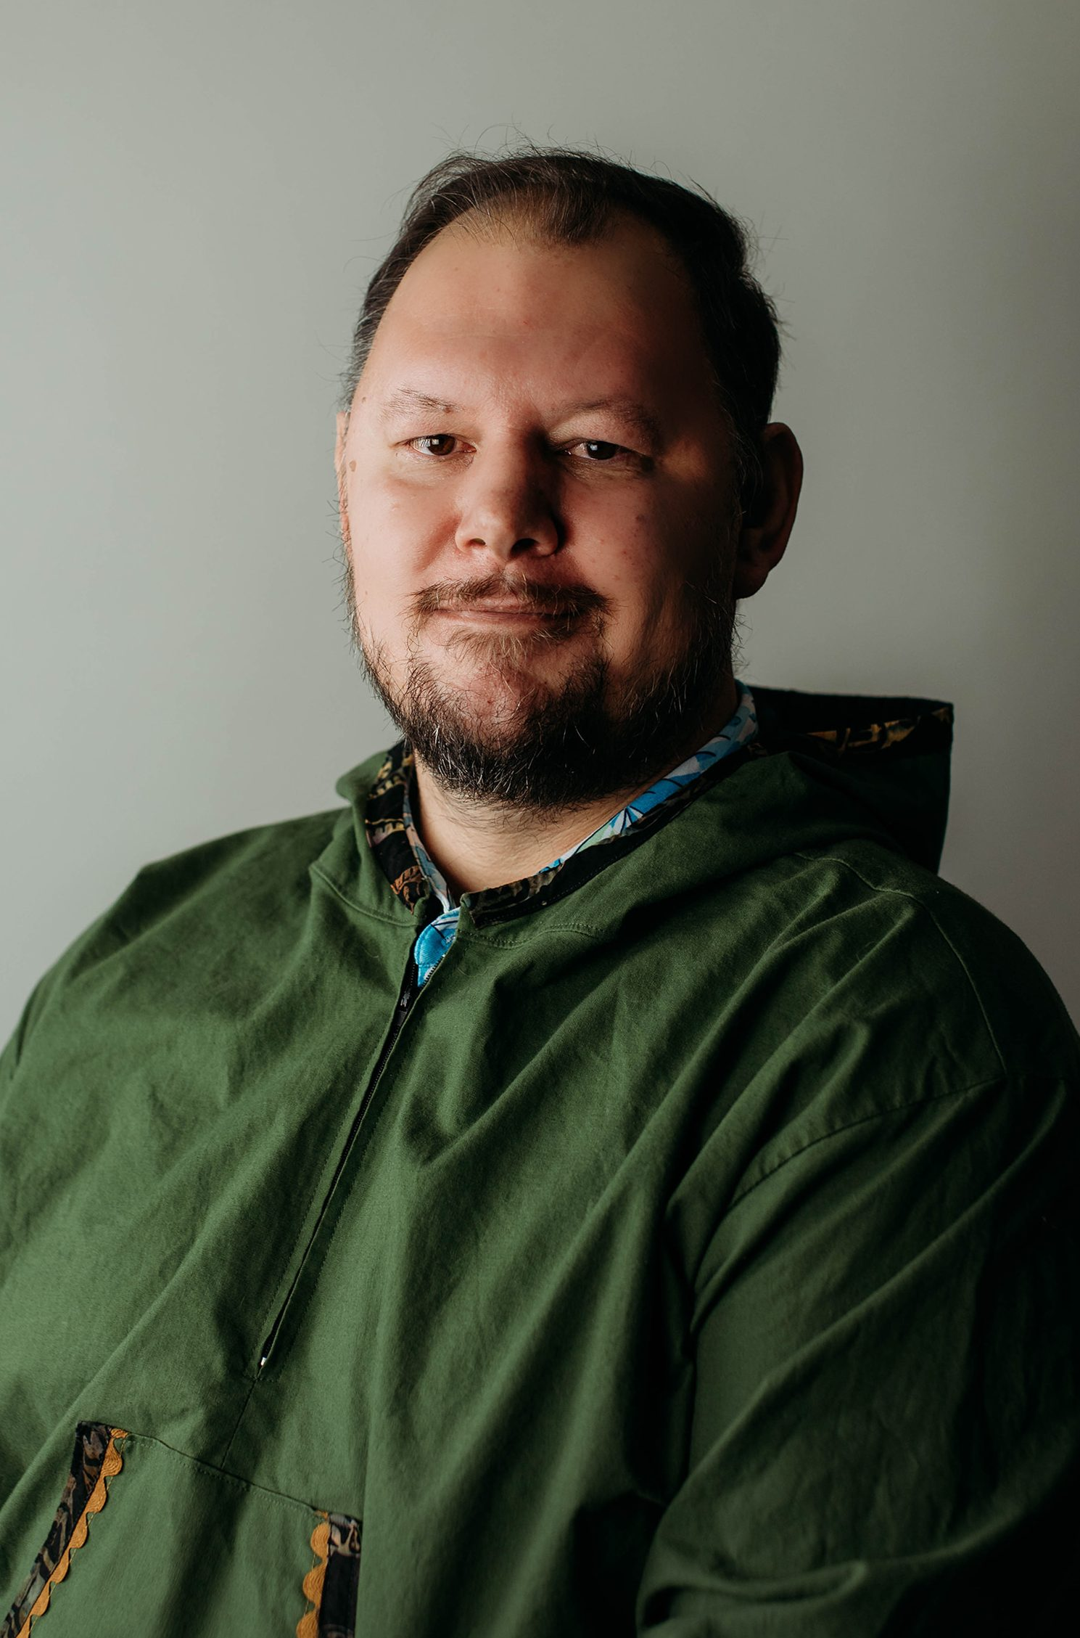
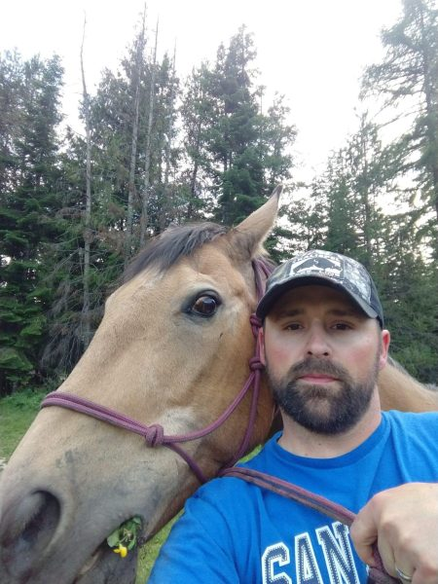
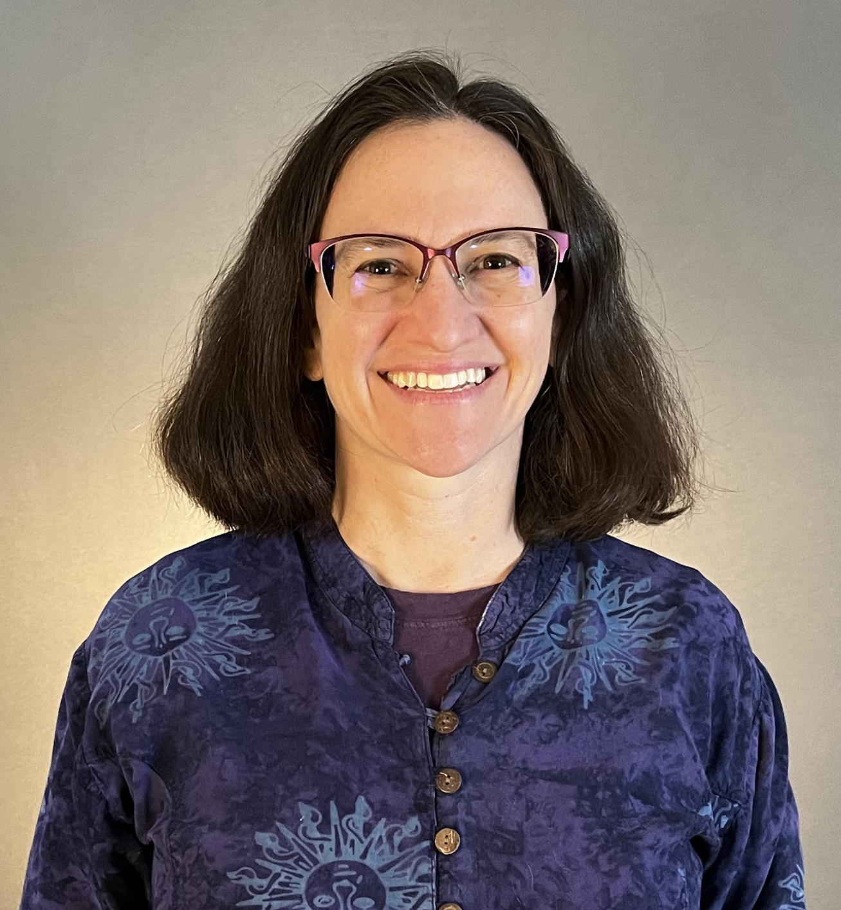
PRESENTERS
Mike Lithgow Kalispel Tribe of Indians
Will Hartman
Kuskokwim Corporation
Sherri Wormstead
U.S. Forest Service

Slide 8
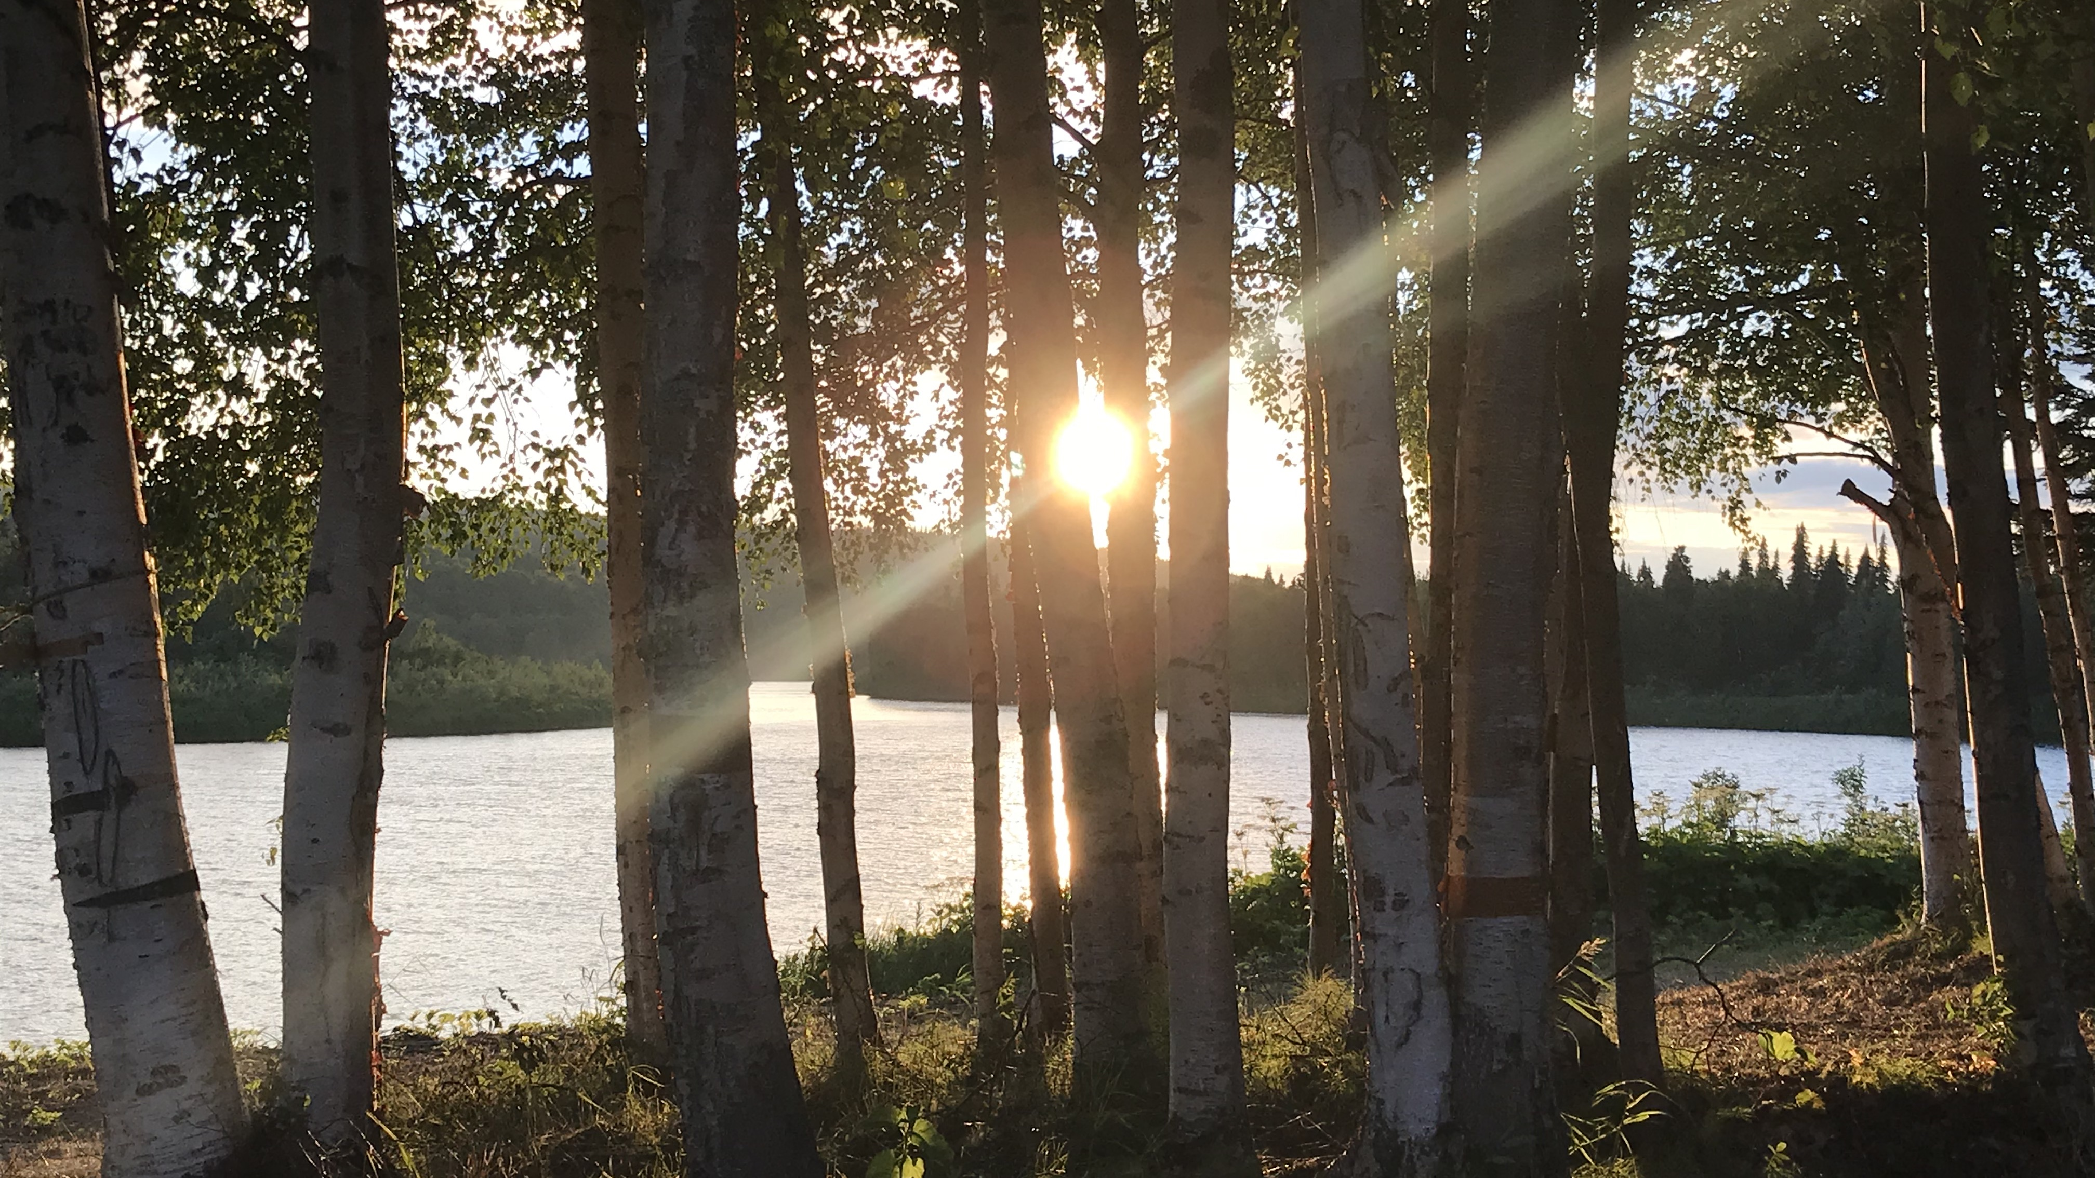

The Kuskokwim Corporation Landscape Scale Restoration Project

Slide 9
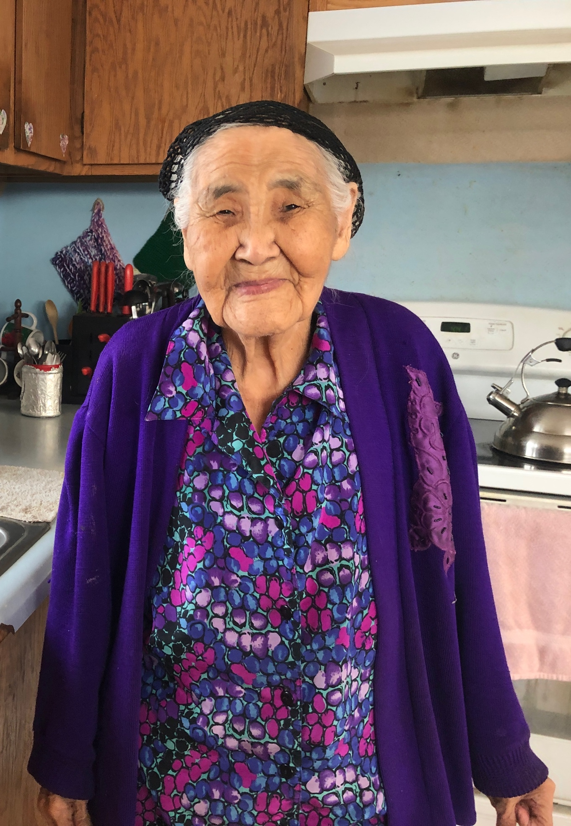
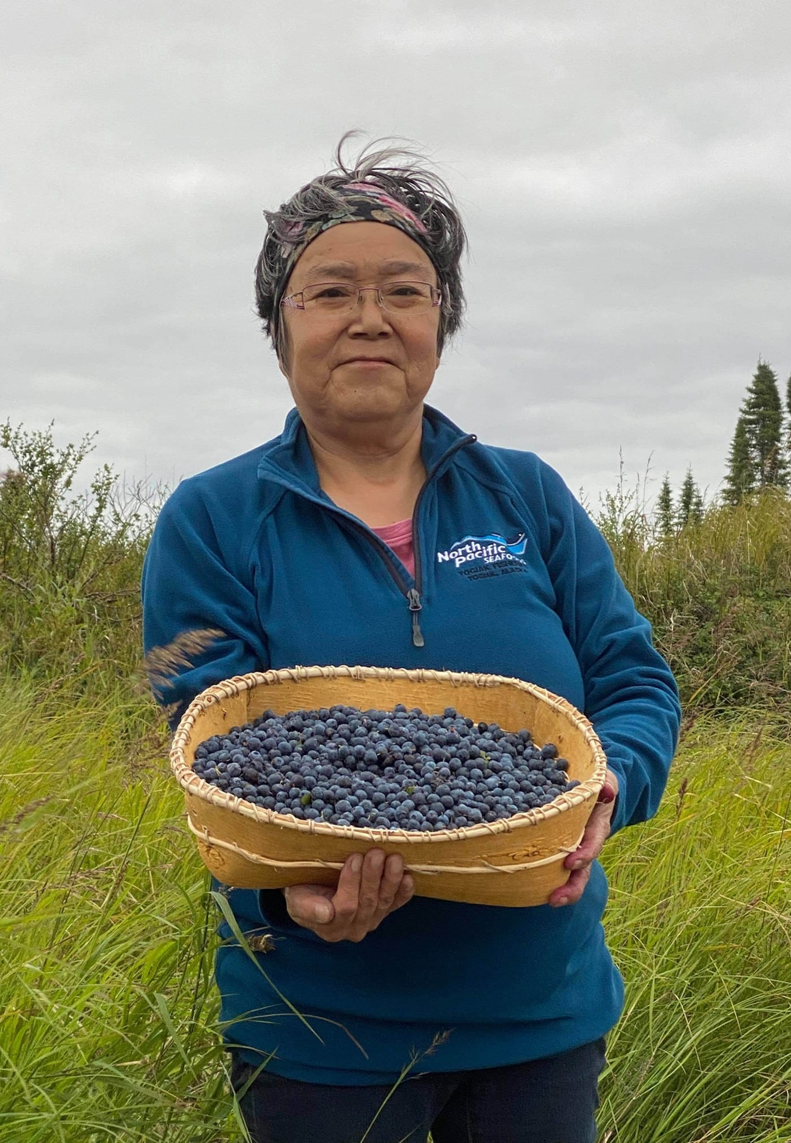
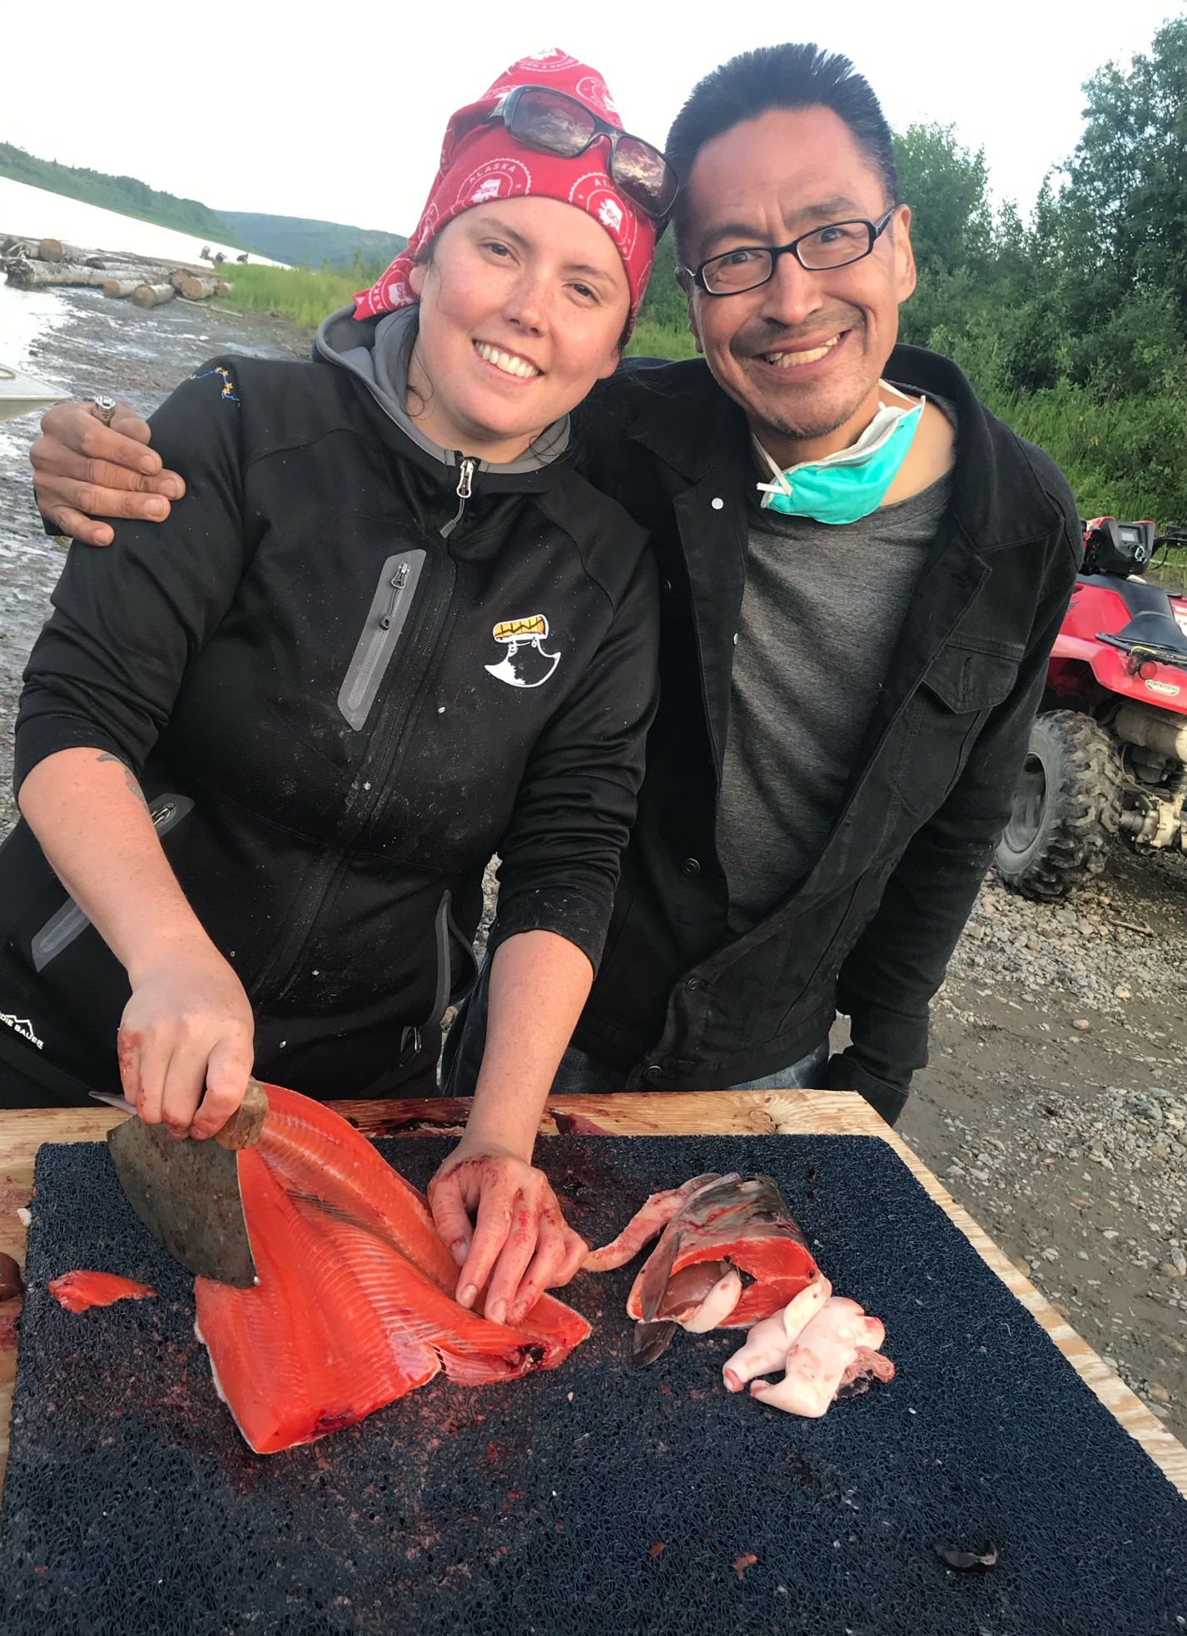

Slide 10
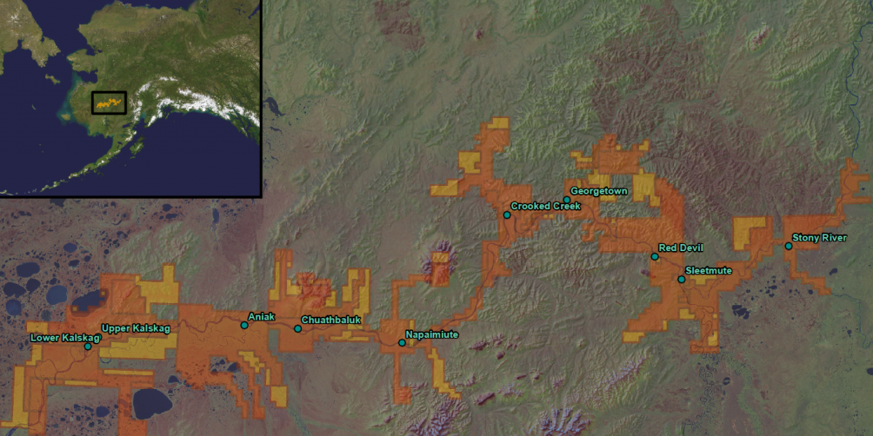

Our Middle Kuskokwim Region

Slide 11
Stewards of Our Homeland
Four areas of focus for rural development have been identified by our Shareholders:
Cost of living
Broadband internet access
Energy
Housing

Slide 12
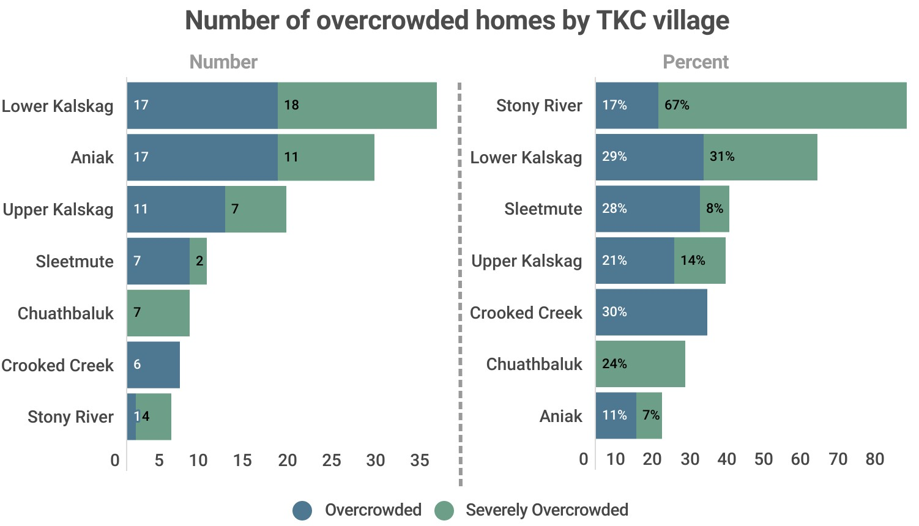

Slide 13
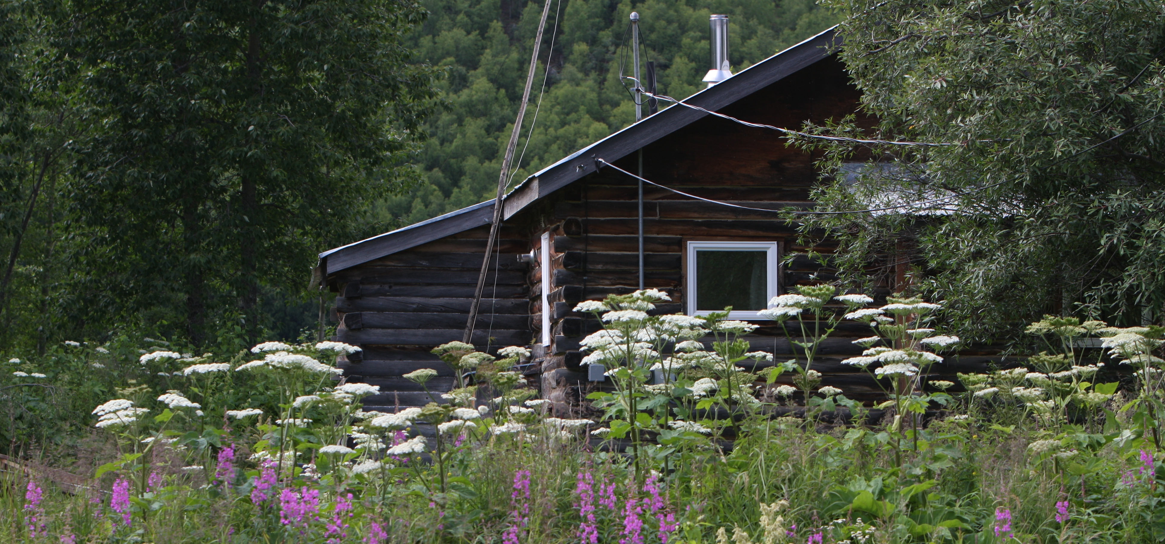
Harvest to Home A Holistic Regional Housing Project

Slide 14
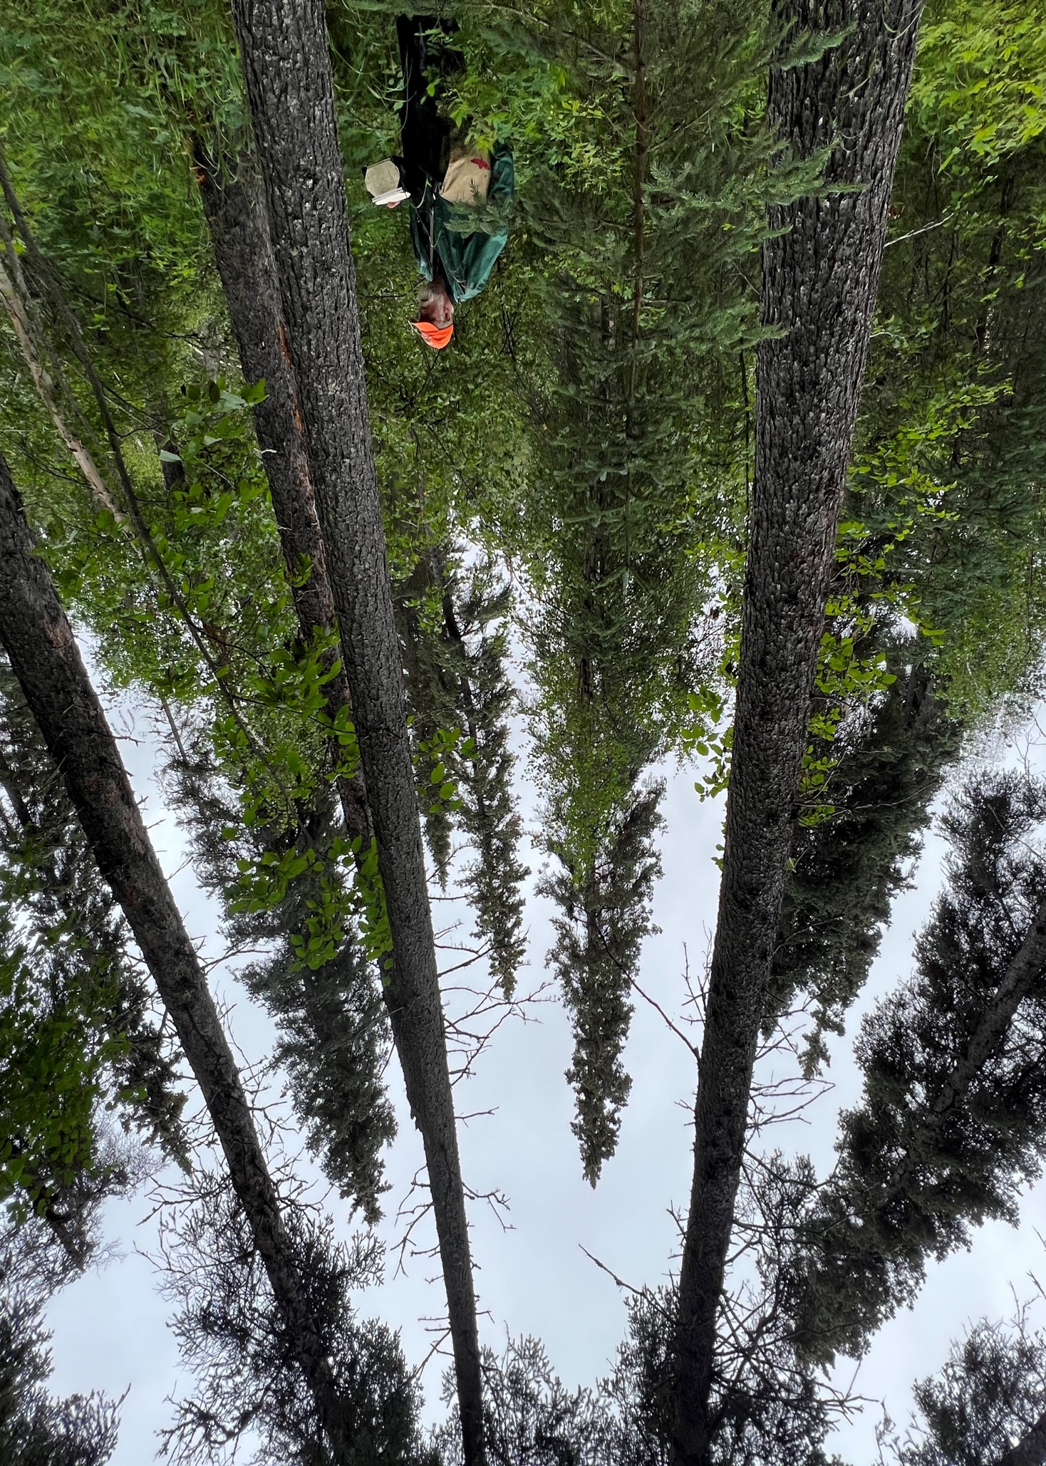
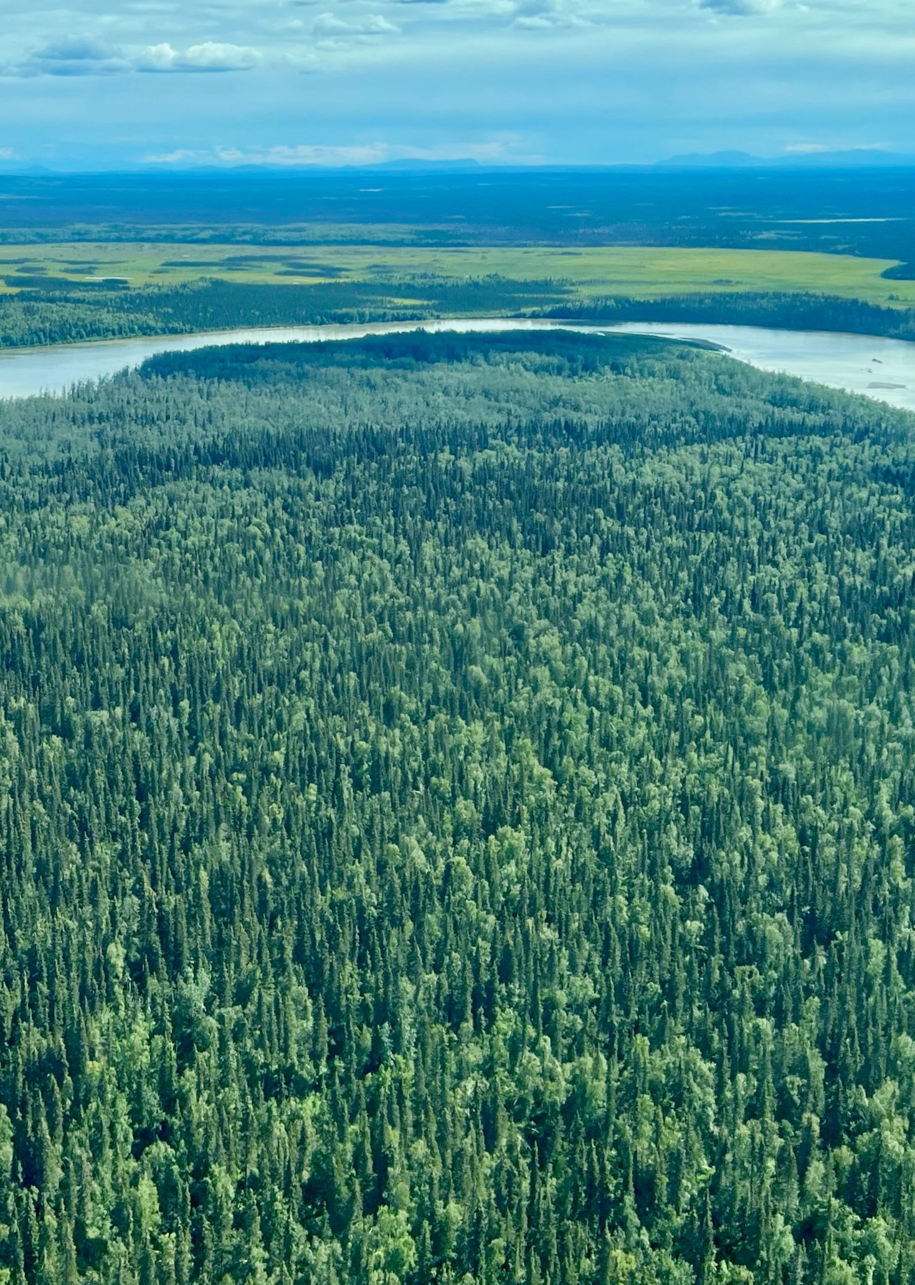
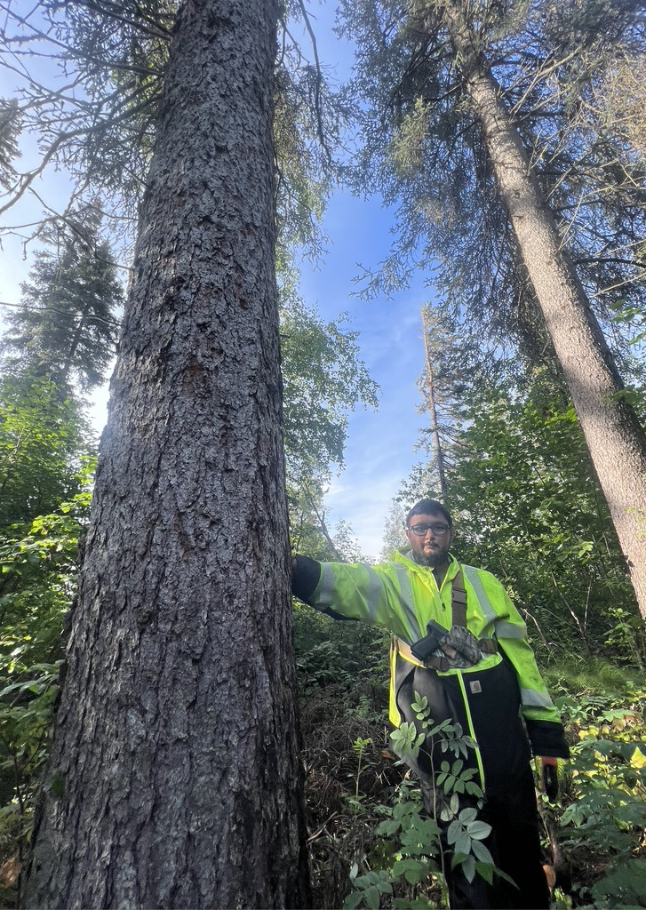

Slide 15
LSR Project Goals
Protect forest health by establishing capacity and strategy for health monitoring and reforestation.
Improve forest ecosystem with forest inventory analyses for sustainable harvest, protecting subsistence resources, and mitigation of fire and insect damage.
Promote economic development and forest stewardship by investing in workforce training and jobs.

Slide 16
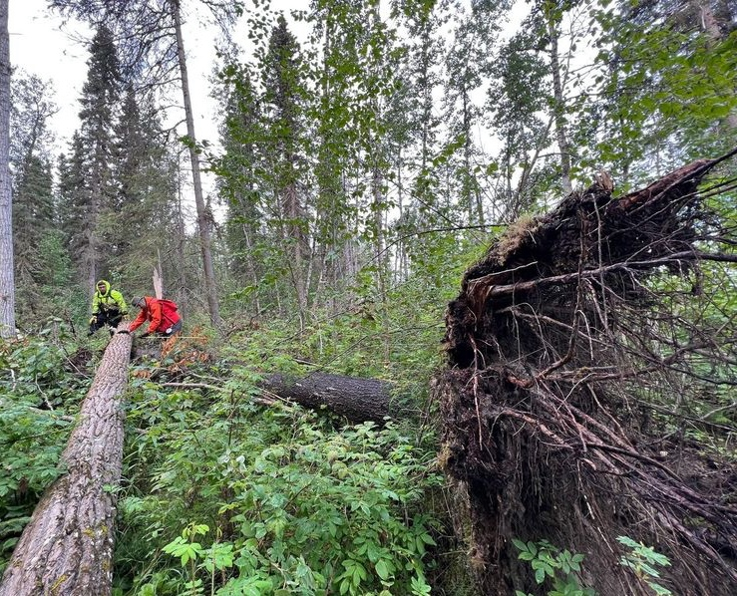
LSR Project Activities
Harvest Forestry Management Planning
Community Engagement
Sustainable Harvest Analysis
Fuels/Fire Analysis
Forest Monitoring
Reforestation Pilot Project

Slide 17
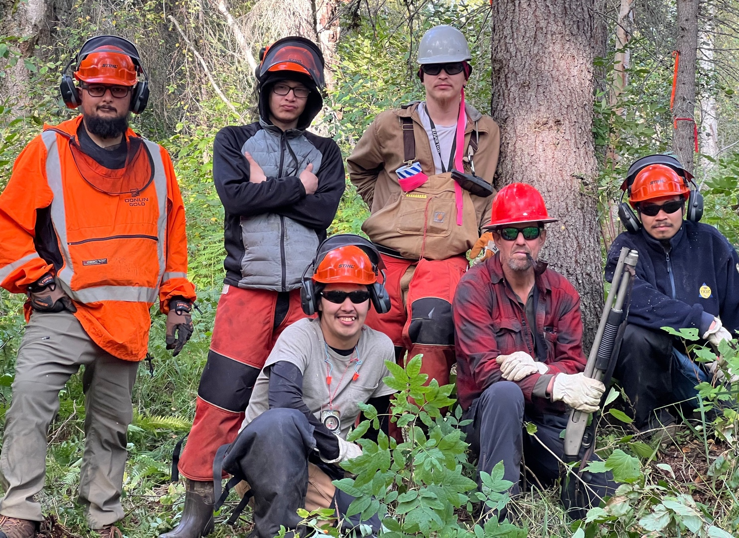
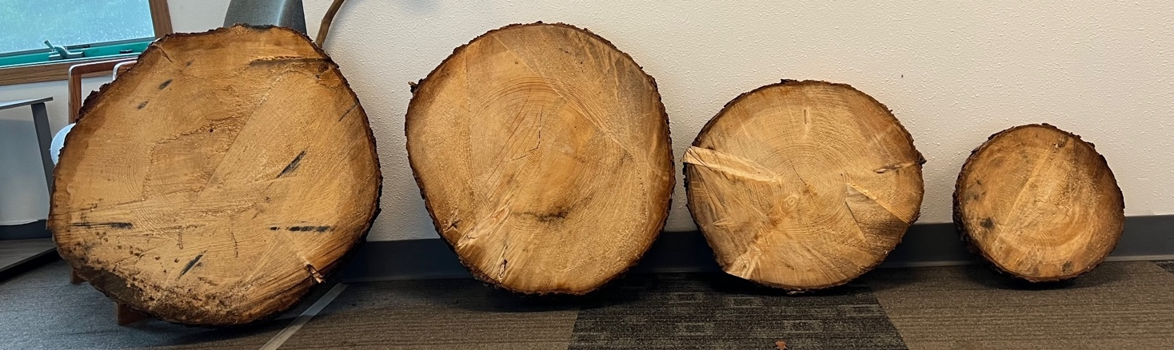
LSR Project Activities
Harvest Management Capacity Development and Collaboration
Harvest Safety Planning
Harvester Workforce Development

Slide 18
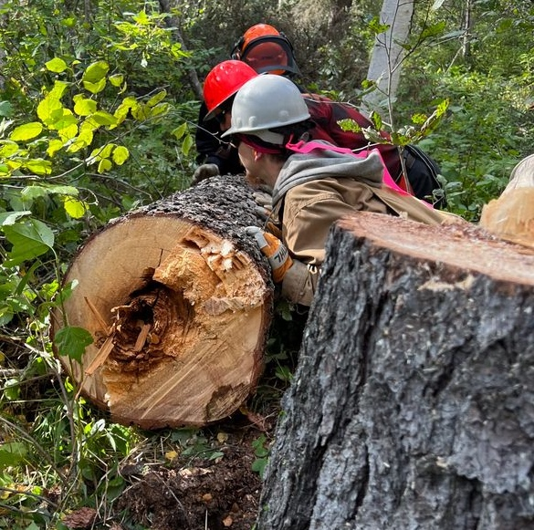
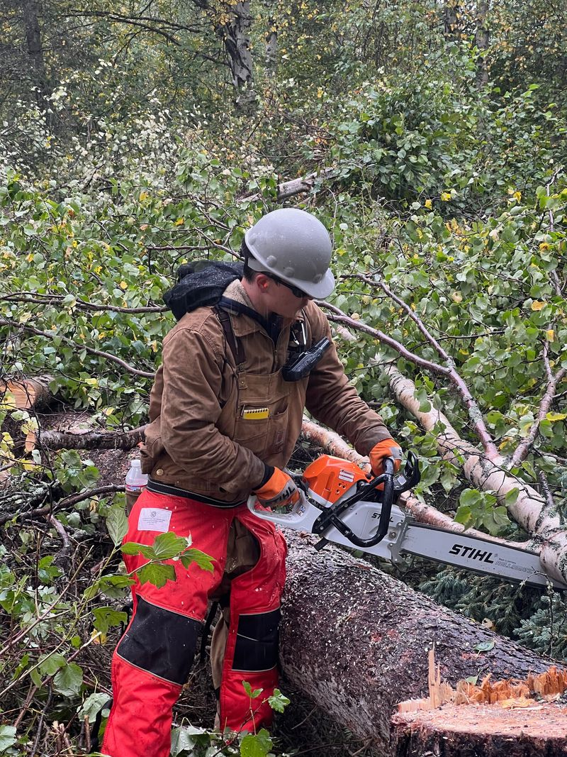
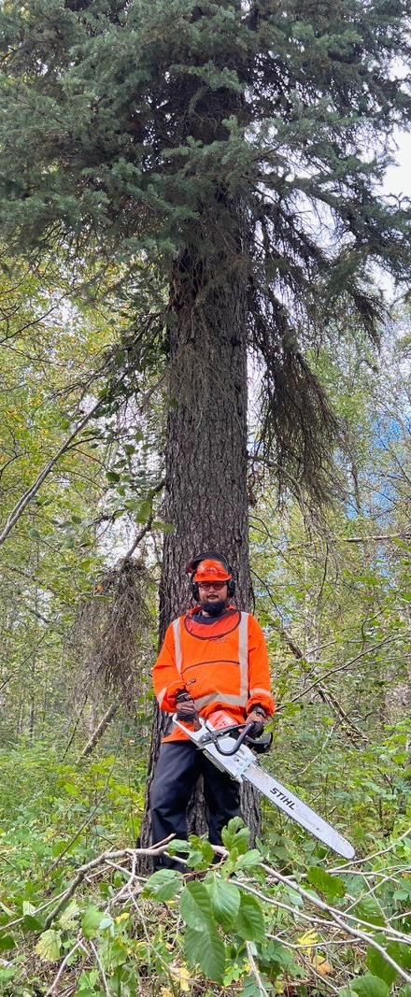

Slide 19
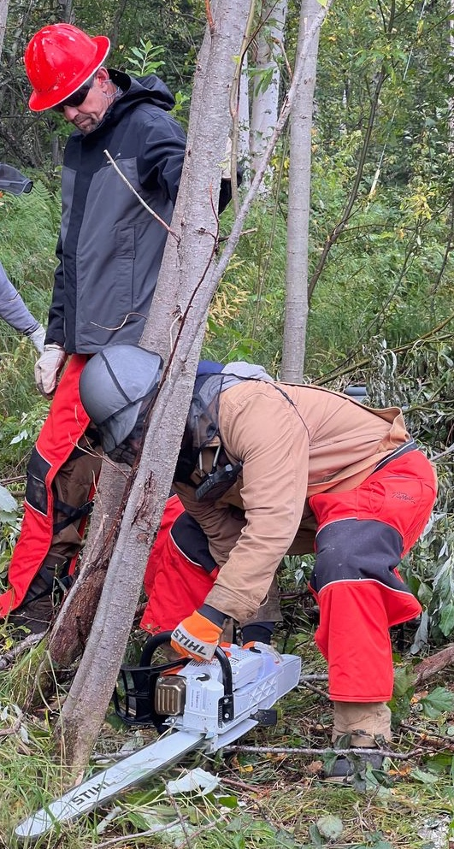
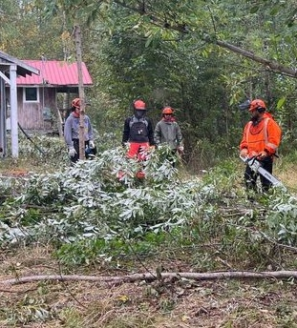
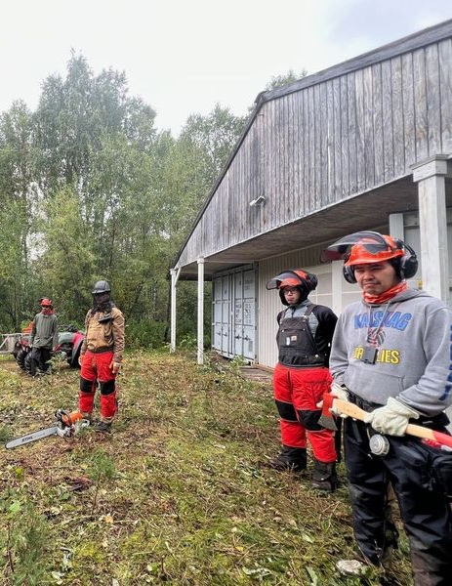

Slide 20
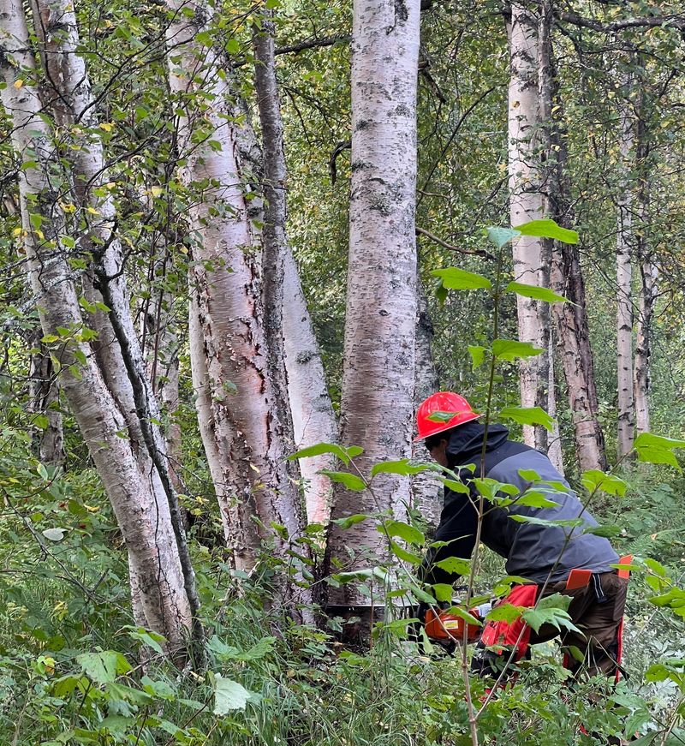
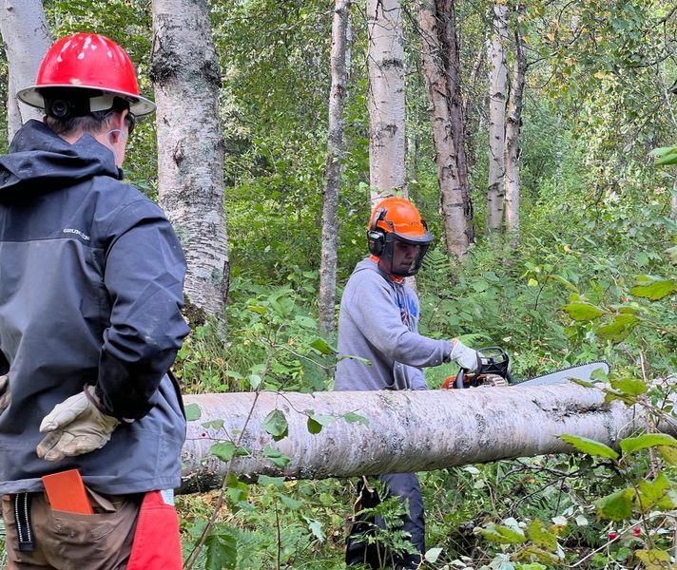

Slide 21
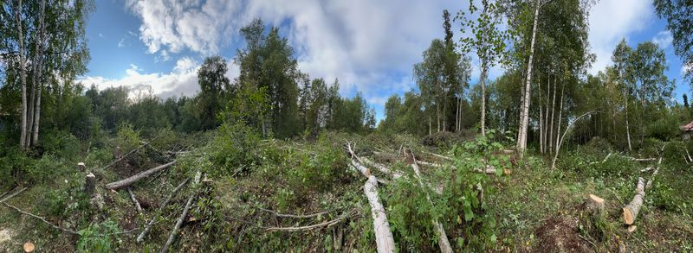

Slide 22
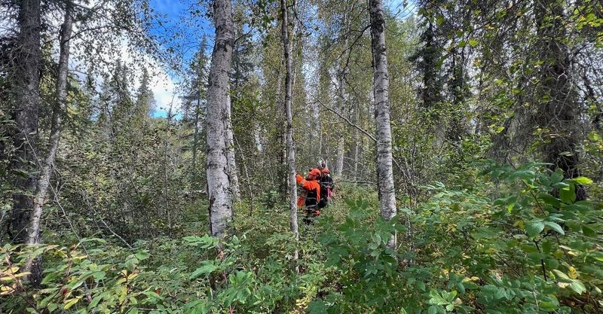

Slide 23
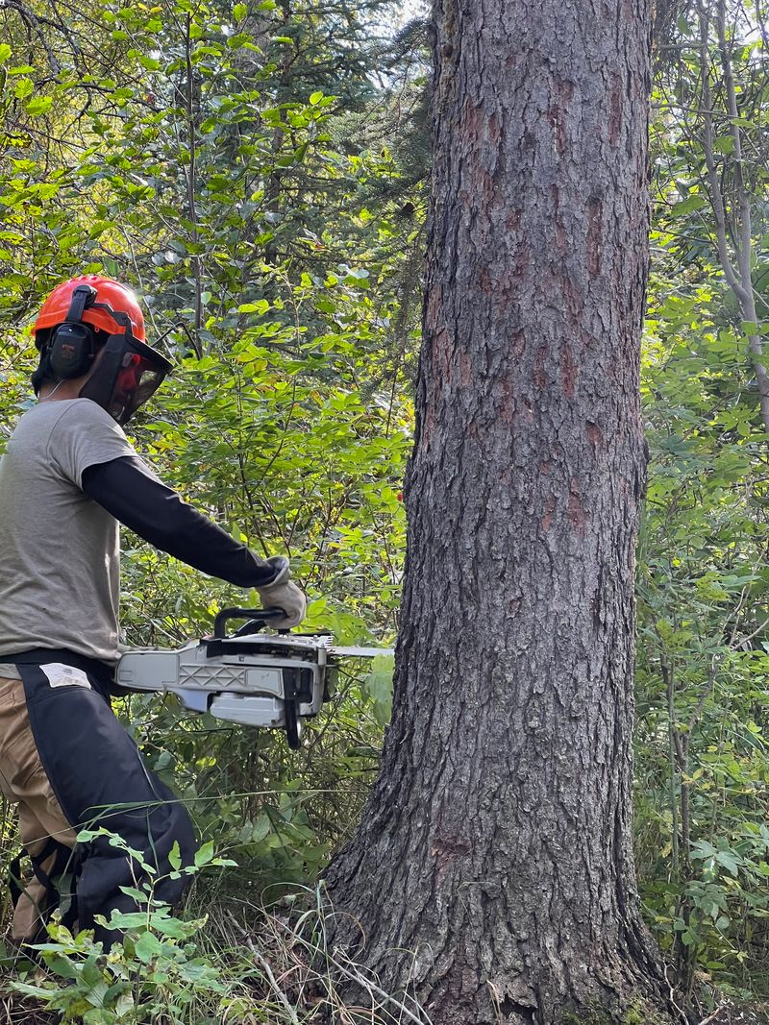
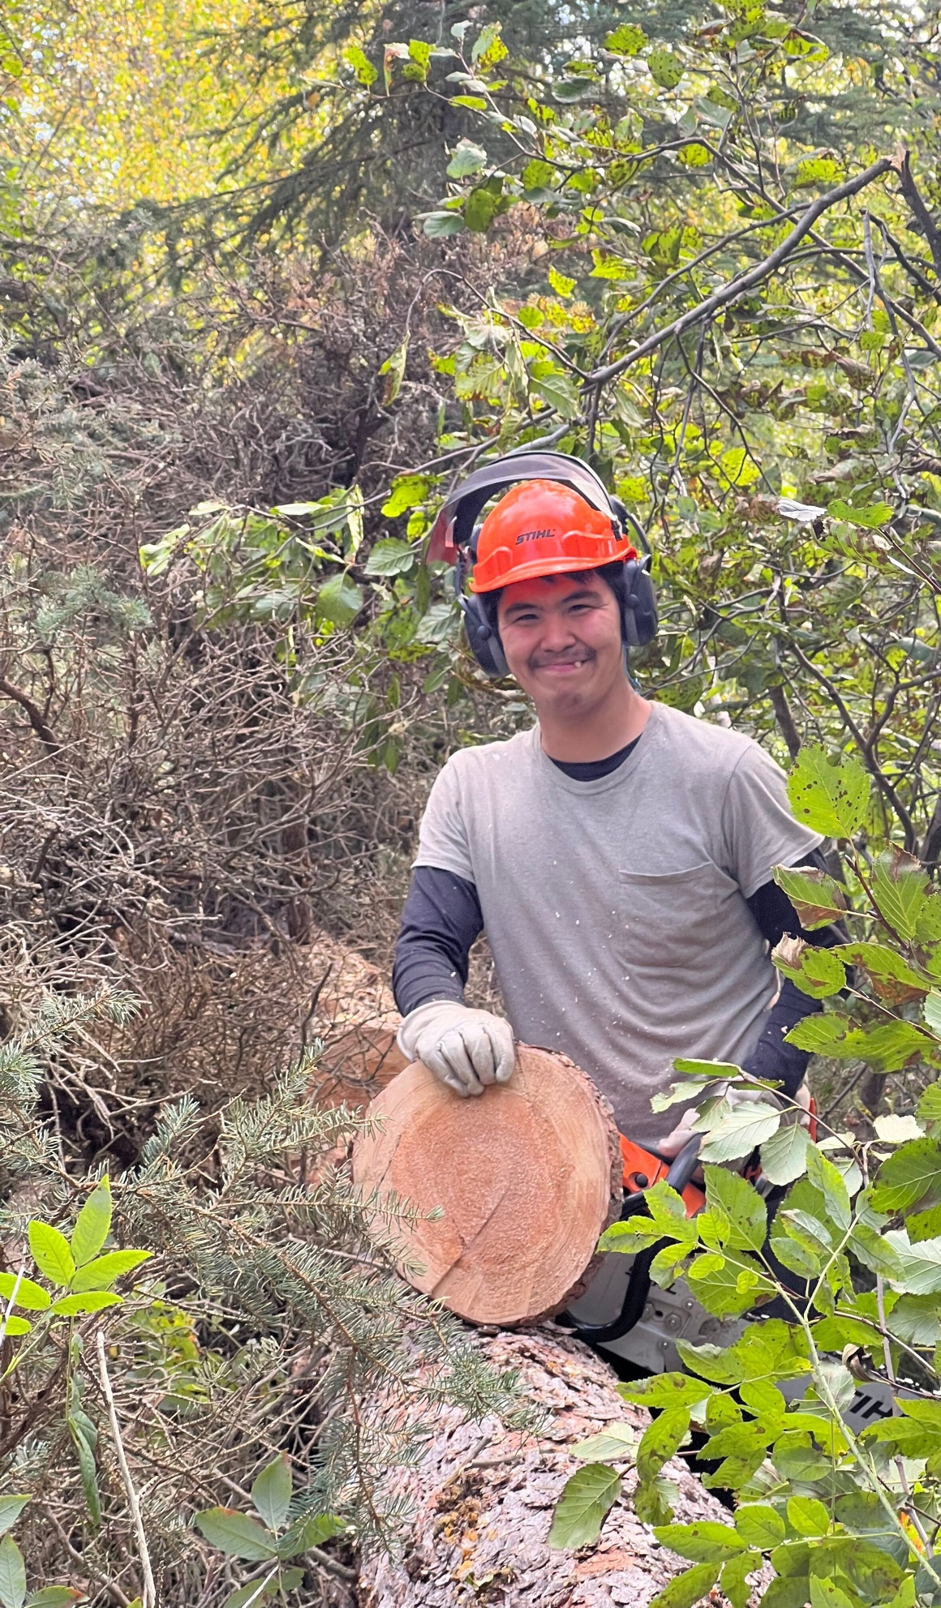
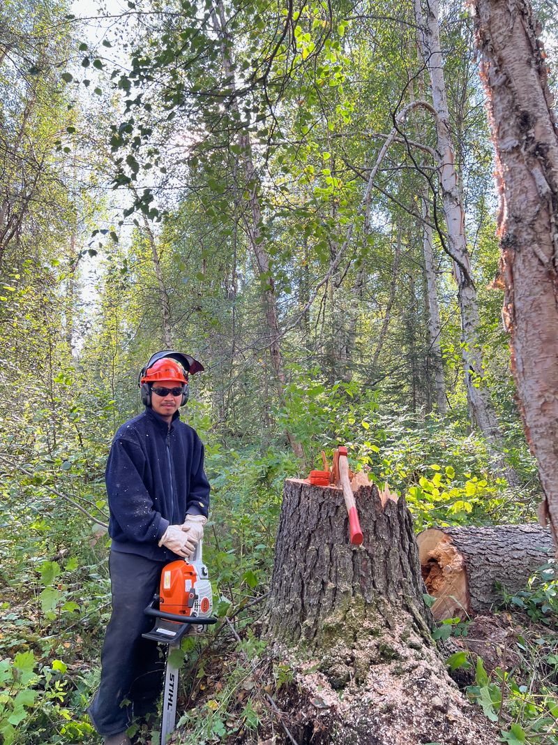

Slide 24
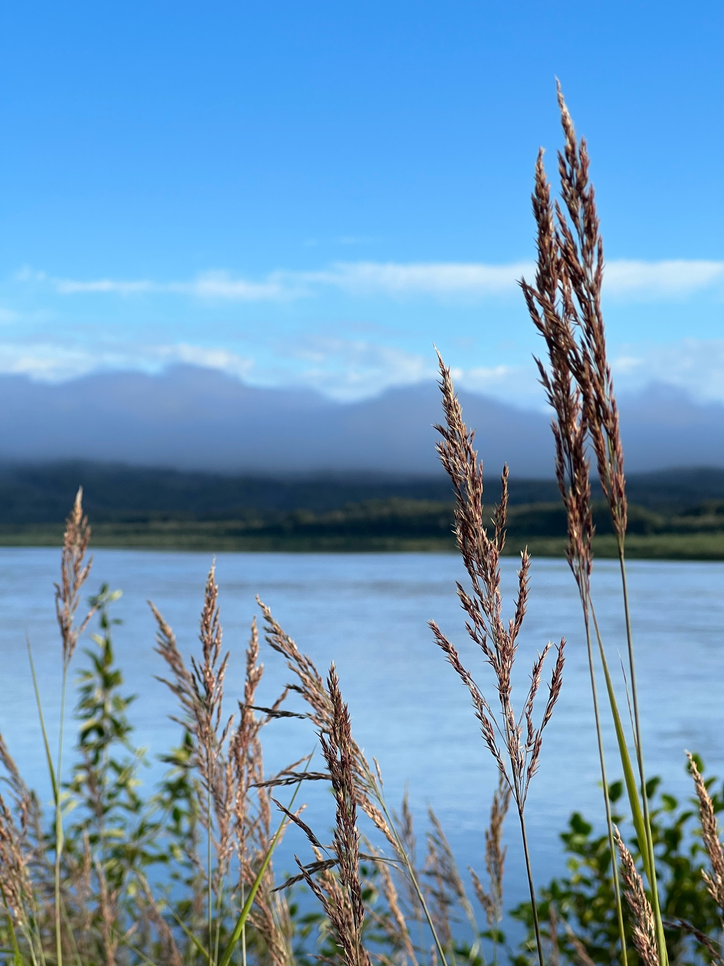
Recommendations for applying for and implementing a LSR Project
Have a vision and design the project to achieve that vision.
Use data for effective storytelling.
Realistic budget.
Identify people to implement the project and partners to support it.
Start early.

Slide 25
QUESTIONS

Slide 26
SAVE THE DATE
Tribal Co-Stewardship and Co-Management Conference
November 19-20, 2024
Gila River Resort, Wild Horse Pass
Chandler, AZ

Slide 27




COMMUNICATIONS
ACCESS THE WEINBAR RECORDING AND RESOURCES IN FIRST NATIONS KNOWLEDGE CENTER
FOLLOW US ON SOCIAL MEDIA
fndi303 First Nations Development Institute
FirstNationsDevelopmentInstitute
@FNDI303

Slide 28

CONTACT
Mary Adelzadeh
madelzadeh@firstnations.org
Wolf Star Duran
wsduran@firstnations.org

Slide 29



THANK YOU
NATIONAL HEADQUARTERS
First Nations Development Institute 2432 Main Street
Longmont, CO 80501
CONTACT
Tel: 303.774.7836
Fax: 303.774.7841 info@firstnations.org
CONNECT
firstnations.org fndi303 First Nations Development Institute
FirstNationsDevelopmentInstitute
@FNDI303

