Slide 1

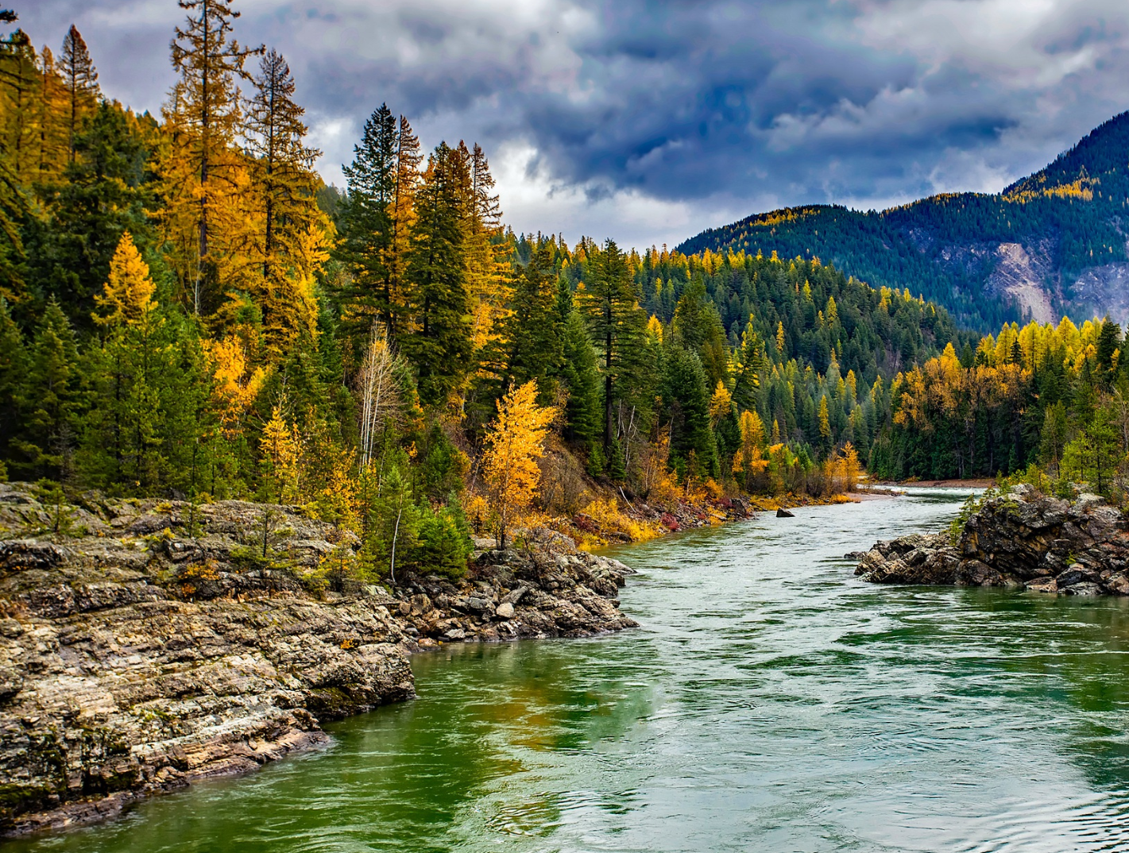

STEWARDING NATIVE LANDS PRESENTS
Co-management and co-stewardship: 101

Slide 2

WEBINAR MANAGEMENT
If you have questions, please type them in the question box.
They will be addressed during the Questions section.
All attendees will be muted throughout this webinar.
This webinar is being recorded.

Slide 3

We believe that the world will be more sustainable and prosperous when Native knowledge is centered in the stewardship of lands

Slide 4
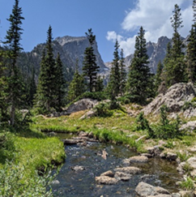
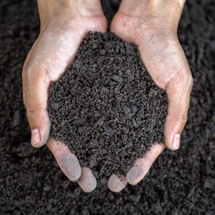
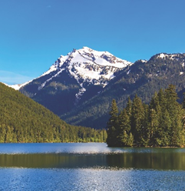
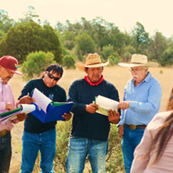
STEWARDING NATIVE LANDS
ENVIRONMENTAL SOVEREIGNTY & JUSTICE
ECOLOGICAL STEWARDSHIP
COMMUNITY PATHWAYS
CLIMATE
Protecting communities and lands from harmful practices, projects, and policies
Sustainably managing and restoring lands for our communities and future generations
Addressing ongoing and anticipated impacts of climate change to preserve lands and cultural lifeways
Upholding traditions and amplifying knowledge

Slide 5
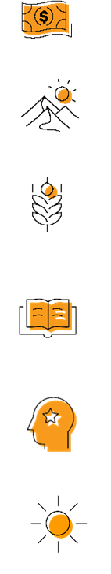
OUR STRATEGIES
DIRECT FINANCIAL SUPPORT THROUGH GRANTMAKING
TECHNICAL ASSISTANCE & TRAINING
CONVENINGS & WEBINARS
RESEARCH ON BEST PRACTICES & MODELS
COALITION BUILDING & FELLOWSHIPS
ADVOCACY

Slide 6
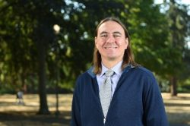
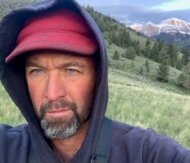
PRESENTERS
MONTE MILLS
UNIVERSITY OF WASHINGTON SCHOOL OF LAW
NATIVE AMERICAN LAW CENTER DIRECTOR
MARTIN NIE
UNIVERSITY OF MONTANA COLLEGE OF FORESTRY
BOLLE CENTER FOR PEOPLE AND FORESTS DIRECTOR

Slide 7
QUESTIONS

Slide 8

CONTACT
MARY ADELZADEH
madelzadeh@firstnations.org
530-402-5404
BRETT TREADWAY
btreadway@firstnations.org
828-788-3031
MARTIN NIE
martin.nie@mso.umt.edu
MONTE MILLS
mtmills@uw.edu

Slide 9




COMMUNICATIONS
ACCESS THE WEINBAR RECORDING IN FIRST NATIONS KNOWLEDGE CENTER:
Here is where you can find the webinar recording and slides once they are posted: https://www.firstnations.org/fnk
FOLLOW US ON SOCIAL MEDIA
fndi303 First Nations Development Institute
FirstNationsDevelopmentInstitute
@FNDI303

Slide 10
UPCOMING WEBINARS
Indigenous Stewardship on National Forest Lands Webinar Series
East Region
Part I: Sault Ste. Marie Tribe & Leech Lake Band of Ojibwe (March)
Part II: Eastern Band of Cherokee Indians & Great Lakes Indian Fish and Wildlife Commission (April)
Rocky Mountain Region
TBD
Pacific Region
TBD

Slide 11



THANK YOU
NATIONAL HEADQUARTERS
First Nations Development Institute 2432 Main Street
Longmont, CO 80501
CONTACT
Tel: 303.774.7836
Fax: 303.774.7841 info@firstnations.org
CONNECT
firstnations.org fndi303 First Nations Development Institute
FirstNationsDevelopmentInstitute
@FNDI303

