Slide 1

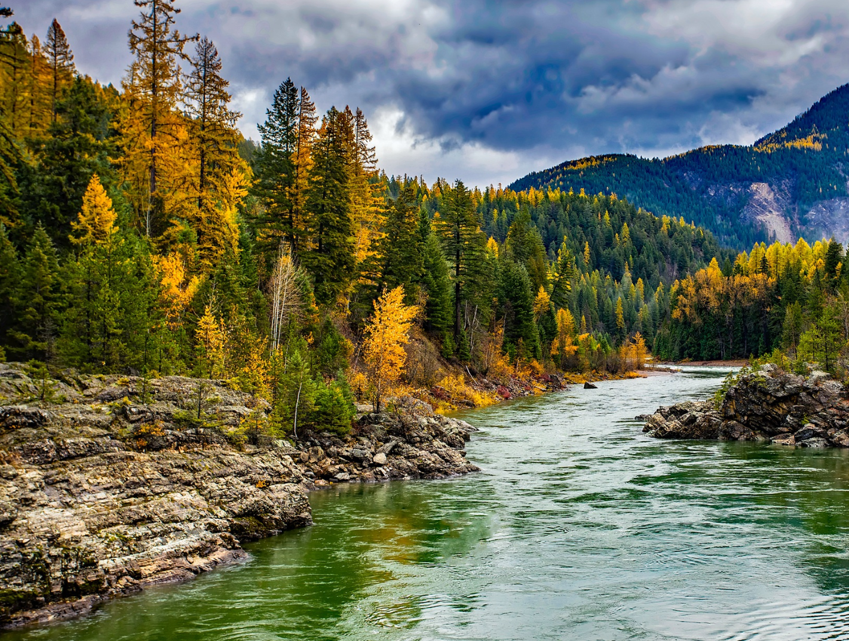

STEWARDING NATIVE LANDS AND THE U.S. FOREST SERVICE PRESENTS
Indigenous stewardship on national forest lands webinar series: Great lakes region

Slide 2

WEBINAR MANAGEMENT
If you have questions, please type them in the question box.
They will be addressed during the Questions section.
All attendees will be muted throughout this webinar.
This webinar is being recorded.

Slide 3
ABOUT FIRST NATIONS DEVELOPMENT INSTITUTE
Native-Led Nonprofit
Founded in 1980
Based in Longmont, Colorado
Four Programs: SNL, NALK, NAFSI, CTF
Grantmaking to date: 3,385 grants, $80 million
Constituent Base: Tribal Programs, Native-Led Nonprofits & Community Orgs
51 Staff Members

Slide 4

First Nations Development Institute’s mission is to uplift and sustain the lifeways and economies of Native communities through advocacy, financial support, and knowledge sharing.

Slide 5
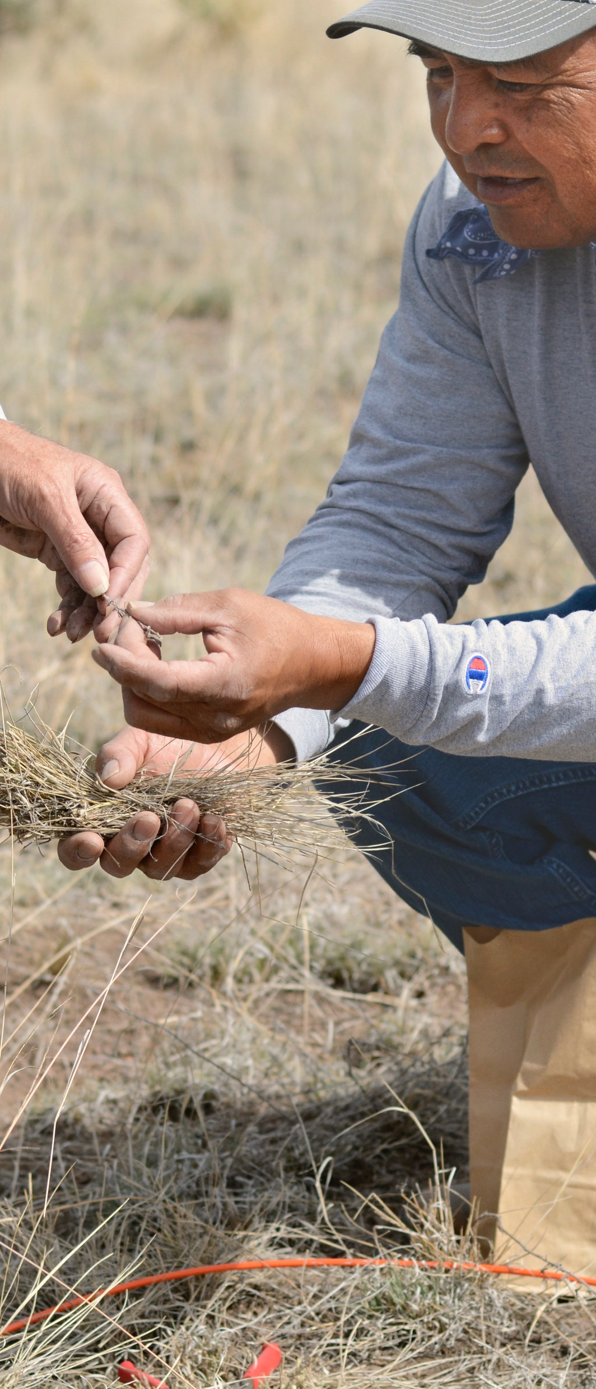
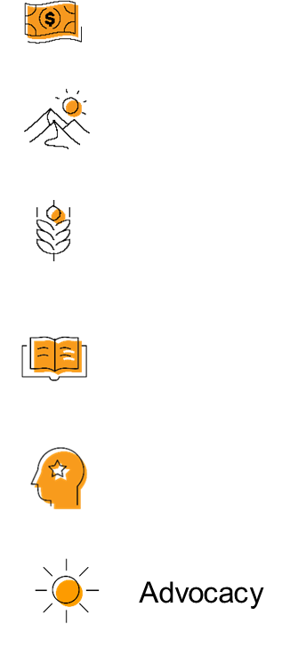

OUR STRATEGIES
DIRECT FINANCIAL SUPPORT THROUGH GRANTMAKING
TECHNICAL ASSISTANCE & TRAINING
CONVENINGS & WEBINARS
RESEARCH ON BEST PRACTICES & MODELS
COALITION BUILDING & FELLOWSHIPS
ADVOCACY

Slide 6
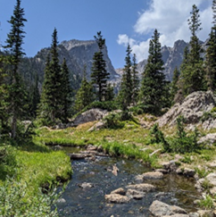

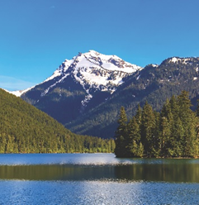
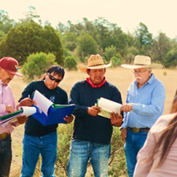
STEWARDING NATIVE LANDS
ENVIRONMENTAL SOVEREIGNTY & JUSTICE
ECOLOGICAL STEWARDSHIP
COMMUNITY PATHWAYS
CLIMATE
Protecting communities and lands from harmful practices, projects, and policies
Sustainably managing and restoring lands for our communities and future generations
Addressing ongoing and anticipated impacts of climate change to preserve lands and cultural lifeways
Upholding traditions and amplifying knowledge

Slide 7
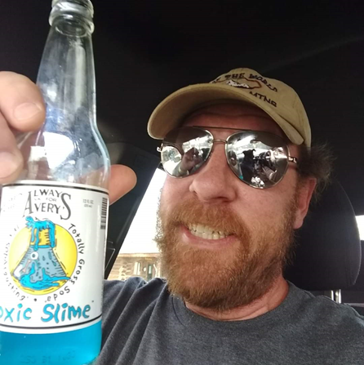
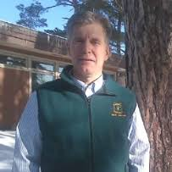
Leech Lake Band of Ojibwe
KEITH KARNES
FORESTRY DIRECTOR, LEECH LAKE BAND OF OJIBWE
BRIAN PALIK
RESEARCH ECOLOGIST, USDA FOREST SERVICE
NORHTERN RESEARCH STATION

Slide 8
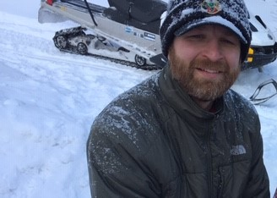
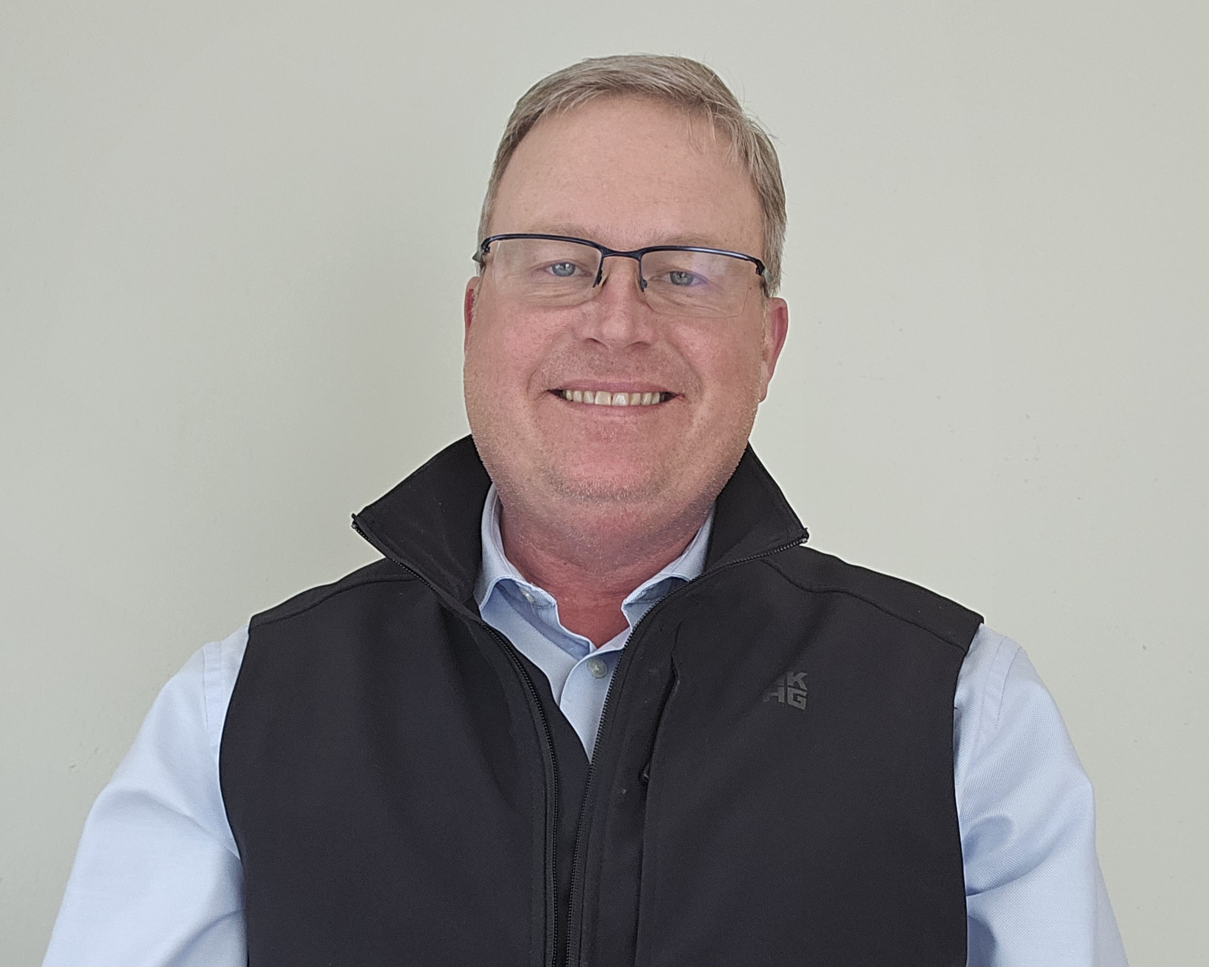
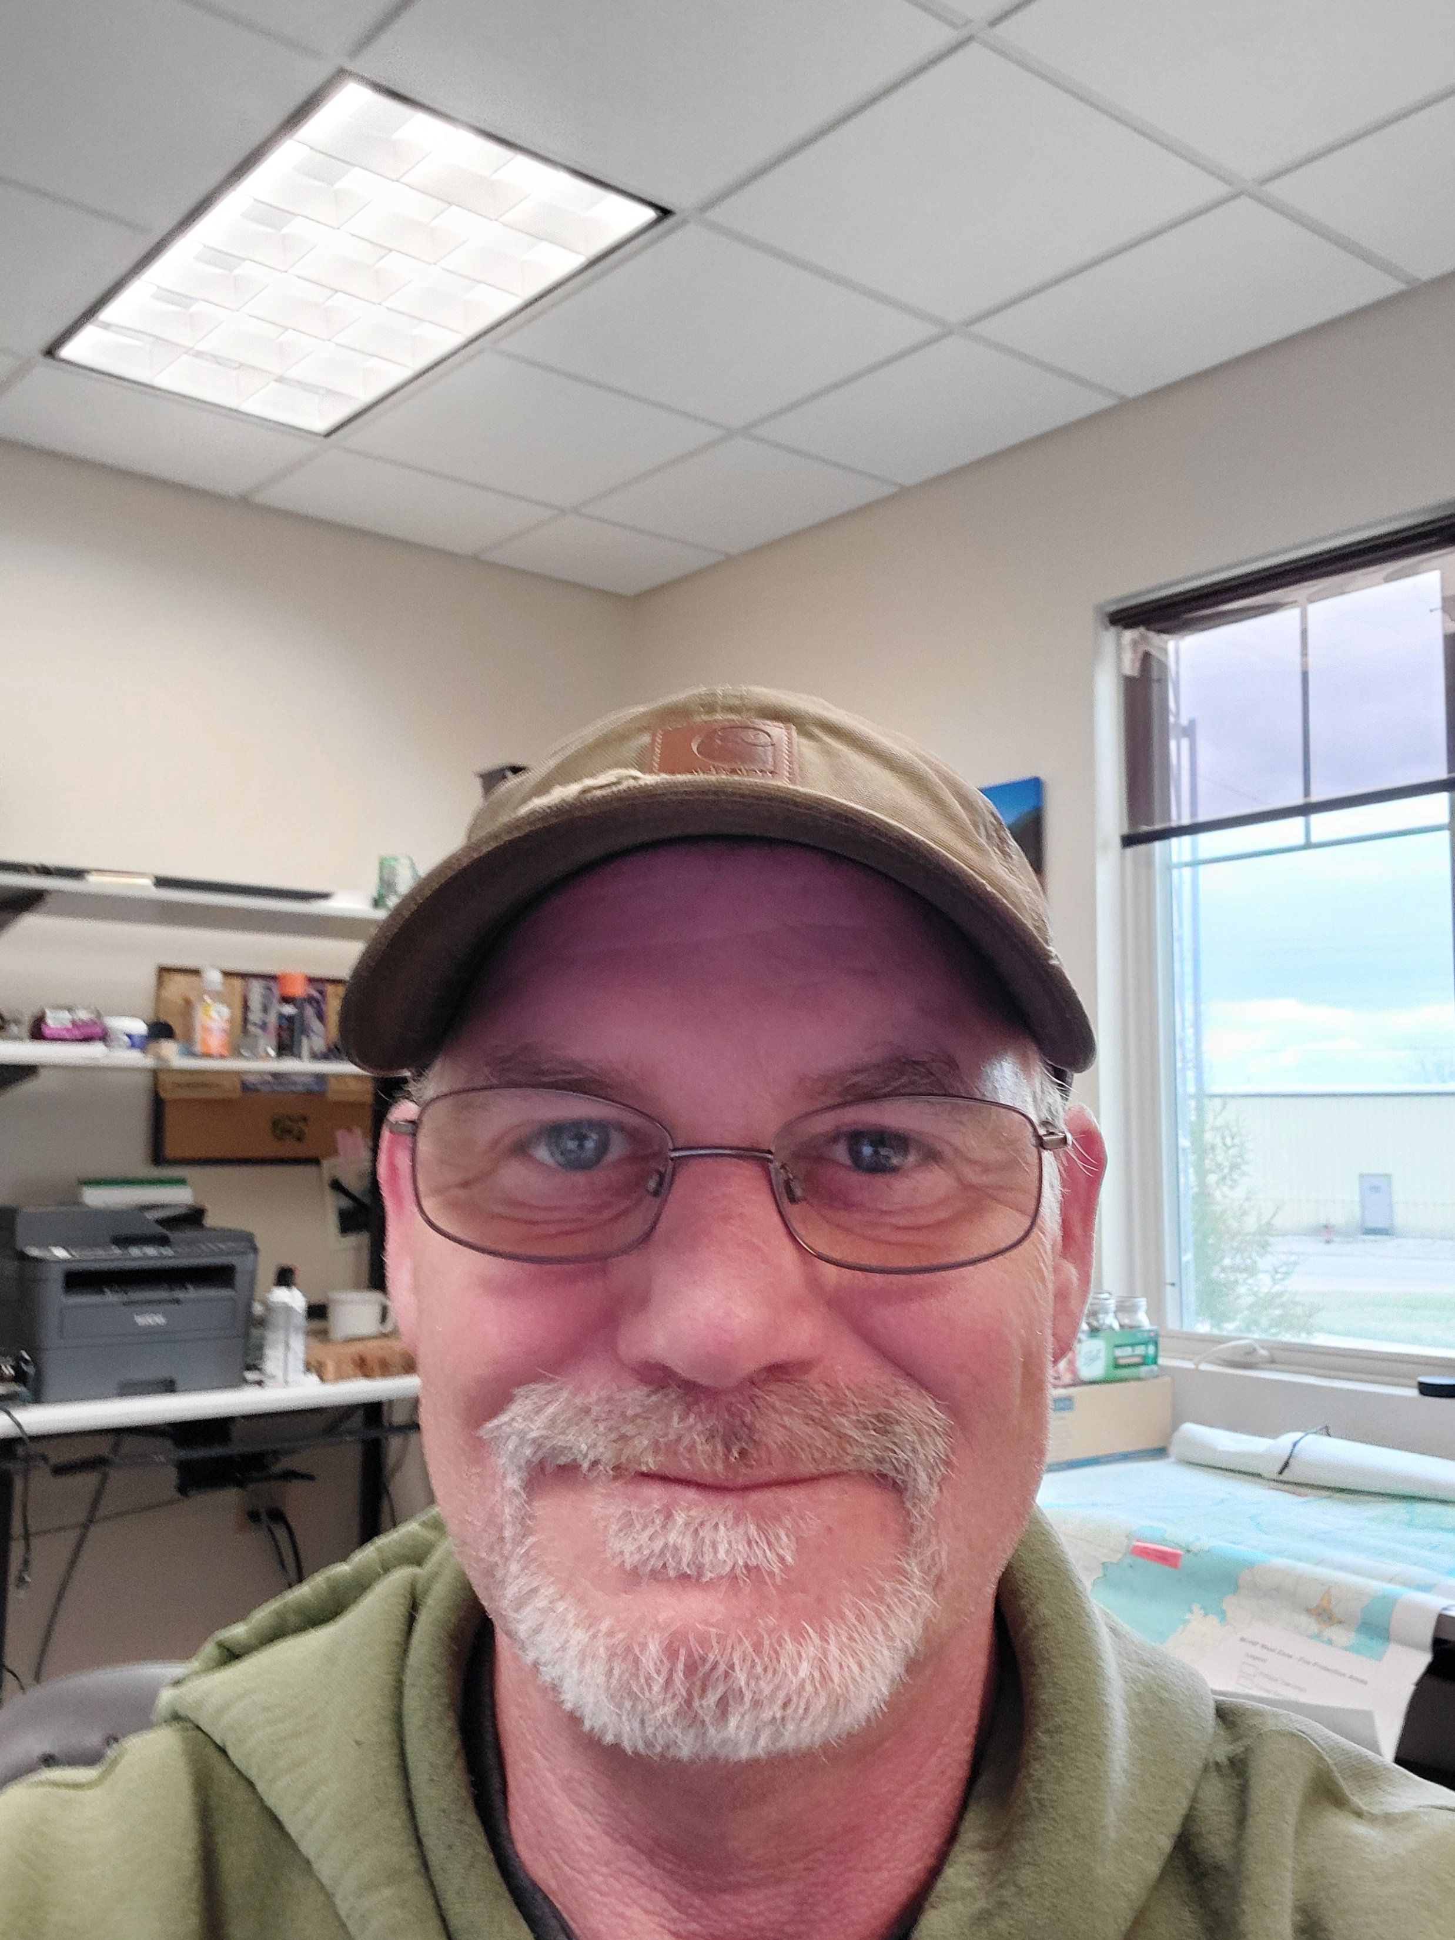
Sault Ste. Marie Tribe of Chippewa Indians
ERIC CLARK
Director of the Consortium for Cooperative Ecological Resilience with the Sault Ste. Marie Tribe of Chippewa Indians
PAUL D. THOMPSON
U.S. Forest Service, Forest Terrestrial Ecologist Hiawatha National Forest
ERIC REBITZKE
U.S. Forest Service, Unit Fire Management Officer Ottawa and Hiawatha National Forests

Slide 9
Question & Answer

Slide 10

CONTACTS
BRETT TREADWAY (FNDI)
btreadway@firstnations.org
(303)867-8015
KEITH KARNES (Leech Lake Band of Ojibwe)
keith.karnes@llojibwe.net
ERIC CLARK (Sault Ste. Marie Tribe of Chippewa)
EClark@saulttribe.net

Slide 11
U.S. FOREST SERVICE CONTACTS
BRIAN PALIK (Northern Research Station)
brian.palik@usda.gov
PAUL D. THOMPSON (Hiawatha National Forest)
paul.d.thompson@usda.gov
ERIC REBITZKE (Ottawa and Hiawatha National Forests)
eric.rebitzke@usda.gov

Slide 12
UPCOMING WEBINARS
Indigenous Stewardship on National Forest Lands Webinar Series
East Region:
Tommy Cabe Eastern Band of Cherokee Indians & Alex Bohman Great Lakes Indian Fish and Wildlife Commission (MAY)
Rocky Mountain Region:
DATE TBD
Pacific Region:
DATE TBD

Slide 13
OPPORTUNTIES
Strengthening Tribal Co-management and Co-Stewardship Grant Opportunity
Application info: https://www.firstnations.org/grantmaking/
Note Application closes Monday at 5pm MT
Community Navigator Grant Opportunity
Lindsay Riggs (Navajo): FNDI Program Officer

Slide 14
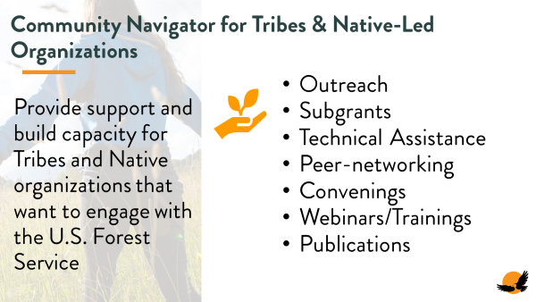

Slide 15




COMMUNICATIONS
ACCESS THE WEINBAR RECORDING IN FIRST NATIONS KNOWLEDGE CENTER:
Here is where you can find the webinar recording and slides once they are posted: https://www.firstnations.org/fnk
FOLLOW US ON SOCIAL MEDIA
fndi303 First Nations Development Institute
FirstNationsDevelopmentInstitute
@FNDI303

Slide 16



THANK YOU
NATIONAL HEADQUARTERS
First Nations Development Institute 2432 Main Street
Longmont, CO 80501
CONTACT
Tel: 303.774.7836
Fax: 303.774.7841 info@firstnations.org
CONNECT
firstnations.org fndi303 First Nations Development Institute
FirstNationsDevelopmentInstitute
@FNDI303

