Slide 1
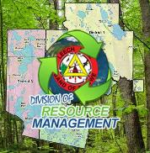

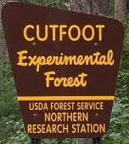
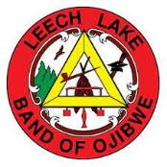

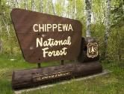
Fire Reintroduction in a Long Fire Excluded
Red Pine Woodland
-Red pine woodlands in northern MN
-What is a natural fire regime in this setting?
-The Sunken Lake project: collaborative restoration
Brian Palik
USDA Forest Service
Northern Research Station
Grand Rapids MN

Slide 2
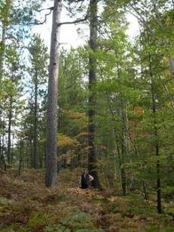
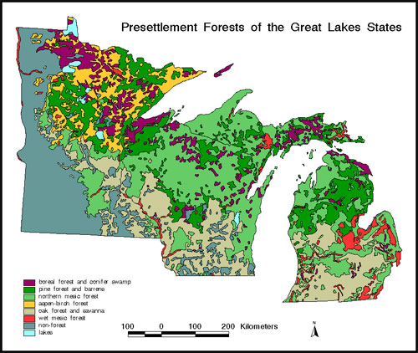
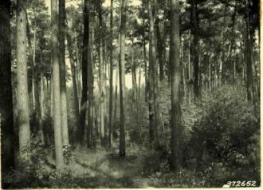
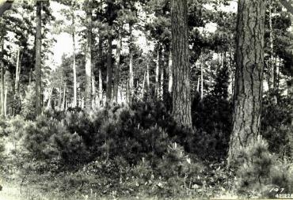
Laurentian-Acadian Northern Pine-(Oak) Woodlands

Slide 3
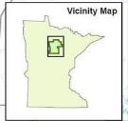
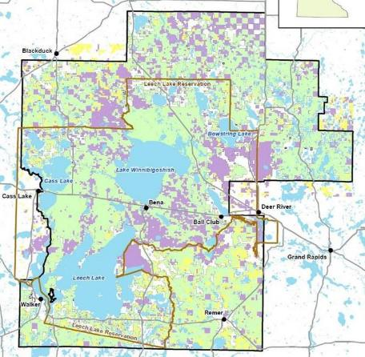
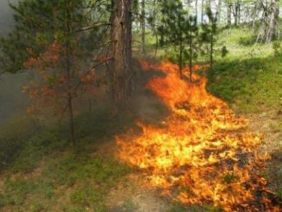
What do we know about natural fire regimes?
Heinselman (1973, 1996): return interval (yrs)
-Crown fire: 150-250
-Surface fire: 5-50
-Stand replacing fire-single cohort stands
Recent quantitative estimates
Fire intervals: 1-40 years
Mean fire interval: 6.6 yrs
Stambaugh et al. 2021. Forest Ecology and Management
Similar estimates in WI and MI
Fires were not all stand replacing
Leech Lake Band of Ojibwe Homeland
Chippewa National Forest
Jack McGowan-Stinski

Slide 4
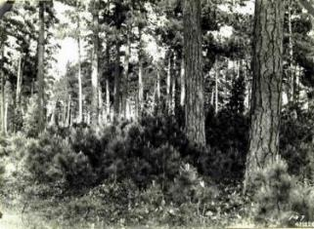

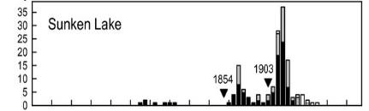


Mixed-severity fire regimes, including less-than-stand-replacing fire
(Bergman 1924, Shirely 1932, Eyre and Zehngraff 1948)
What did these ecosystems look like?
-Woodlands
-Open and variable canopy cover
-Two, three, more age cohorts of pine
-Pines regenerating in “large gaps”
-Mixed-species, up to 10-11 tree species
-Variable but open understory
“Large old pines and
red pine cohort regeneration.”
Fire intervals: 1-40 years
Mean fire interval: 6.6 yrs
Lightning? Probably not…6.6 years is too short for lightning
Indigenous burning? Probably, especially for the shorter range
How is this a natural fire regime?...Humans were lighting the fires!

Slide 5

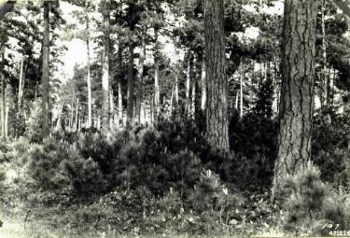

Fire intervals: 1-40 years
Mean fire interval: 6.6 yrs
The range likely reflects varying degrees of Indigenous burning
Shorter intervals in higher use areas?
So how is this natural?
….Leech Lake Ojibwe People are part of the natural environment, not outside of it.…
Interview with NPR reporter, September 2023
Ben Benoit….
Leech Lake Band of Ojibwe & Deer River
District Ranger, Chippewa National Forest
This is what people want red pine woodlands to look like and if it is due to Indigenous burning and lightning fires…than that is the fire regime we should be emulating…
It’s natural

Slide 6
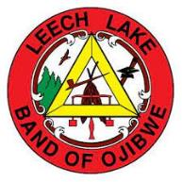
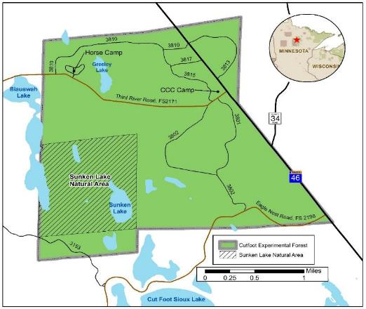


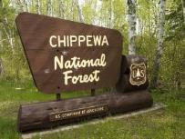
With a better understanding of what a mixed-pine woodland should look like……and the fire regime
The Sunken Lake Prescribed Fire Project
Leech Lake Band of Ojibwe Homeland
Chippewa National Forest

Slide 7
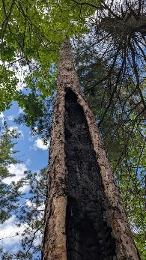
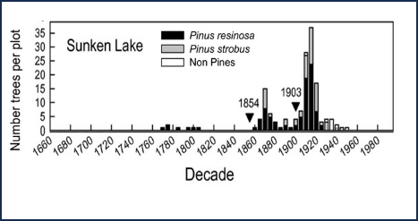
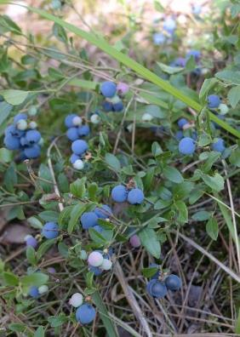
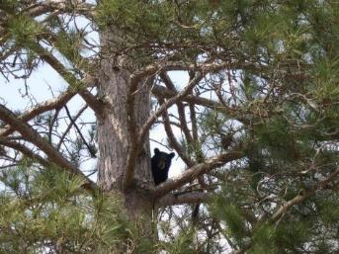
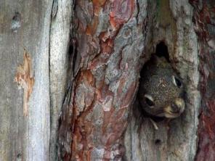
Objectives:
-Emulate pre-1920~ fire regime
-Restore structure…age, size, habitat
-Reduce hardwood encroachment
-Increase regeneration of pine species
-Promote culturally important plant communities
Doug Kastendick
Doug Kastendick
Greg Corace
Igor Drobyshev

Slide 8
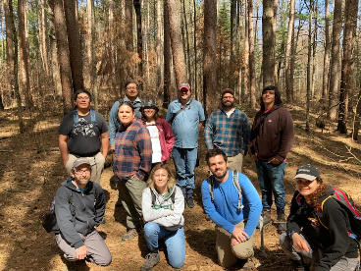
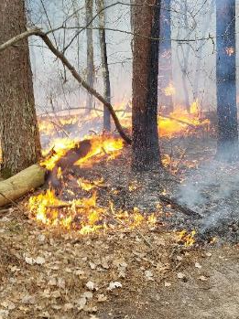
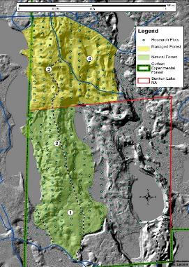
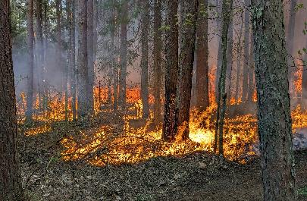
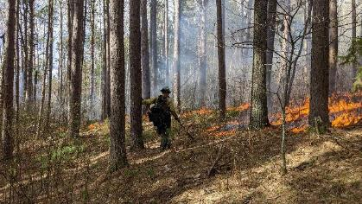
  Burning Status:
  -May 2021 Units 1 and 2
  -May 2023 Unit 3
  -May 2024 Unit 4 and Units 1-2 again
  -Etc. until hardwoods/shrubs are reduced
  -Some patch mortality of pines expected/encouraged….regeneration
  -Ongoing vegetation monitoring….by students
Leech Lake Tribal College Students
Photos: Doug Kastendick

Slide 9
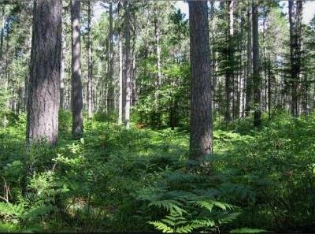
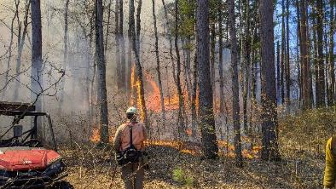
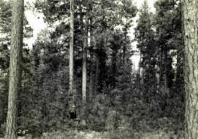
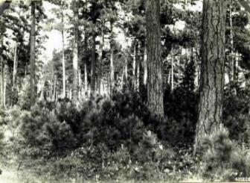
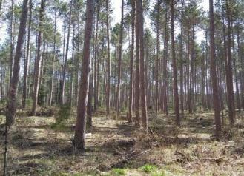
But what about this model for restoration and climate change?
  -Lower density woodlands are more resistant to drought
  -Complex age/size structure is more resistant to wind
  -Mixed-species = more options
  -Rx burning reduces hazardous fuels

Slide 10
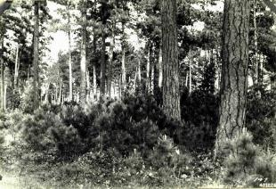
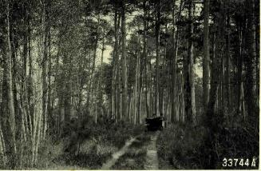
Summary
-Red pine woodlands are rare on the landscape
-Red pine woodlands are important to the Leech Lake people
-Lack of fire & timber-focused management contribute to the loss
-Rx fire to restore woodland structure and composition
-Increases adaptation potential to climate change
-We are learning about the importance of red pine woodlands to the Leech Lake people
-Student interns from the LLTC are leaning about this first-hand
Brian Palik
USDA Forest Service
Northern Research Station
brian.palik@usda.gov
Leech Lake Tribal College
Melinda Neville, Joey Riley,
Daniel Devault, &
Student Interns
Leech Lake Division of Resource Management
Kate Hagsten
Tanya Roerick
Garrett Williams
Chippewa National Forest
Mike Klick
Joe Kaufmann
USDA FS Northern Research Station
Doug Kastendick

