Slide 1

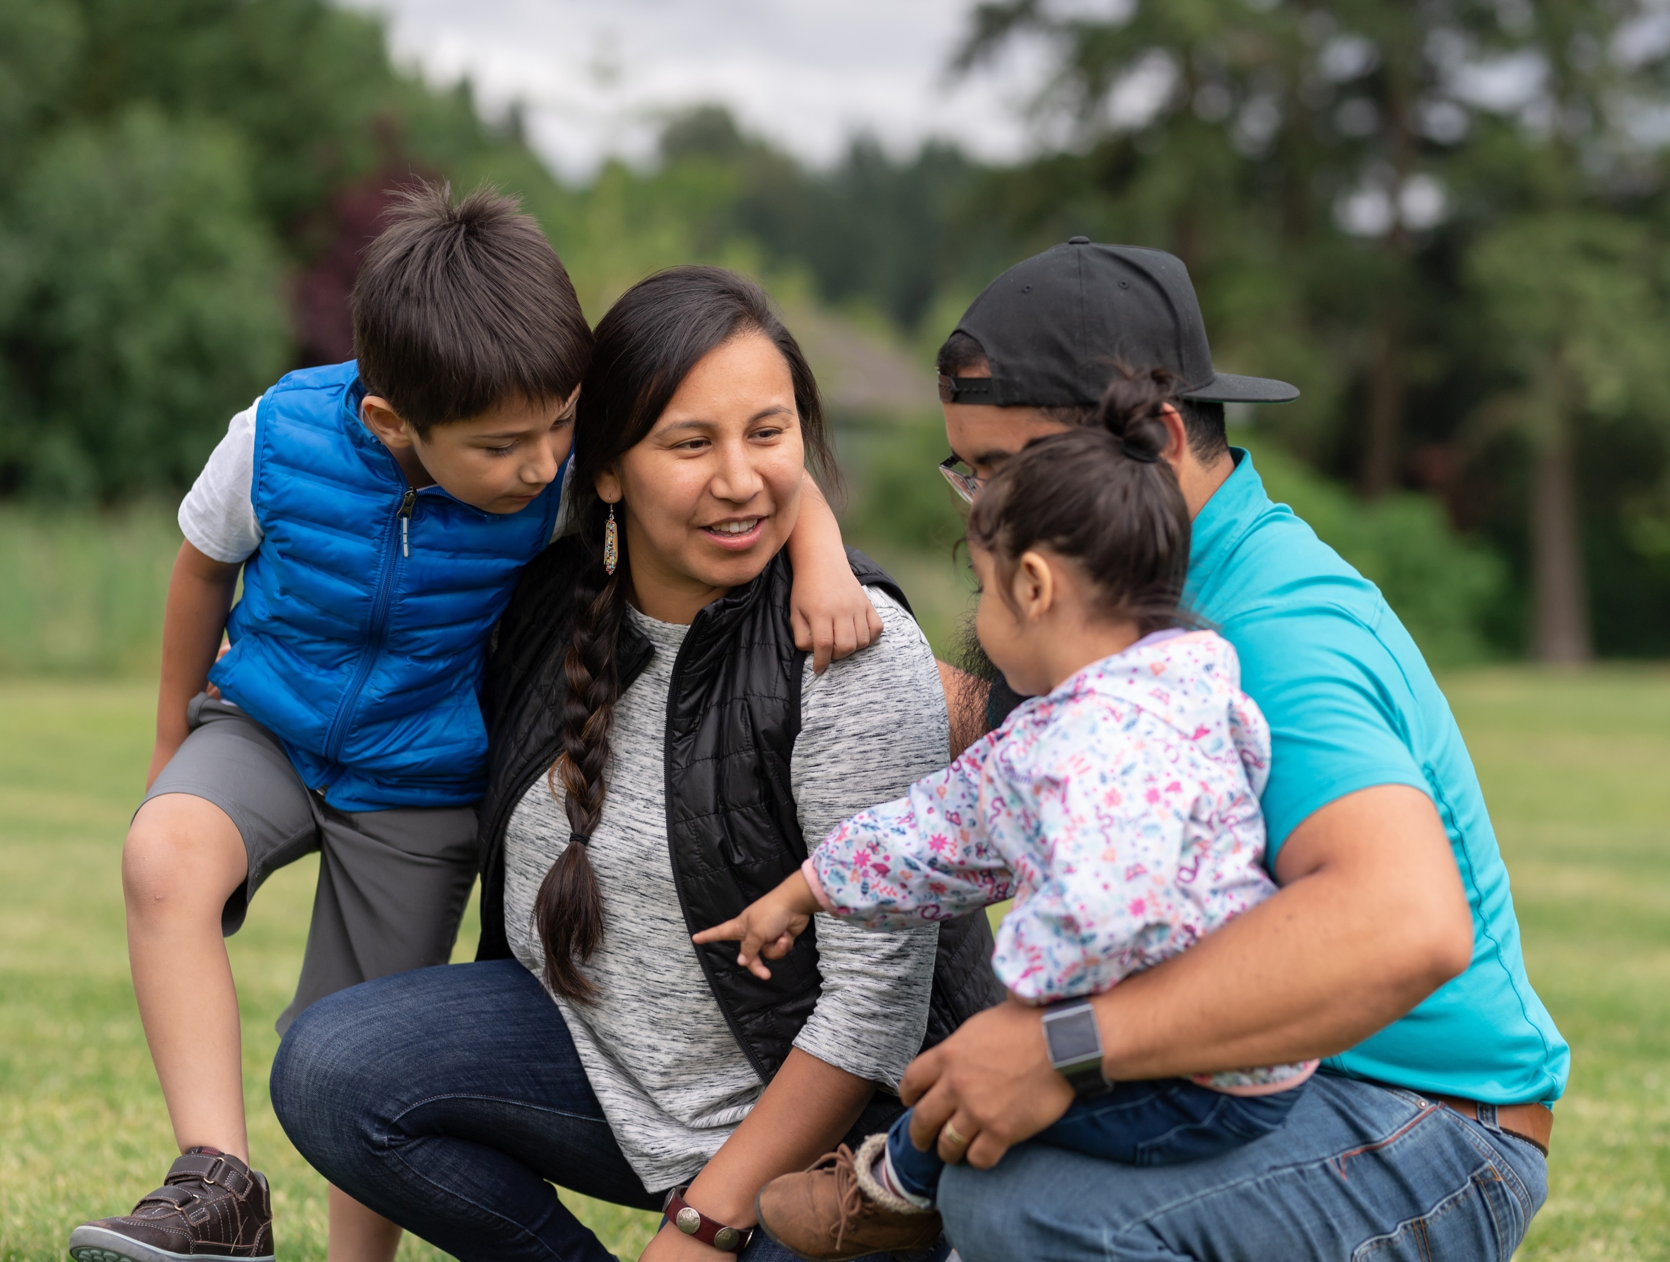
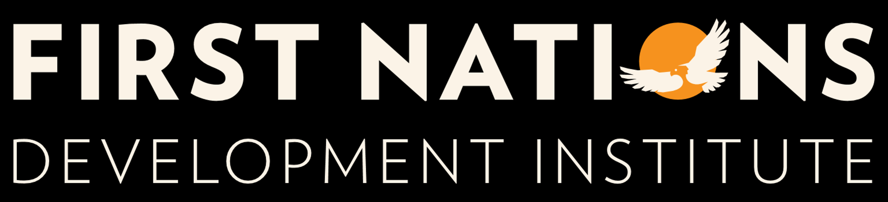
2024 Native Youth & Culture Fund Q&A
Monday, May 13, 2024
11:00 am – 12:00 pm MDT

Slide 2


Webinar Format
All attendees will be muted throughout this webinar.
If you have questions, please use the Q&A button and enter your question(s) in the box.
Q&A: Ask questions to the host and panelists or request technical help. Chat: Send a message to the panelists or everyone (All Panelists and Attendees) in the webinar.
Audio Settings: Change your audio settings to phone or computer audio. You can also click the upward arrow (^) next to change your speaker.
Live Transcript: Show subtitles for the webinar, view the full transcript or change the subtitle settings.

Slide 3

01 | About First Nations Development Institute
02 | ABOUT the NATIVE youth & culture fund (nycf)
03 | nycf eligibility
04 | Grant application
05 | QUESTION & ANSWER
AGENDA

Slide 4

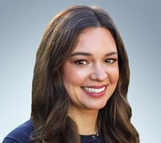
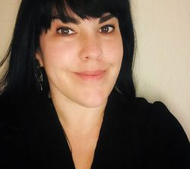
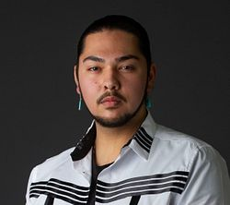
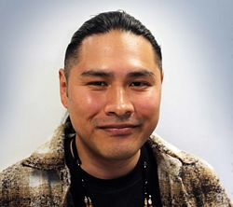
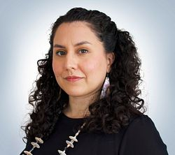
THE 2024 NYCF TEAM
ABI WHITEING
REBECCA TORTES
Director of Programs, NALK
Director of Programs, CTF
Blackfeet
Cahuilla, Luiseño, & Assiniboine Sioux
A.J. GARCIA
ANTHONY MOTA
SABINE TALAUGON
Programs Officer, NALK
Program Associate, CTF
Lead Program Officer, CTF
Jicarilla Apache & Nahua
Pomo, Cahto, Kanaka Maoli
Samala Chumash

Slide 5
First Nations Development Institute
Mission
Our mission is to uplift and sustain the lifeways and economies of Native communities through advocacy, financial support, and knowledge sharing.
Vision
We envision a world in which Tribal Sovereignty is upheld, and Native ingenuity and knowledge are honored and respected.
Native-Led Nonprofit founded in 1980
Headquartered in Longmont, Colorado – Satellite offices in New Mexico and California
52 staff members
Grantmaking launched in 1993
Awarded 3,385 grants totaling $80 million since 1993
Serving Tribal Programs, Native-Led Nonprofits, and Community Organizations

Slide 6

OUR CORE PROGRAMS
ACHIEVING NATIVE FINANCIAL EMPOWERMENT
NOURISHING
NATIVE FOODS
AND HEALTH
CALIFORNIA TRIBAL FUND
Investing in the viability and visibility of California Tribal Nations and communities to support in controlling and protecting land, water, food systems, and culture.
Native financial and investor education, consumer protection and financial fraud education, combating predatory lending and research.
Native food systems, food security, health and nutrition and food sovereignty efforts.
STEWARDING
NATIVE LANDS
INVESTING IN
NATIVE YOUTH
NATIVE ARTS, LANGUAGE, & CULTURE
Financial and technical assistance to support Native ecological stewardship and Native control of ancestral lands and resources.
Native Youth and Culture Fund, college scholarship/internship programs, and youth-oriented financial education.
Nonprofit capacity-building activities, support for Native arts, Native language immersion, professional development and coalition building.

Slide 7

ABOUT NYCF
Launched in 2002 to support Native youth programs that provide Native language learning, leadership building, and intergenerational mentoring.
Through NYCF First Nations has awarded 532 grants totaling to over $10.3 million
First Nations believes that Native youth represent the future of Native communities and by investing in youth and giving them a sense of place and tradition in the community, it ensures a future of bright and capable leaders. First Nations’ programs supported NYCF meet youth where they are, support them in accomplishing their goals and dreams as future leaders, and shape pathways that prepare them for an empowered adulthood guided by their cultures and families. Through this opportunity, First Nations’ hopes to support programs focused on building a path towards sustainability and longevity.

Slide 8
ELIGIBLE ENTITIES
Tribal Government Programs
Federal- and State-Recognized Tribal Governments and Departments
Native-controlled 501(c)(3) nonprofits
Native-controlled community organizations with fiscal sponsorship
Native §7871 Organizations
Tribal § 7871 entities
Native-Controlled Community Organizations
(with a fiscal agent)
Note: First Nations considers “Native-controlled” to mean that the majority (51% or more) of the organization’s Board of Directors is tribally affiliated.

Slide 9
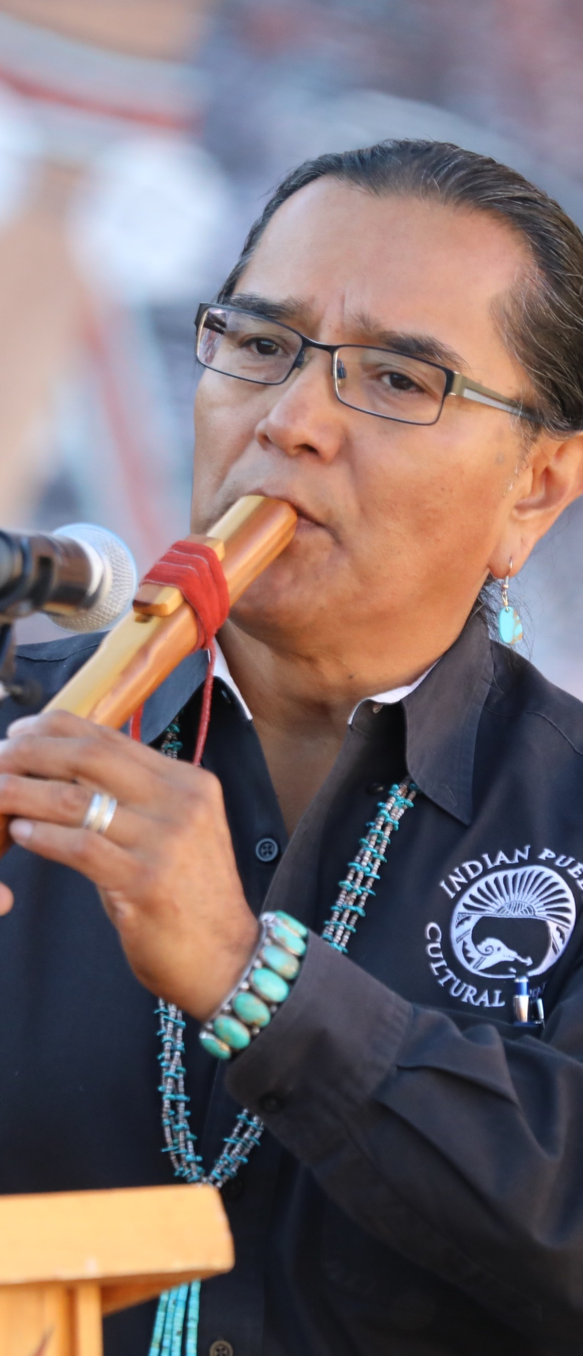




GRANT OVERVIEW
DEADLINE TO APPLY:
Wednesday, June 5, 2024 no later than 5:00pm (Mountain Daylight Time)
GRANT PERIOD:
July 1, 2024 – June 30, 2026
AWARD CEILING:
Total requested funds under this funding opportunity should not exceed $60,000.
GRANT DETERMINATION NOTIFICATIONS:
Notifications on the final status of your grant application will be made on or before Sunday, June 30, 2024

Slide 10
EXPECTED NUMBER OF AWARDS
First Nations expects to award 25-32 grants in total
10 - 12 grants of up to $60,000 will be awarded to structured day and/or overnight camp programs that focus on recreational, cultural, educational, language, Native youth leadership and intergenerational mentoring activities. (If you are applying as a camp program you must indicate this within the application).
4 - 8 grants of up to $60,000 will be awarded to California based tribes or California tribally controlled non-profit organizations. These grants are made possible through our California Tribal Fund (CTF). The CTF was created to support California-based, California-Native-led nonprofits and tribal programs in controlling and protecting their food systems, water, languages, traditional ecological knowledge, and land.
10 - 12 grants of up to $60,000 will be awarded to programs supporting Native youth that demonstrate alignment with one or more of the program priorities

Slide 11
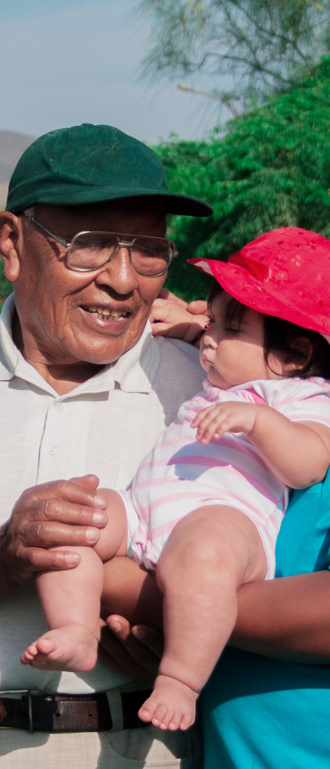
NYCF PRIORITIES
All proposals must demonstrate their project or program will carry out one or more of the following:
Provide structured day or overnight camp activities
We define camps as structured day or overnight programs that focus on recreational, cultural, educational, youth leadership and intergenerational mentoring activities
Focus on preserving, strengthening, or renewing cultural and/or spiritual practices, beliefs, and values of Native youth.
Engage youth and elders in activities that demonstrate methods for documenting traditional knowledge systems, practices, and/or beliefs.
Increase youth leadership and their capacity to lead through intergenerational educational or mentoring programs.
Increase youth access to and sharing of cultural customs and beliefs and traditional Native art forms using appropriate technologies (traditional and/or modern), as a means of reviving or preserving tribal language, arts, history, or other culturally relevant topics.

Slide 12






USE OF GRANT FUNDS
Funds may be used for programmatic, administrative, and organizational capacity-building activities that support Native youth programs. Matching funds are not required under this grant.
Examples of include, but are not limited to:
Staff salaries
Curriculum development
Honoraria
Strengthening technological & informational systems
Food purchases
Materials
Program evaluation

Slide 13
APPLICATION COMPONENTS
PROJECT SUMMARY
OBJECTIVES & GOALS
A concise description of the project and who it will serve.
At least three specific goals/objectives to be accomplished with the funding
(SMART)
PROGRAM NARRATIVE
BUDGET NARRATIVE
A program narrative describing how your program aligns with the NYCF priorities, how your goals/objectives will be achieved; and how the funding will benefit native youth in your community.
A general description of how the funds will be used and the anticipated impact of general operating funding on your program or organization.

Slide 14
APPLICATION ATTACHMENTS
TAX STATUS DOCUMENTATION
DESCRIPTION OF KEY LEADERSHIP STAFF
DESCRIPTION OF BOARD OF DIRECTORS
TIMELINE
BUDGET
ADDITIONAL SUPPLEMENTAL MATERIALS (OPTIONAL)

Slide 15
TIPS FOR APPLYING
01
02
03
04
Preparing your answers in a Word document that you can edit and then copy and paste your finalized answers into the online application.
Making sure you follow the format of each section and do your best to answer every question.
Tying your answers to the grant priorities and also to your objectives.
Submitting all required attachments.

Slide 16

WALK THROUH OF THE ONLINE APPLICATION SYSTEM

Slide 17

CONTACT US
GENERAL NYCF CONTACTS
Abi Whiteing
Director of Programs
(303) 774-783
awhiteing@firstnations.org
OR
A.J. Garcia
Program Officer
(303) 774-7836
agarcia@firstnations.org.
CALIFORNIA TRIBAL FUND
Anthony Mota,
Program Associate
(303) 774-7836
amota@firstnations.org.
ONLINE PORTAL TECHNICAL SUPPORT
Grantmaking Team
grantmaking@firstnations.org

Slide 18
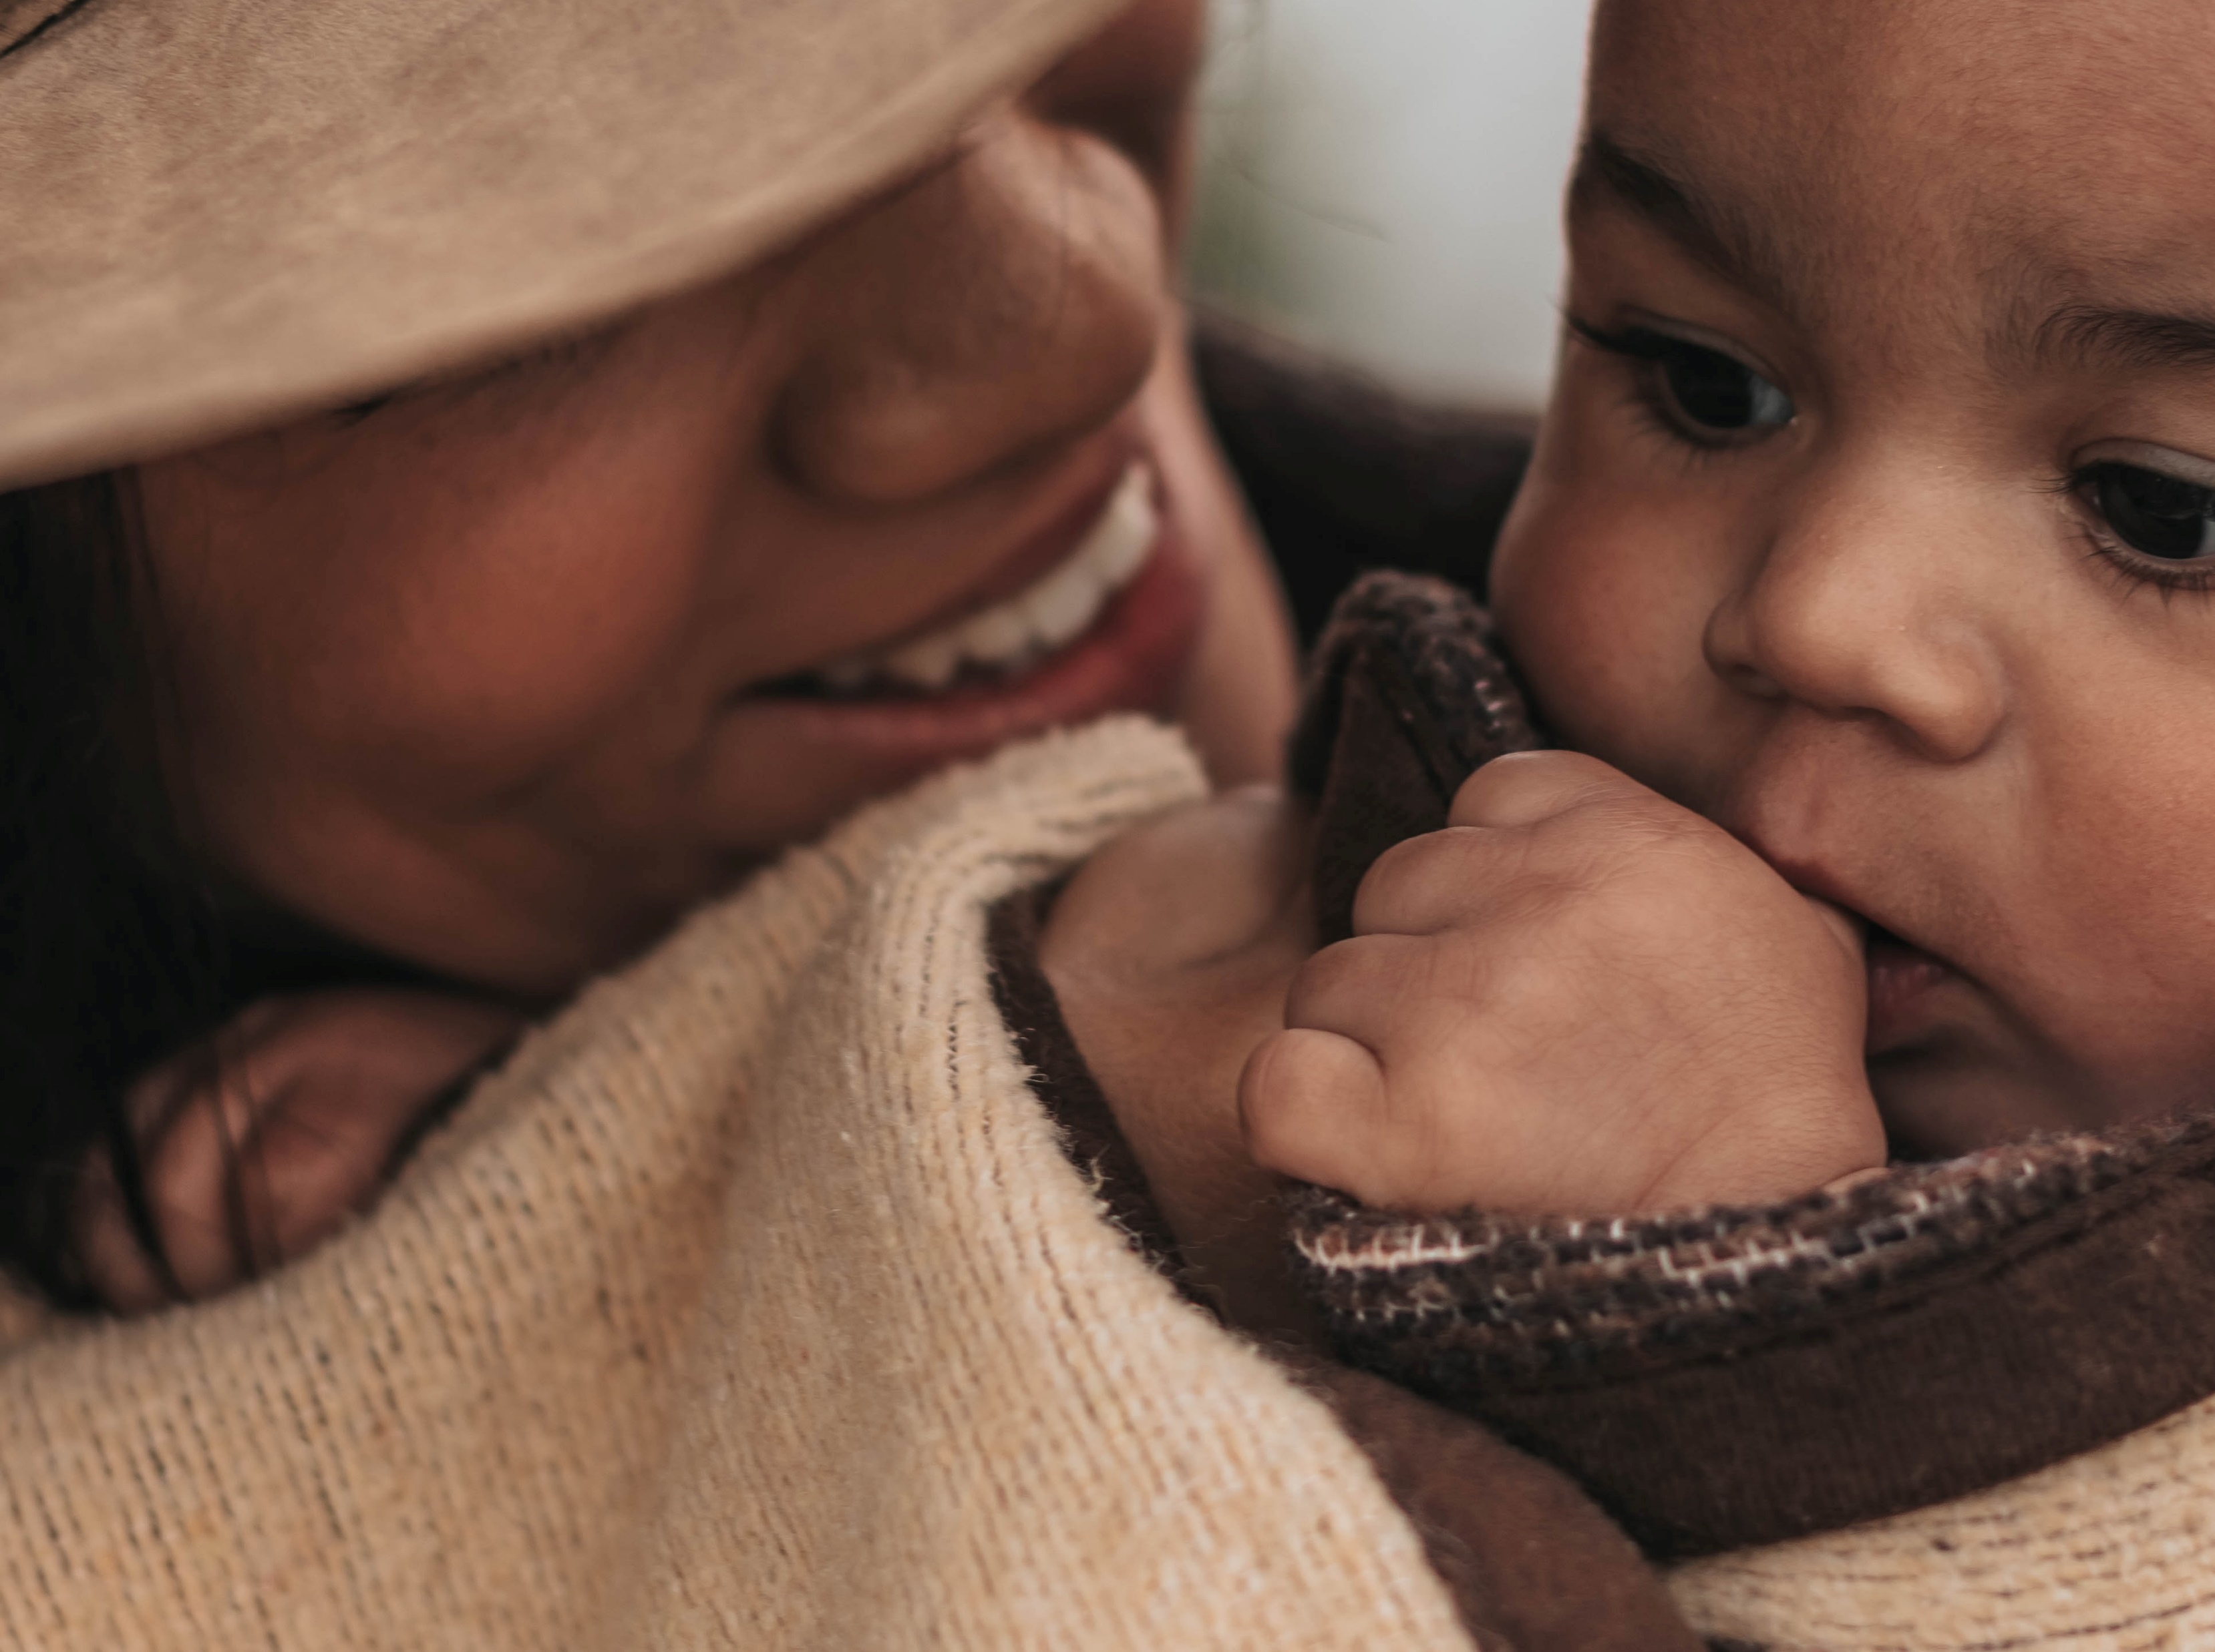






QUESTIONS?
NATIONAL HEADQUARTERS
First Nations Development Institute 2432 Main Street
Longmont, CO 80501
CONTACT
Tel: 303.774.7836
Fax: 303.774.7841 info@firstnations.org
CONNECT
firstnations.org fndi303 First Nations Development Institute
FirstNationsDevelopmentInstitute
@FNDI303

