Slide 1

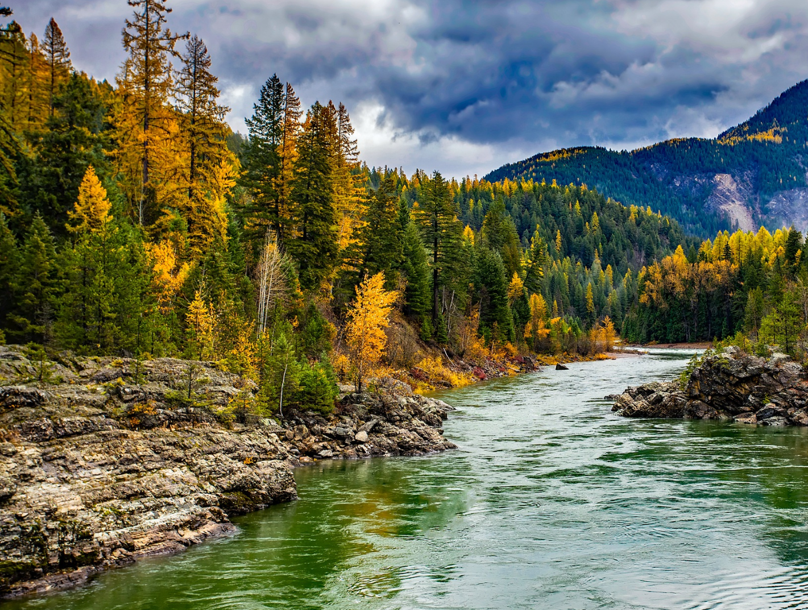

STEWARDING NATIVE LANDS AND THE U.S. FOREST SERVICE PRESENTS
Indigenous stewardship on national forest lands webinar series: East region

Slide 2

WEBINAR MANAGEMENT
If you have questions, please type them in the question box.
They will be addressed during the Questions section.
All attendees will be muted throughout this webinar.
This webinar is being recorded.

Slide 3
ABOUT FIRST NATIONS DEVELOPMENT INSTITUTE
Native-Led Nonprofit
Founded in 1980
Based in Longmont, Colorado
Seven Programs
Grantmaking to date: 3,385 grants, $80 million
Constituent Base: Tribal Programs, Native-Led Nonprofits & Community Orgs
57 Staff Members

Slide 4

First Nations Development Institute’s mission is to uplift and sustain the lifeways and economies of Native communities through advocacy, financial support, and knowledge sharing.

Slide 5
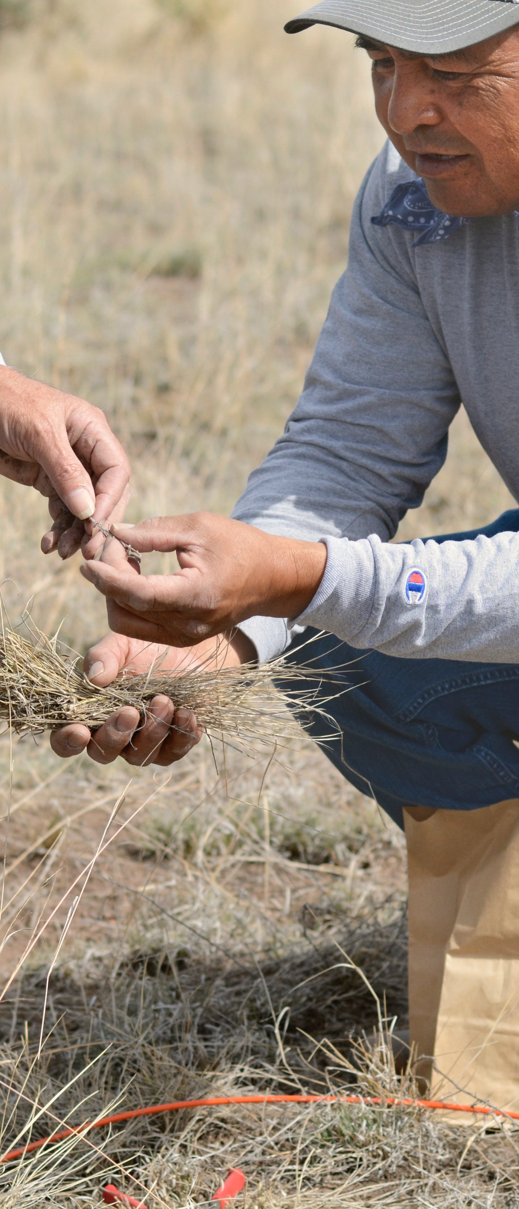
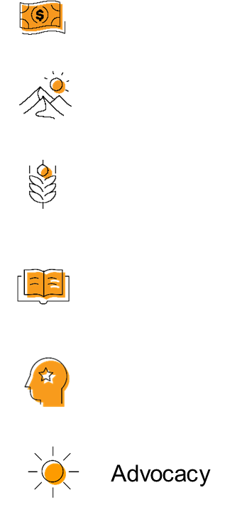

OUR STRATEGIES
DIRECT FINANCIAL SUPPORT THROUGH GRANTMAKING
TECHNICAL ASSISTANCE & TRAININGS
CONVENINGS & WEBINARS
RESEARCH ON BEST PRACTICES & MODELS
COALITION BUILDING & FELLOWSHIPS
ADVOCACY

Slide 6
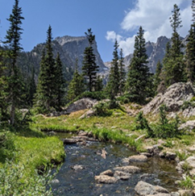
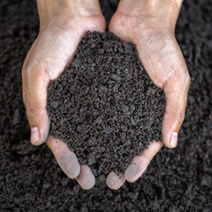
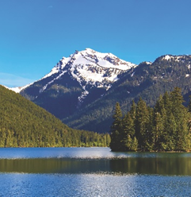
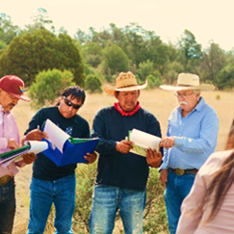
STEWARDING NATIVE LANDS
ENVIRONMENTAL SOVEREIGNTY & JUSTICE
ECOLOGICAL STEWARDSHIP
COMMUNITY PATHWAYS
CLIMATE
Protecting communities and lands from harmful practices, projects, and policies
Sustainably managing and restoring lands for our communities and future generations
Addressing ongoing and anticipated impacts of climate change to preserve lands and cultural lifeways
Upholding traditions and amplifying knowledge

Slide 7
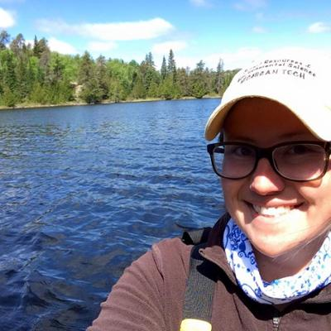
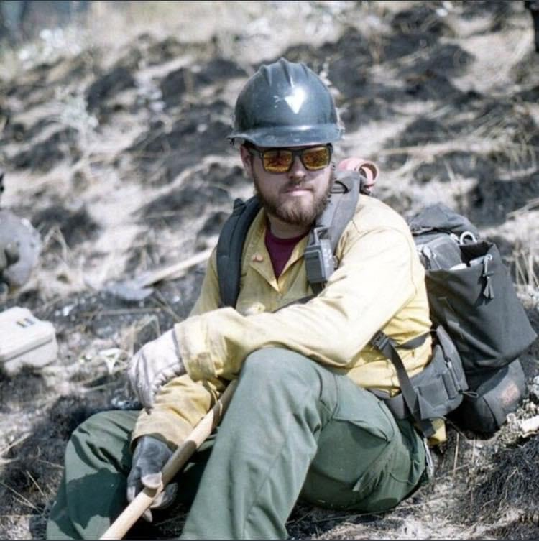
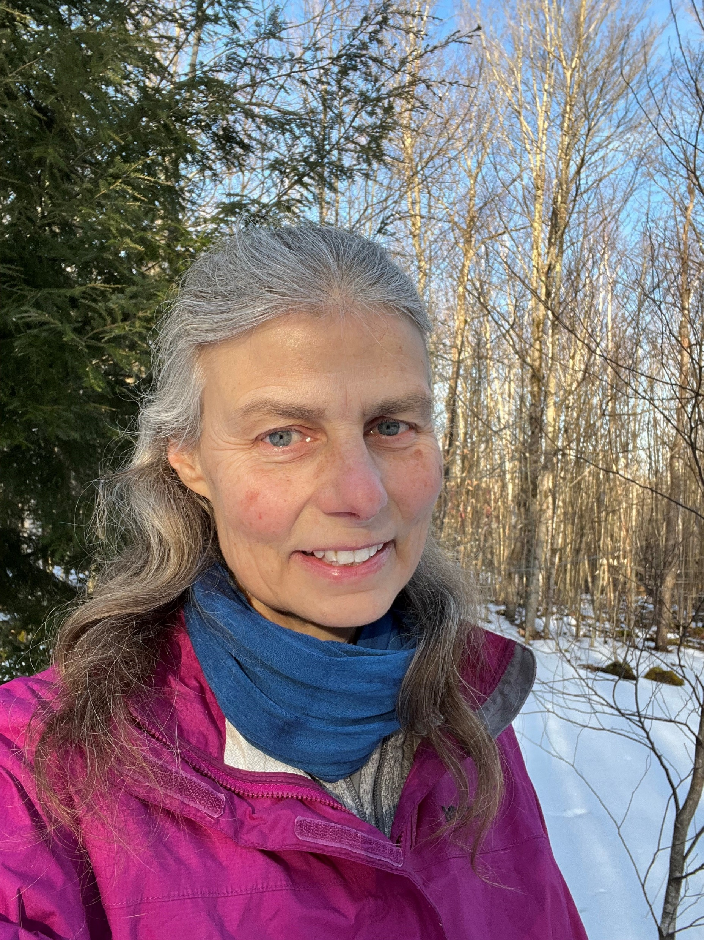
Great Lakes Indian Fish and Wildlife Commission
ALEX BOHMAN
Forest Ecology Program Coordinator, Great Lakes Indian Fish & Wildlife Commission
TRAVIS SWANSON
U.S. Forest Service Norther Research Station, Research Forester and NRS FIA Tribal Liaison
RACHEL RIEMANN
U.S. Forest Service Norther Research Station, Research Forester and NRS FIA Tribal Liaison

Slide 8
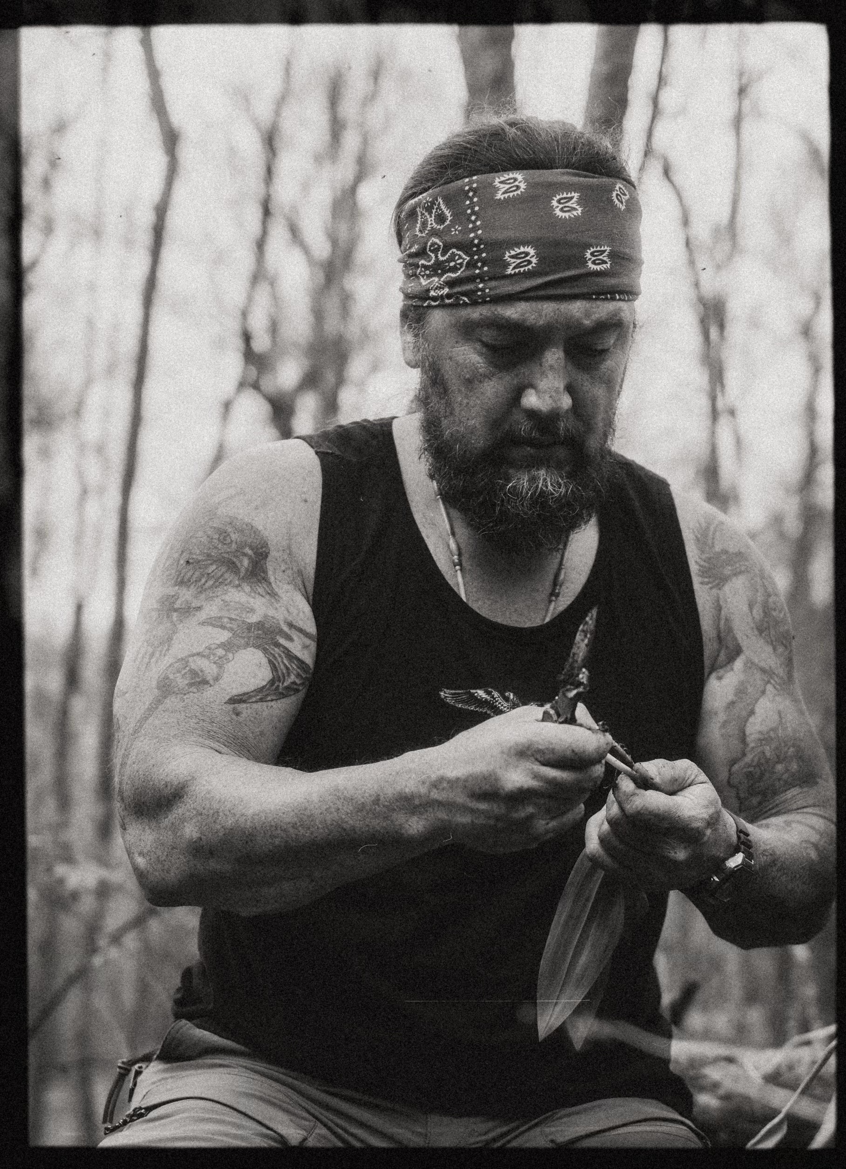
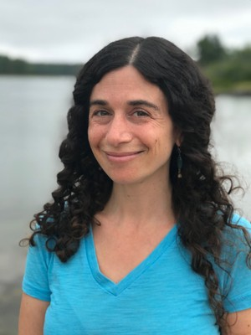
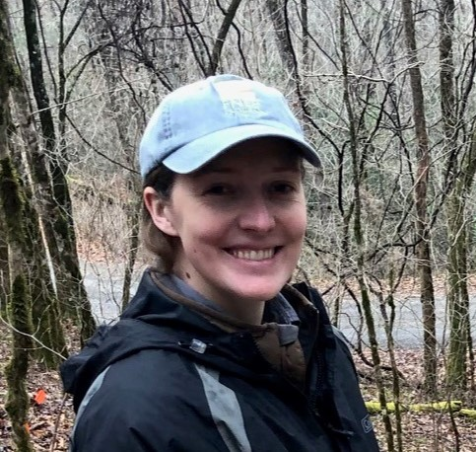
Eastern Band of Cherokee Indians
TOMMY CABE
Forest Resource Specialist, Eastern Band of Cherokee Indians Natural Resource Department
MICHELLE BAUMFLEK
U.S. Forest Service, Research Biologist and Tribal Liaison, Southern Research Station
MARIA DUNLAVEY
U.S. Forest Service, Botanist, Nantahala National Forest

Slide 9
Question & Answer

Slide 10

CONTACTS
Brett Treadway (FNDI)
btreadway@firstnations.org / (303)867-8015
Alex Bohman (Great Lakes Indian Fish and Wildlife Committee)
abohman@glifwc.org
Travis Swanson (Great Lakes Indian Fish and Wildlife Committee)
  tswanson@glifwc.org
Tommy Cabe (Eastern Band of Cherokee Indians)
  tommcabe@ebci-nsn.gov

Slide 11
U.S. FOREST SERVICE CONTACTS
Rachel Riemann (Northern Research Station)
rachel.riemann@usda.gov
Michelle Baumflek (Southern Research Station)
michelle.baumflek@usda.gov
Maria Dunlavey (Nantahala National Forest)
  Maria.Dunlavey@usda.gov

Slide 12
Previous Webinars
INDIGENOUS STEWARDSHIP ON NATIONAL FOREST LANDS: GREAT LAKES REGION
  KEITH KARNES, Leech Lake Band of Ojibwe
  ERIC CLARK, Sault Ste. Marie Band of Chippewa Indians
CO-STEWARDSHIP AND CO-MANAGEMENT 101 WEBINAR
  MARTIN NIE, University of Montana College of Forestry & Director of the Bolle Center for People and Forests
  MONTE MILLS, University of Washington School of Law & Director of the Native American Law Center
LINK TO RECCORDINGS HERE: https://www.firstnations.org/webinars/stewarding-native-lands-webinars/

Slide 13
UPCOMING WEBINARS
Indigenous Stewardship on National Forest Lands Webinar Series
Rocky Mountain Region:
DATE TBD
Pacific Region:
    DATE TBD

Slide 14

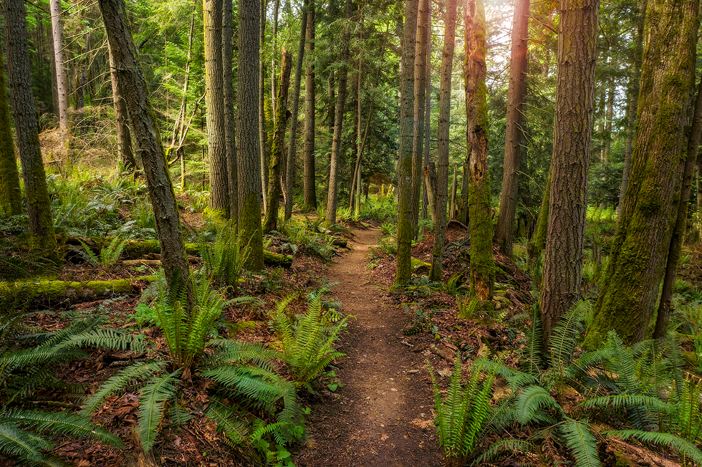


Opportunities: Community Navigator
First Nations will conduct outreach and support engagement of Tribes and Native-led Organizations in U.S. Forest Service IRA and related BIL programs and opportunities.
Technical Assistance
Capacity Support Grants (up to $25,000)
Webinars and Presentations
Publications and Resource Guides
And more
IRA – Inflation Reduction Act
BIL – Bipartisan Infrastructure Law
Lindsay Riggs
Lead Program Officer
First Nations Development Institute
lriggs@firstnations.org
303.774.7836
www.firstnations.org/community-navigator
Notes:
I’d like to highlight our partnership with the Forest Service as a Community Navigator. In this role, we will grow our outreach and technical assistance to tribes in areas in which we are already invested and connected, and will enable greater tribal access to Forest Service programming. The vehicle for this work will be through the Stewarding Native Lands program and will utilize strategies we already have built into our programs and include:
Targeted Technical Assistance – which will be provided to improve tribal access to and capacity building for participation in FS opportunities. This TA can cover needs like feasibility assessments, grant writing, project and grant management training, strategic planning, development of conservation strategies, plans that incorporate diverse funding sources, and more. TA will use site visits and consultants with relevant expertise.
Capacity Support – will provide grants to cover costs associated with building capacity such as strategic planning, feasibility assessments, grant writing, project and grant management training, development of conservation strategies, and more.
Webinars and Presentations – will support outreach and increase awareness of Forest Service opportunities and resources and collaborate with Tribes to develop webinar topics based on emerging needs and feedback.
Publications and Resource Guides - will share lessons learned from our activities. We will also create an evaluation report to understand effectiveness this effort and to provide feedback to the US Forest Service and how to reduce barriers to accessing USFS programs and opportunities.

Slide 15




COMMUNICATIONS
ACCESS THE WEINBAR RECORDING IN FIRST NATIONS KNOWLEDGE CENTER:
Here is where you can find the webinar recording and slides once they are posted: https://www.firstnations.org/fnk
FOLLOW US ON SOCIAL MEDIA
fndi303
First Nations Development Institute
FirstNationsDevelopmentInstitute
@FNDI303

Slide 16



THANK YOU
NATIONAL HEADQUARTERS
First Nations Development Institute 2432 Main Street
Longmont, CO 80501
CONTACT
Tel: 303.774.7836
Fax: 303.774.7841 info@firstnations.org
CONNECT
firstnations.org
fndi303
First Nations Development Institute
FirstNationsDevelopmentInstitute
@FNDI303

