Slide 1
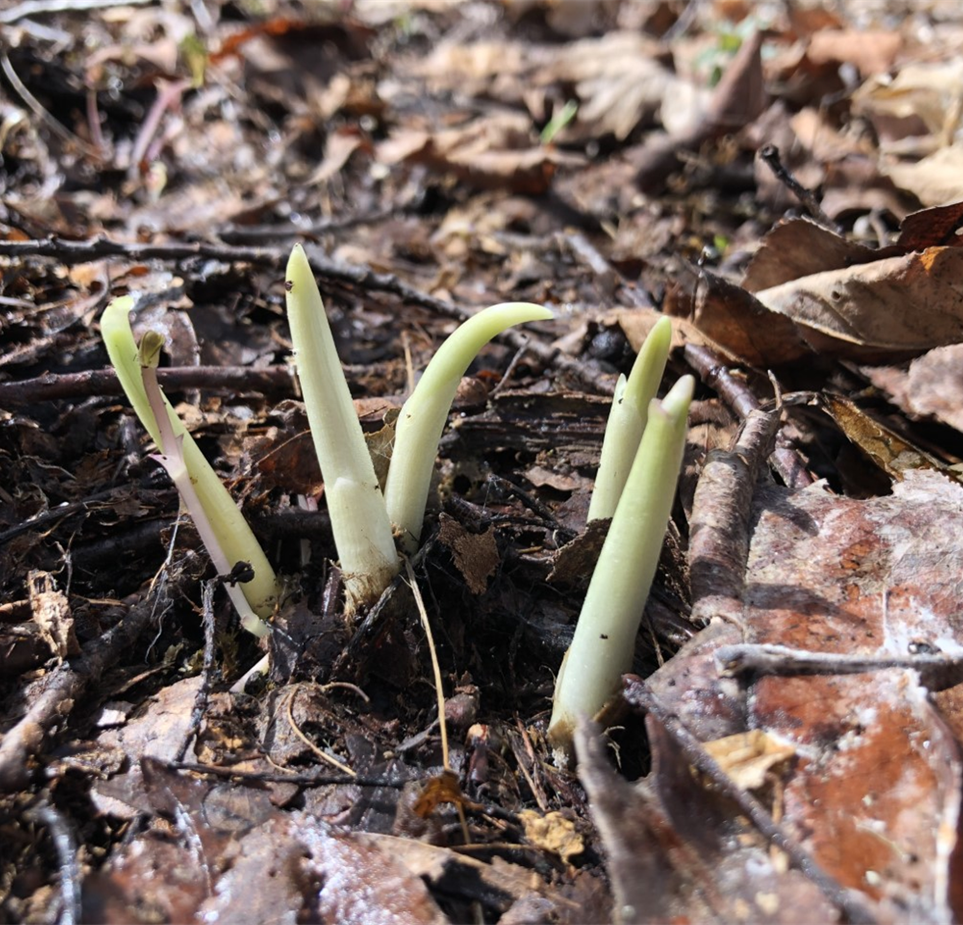
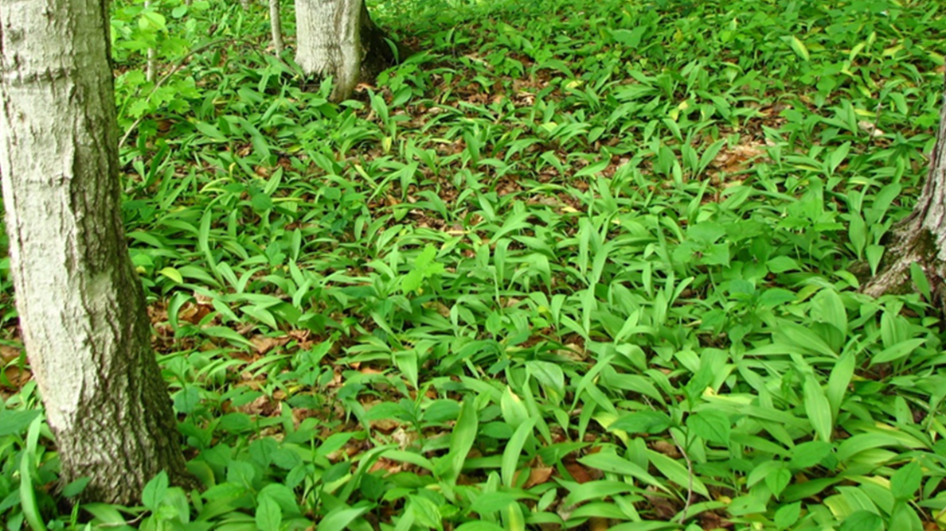
ᎤᏩᏍᏘᎭ, Wasdi, Ramps

Slide 2
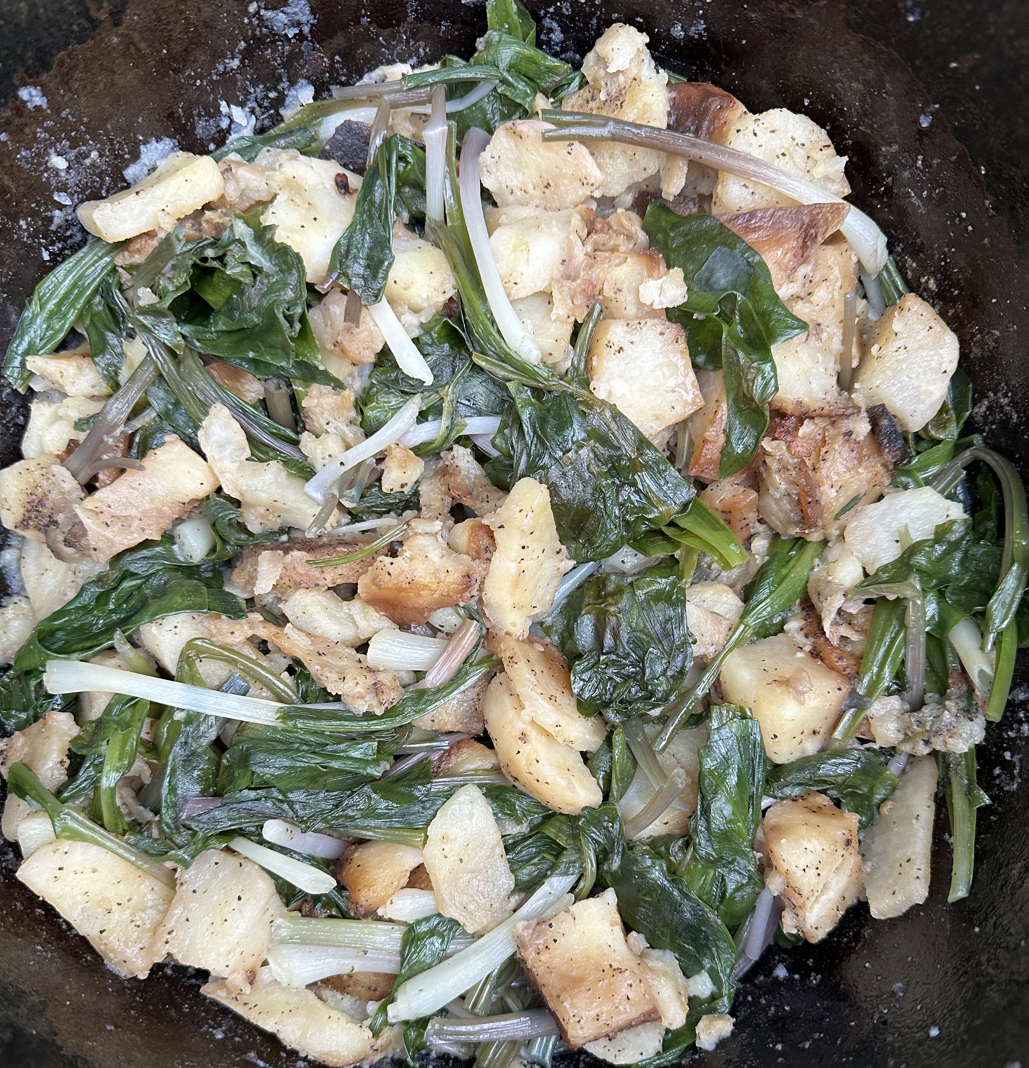
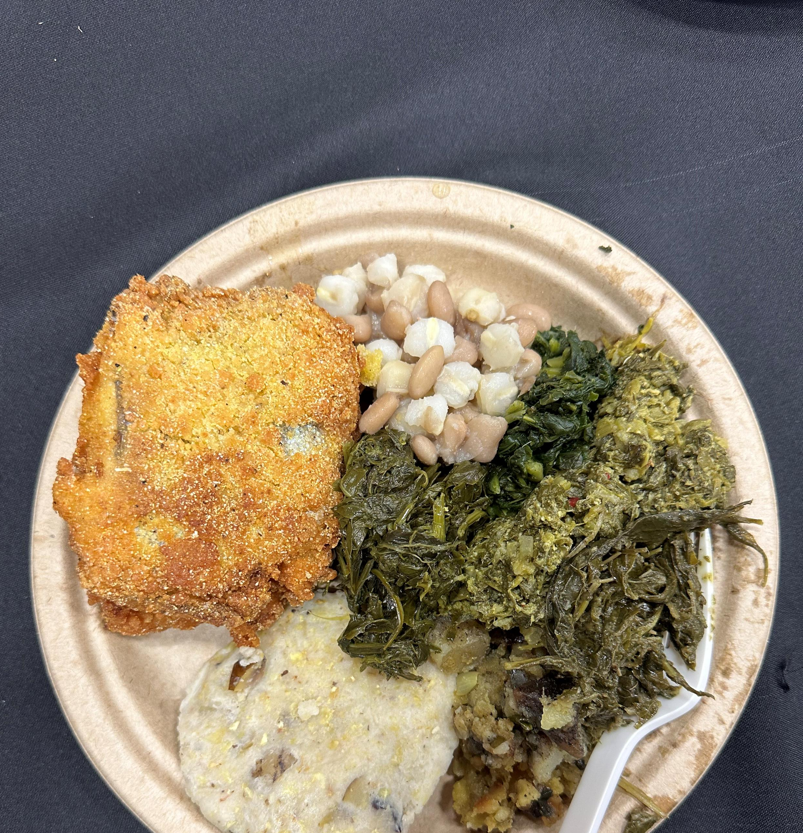

Slide 3
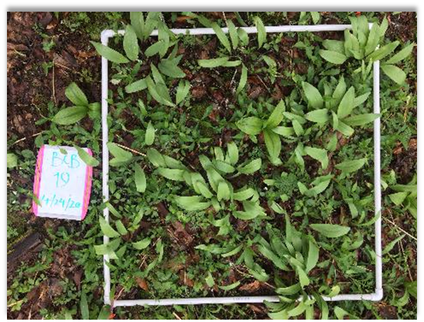
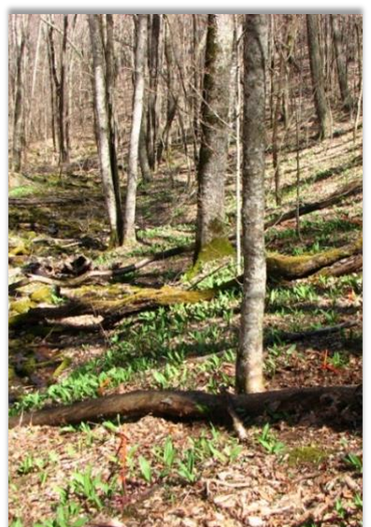
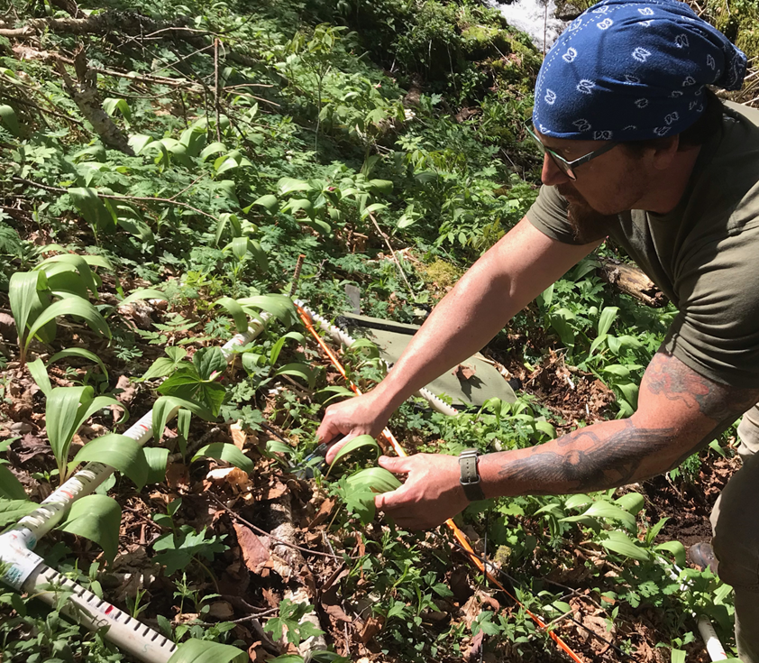
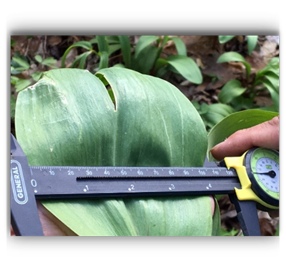
Cherokee-led harvest experiments
Centering Cherokee knowledge and harvesting practices in research
Supporting access and co-stewardship on federal lands towards food sovereignty
Exploring how the presence and harvest of wasdi influences nitrogen cycling and soil fertility
Notes:
Wasdi, or ramps, are an important spring food that Cherokee people have harvested for generations. Concerns of overharvesting by the broader public in the Appalachian region resulted in the restriction of access to traditional harvesting locations for EBCI citizens.
Previous research has been done on ramp harvesting, but it did not include Cherokee knowledge or distinct harvesting practices. The results of those studies in part led to restricted access on publicly-managed lands. To address this, EBCI, Southern Research Station and Stanford University have co-developed a series of harvest studies guided by Cherokee knowledge. The results of our work inform environmental assessments, and forest management on federal lands (NPS and USFS).

Slide 4
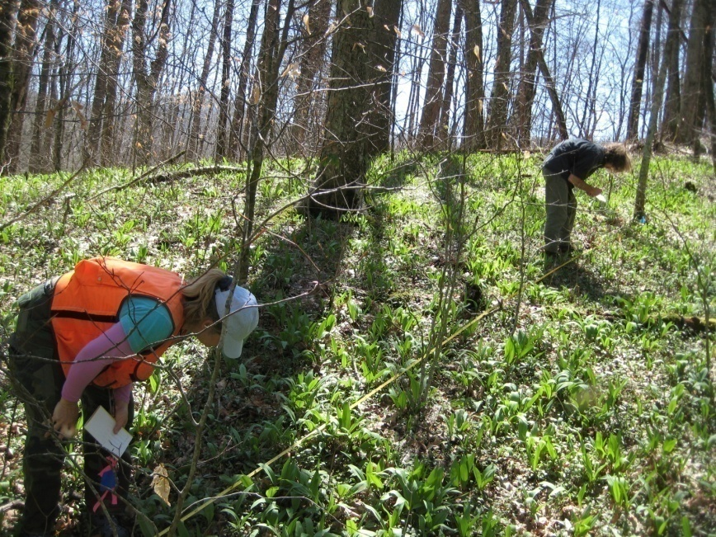
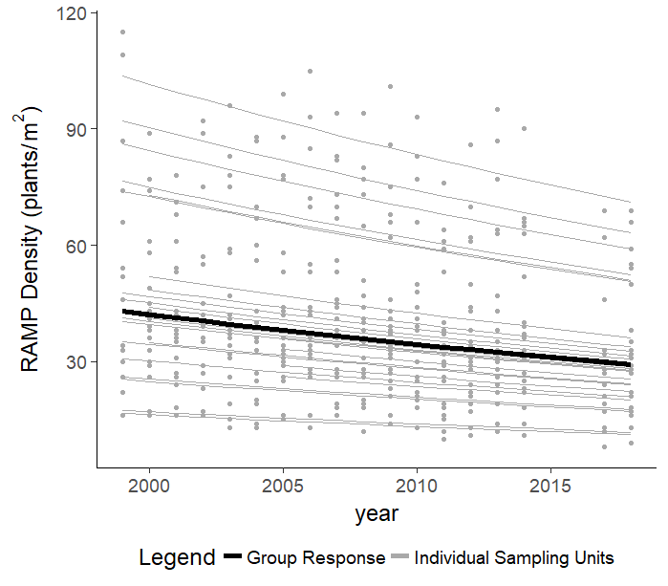
Ramps Populations and Climate in the Southern Appalachians
Established in 1999
25 populations by 2005
Elevational gradient
Harvest gradient
Significant decline through time (about 2%)

Slide 5
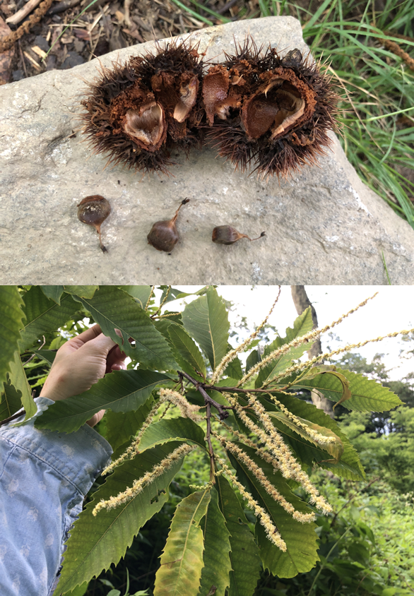
ᏘᎵ, Tilĭ, American Chestnut Restoration
The Eastern Band of Cherokee Indians is engaging with multiple partners to consider restoration of ᏘᎵ, Tilĭ΄, American chestnut, to the Qualla Boundary.
ECBI citizens may place more importance in restoring chestnut as a food source, for both humans and wildlife, as opposed to timber values.
Support community-based decision making around culturally appropriate restoration strategies
Notes:
The Eastern Band of Cherokee Indians (EBCI) is engaging with multiple partners to help restore ᏘᎵ (Tilĭ΄, American chestnut, Castanea dentata) to the Qualla Boundary. Diverse perspectives on Chestnut restoration exist within the EBCI community, especially as it pertains to genetically-modified trees, that must be taken into consideration in larger scale restoration efforts.
Food- Chestnuts are a key ingredient in chestnut bread, popular Cherokee food (currently made with Chinese chestnuts)
The USDA Forest Service is playing a role through an ORISE Fellowship which aims at enhancing understanding of the past and present relationship between the EBCI and this culturally significant tree and assisting the EBCI Natural Resources Department in their future decision making and prioritization of American chestnut restoration on Tribal and adjoining lands
Phase one of the fellowship has begun which includes relationship building and laying the groundwork for co-creation and design of research methods with Cherokee advisorsy group know as the Earth Keepers, including the best ways to approach community engagement.
PHOTOS: Reproductive American Chestnut Jaime van Leuven located on EBCI Tribal Reserve Lands. Photos by Jaime Van Leuven

Slide 6
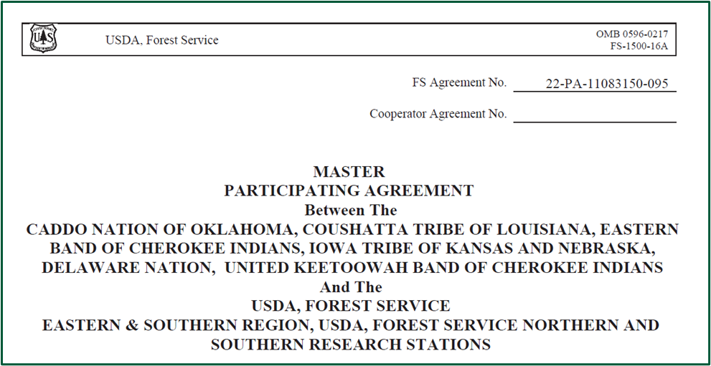
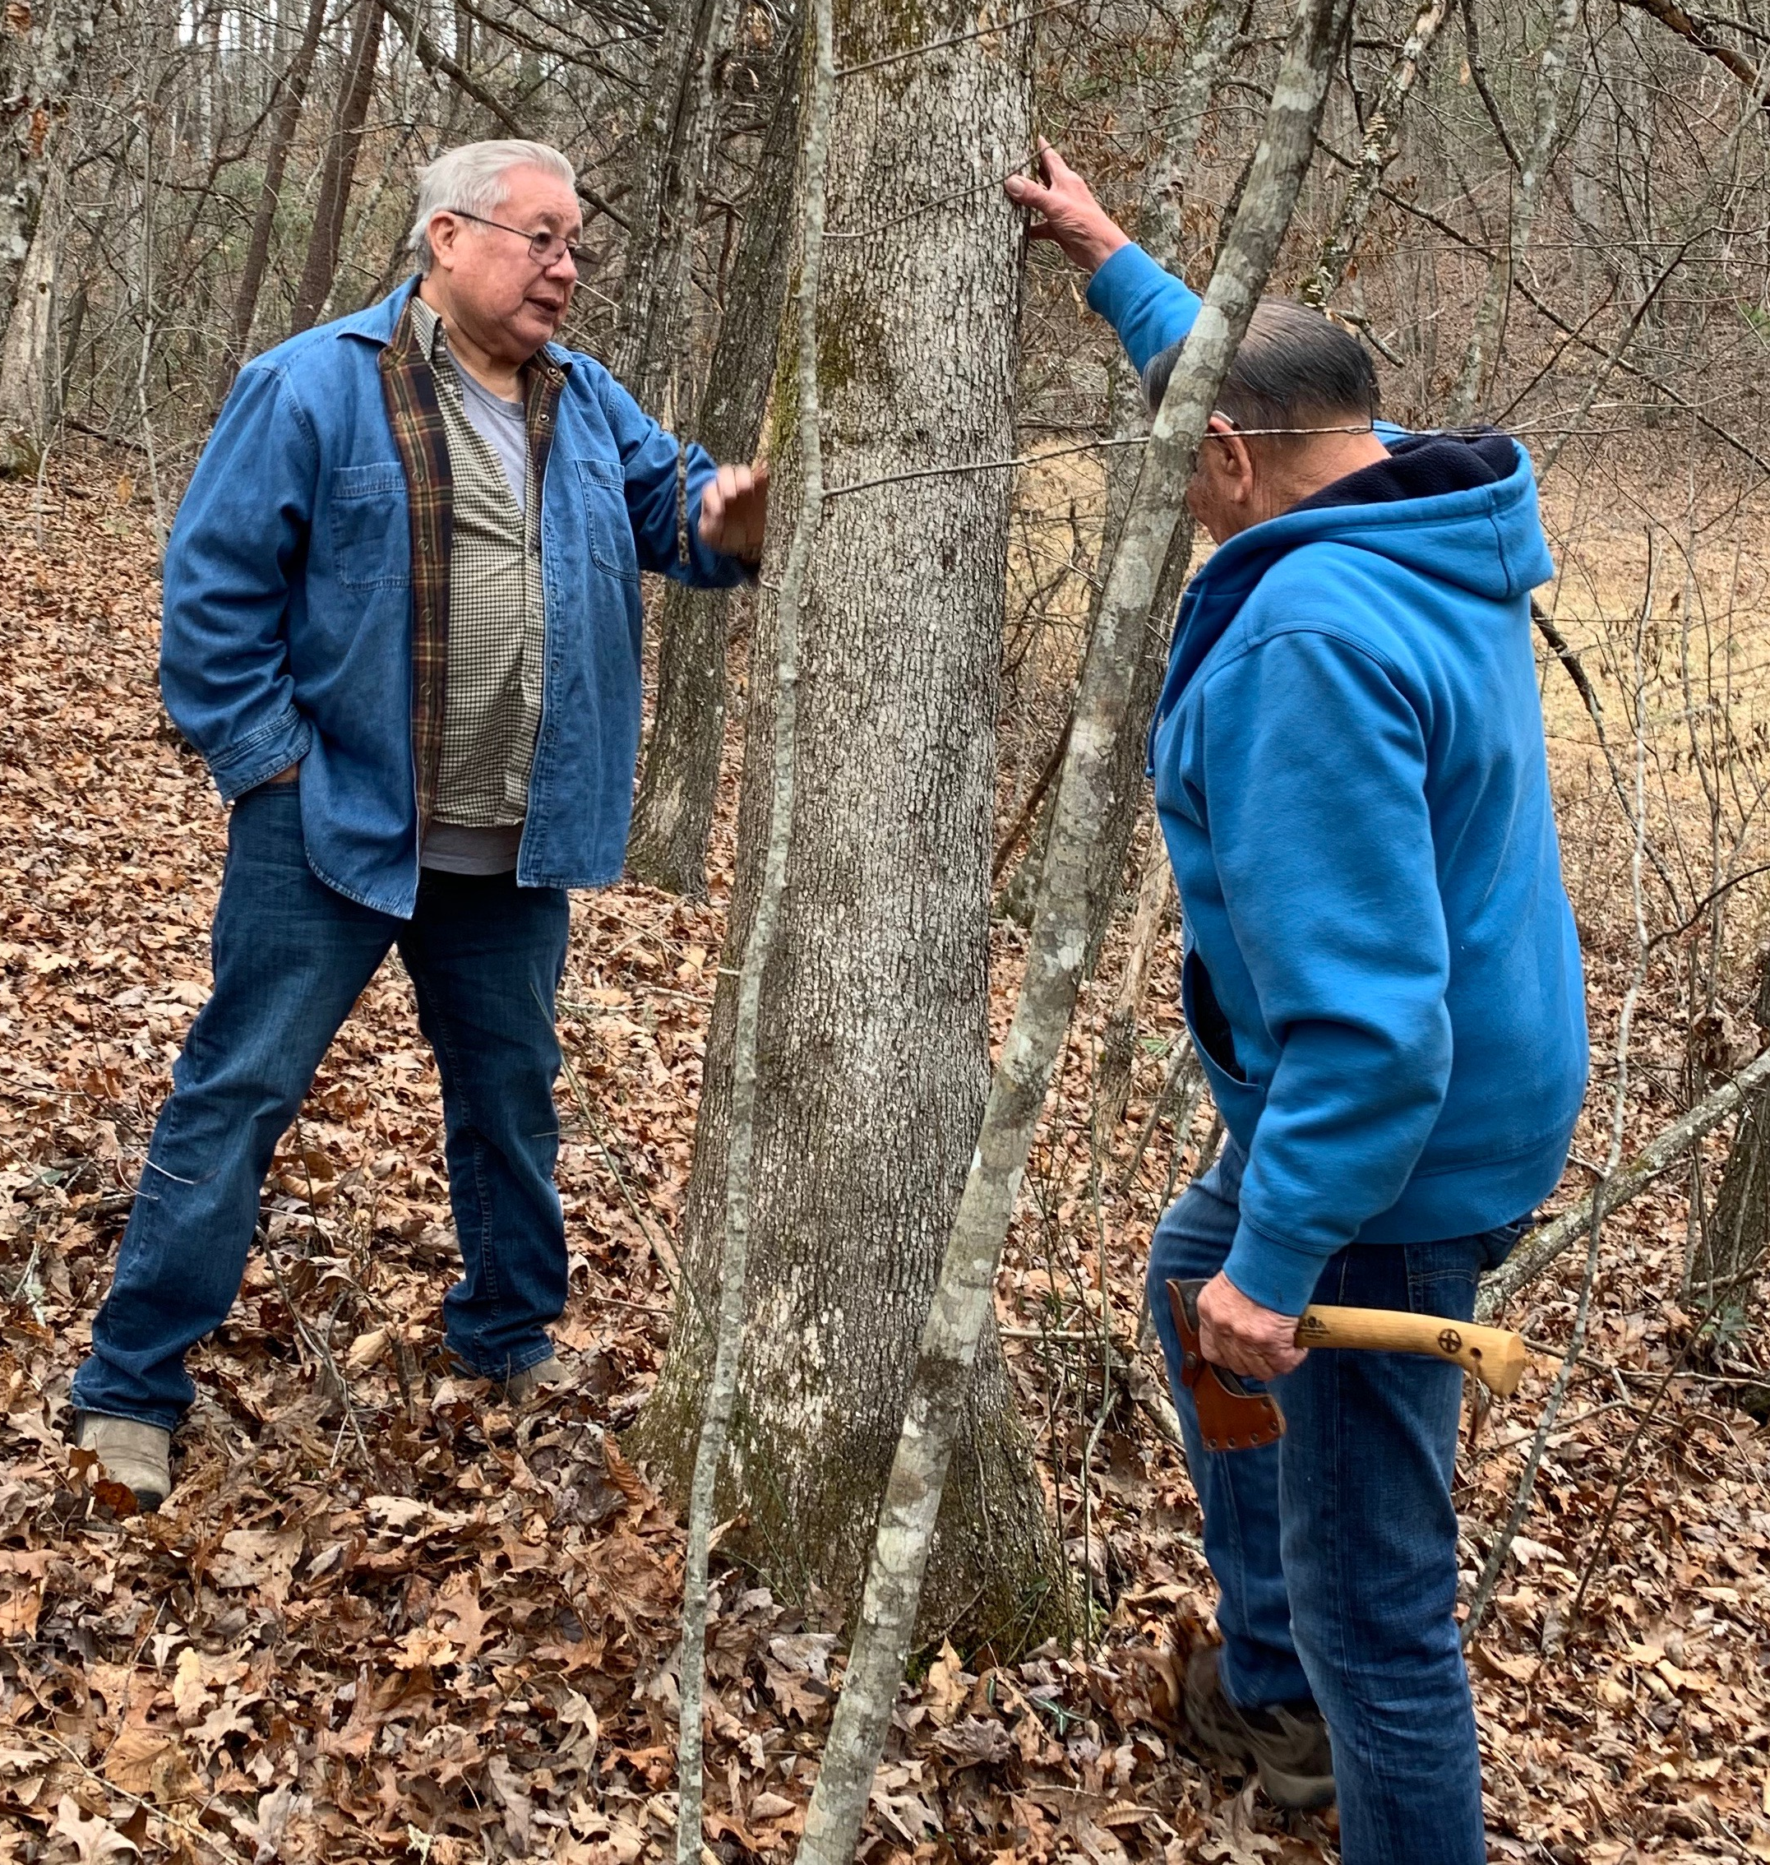
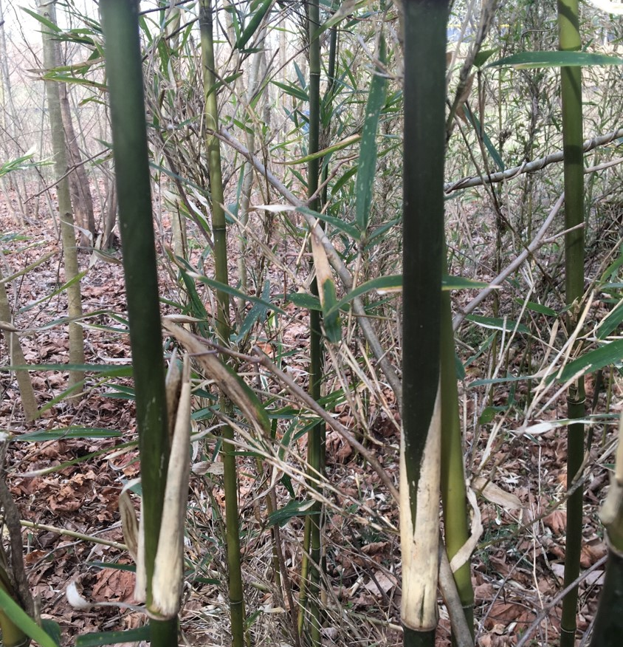
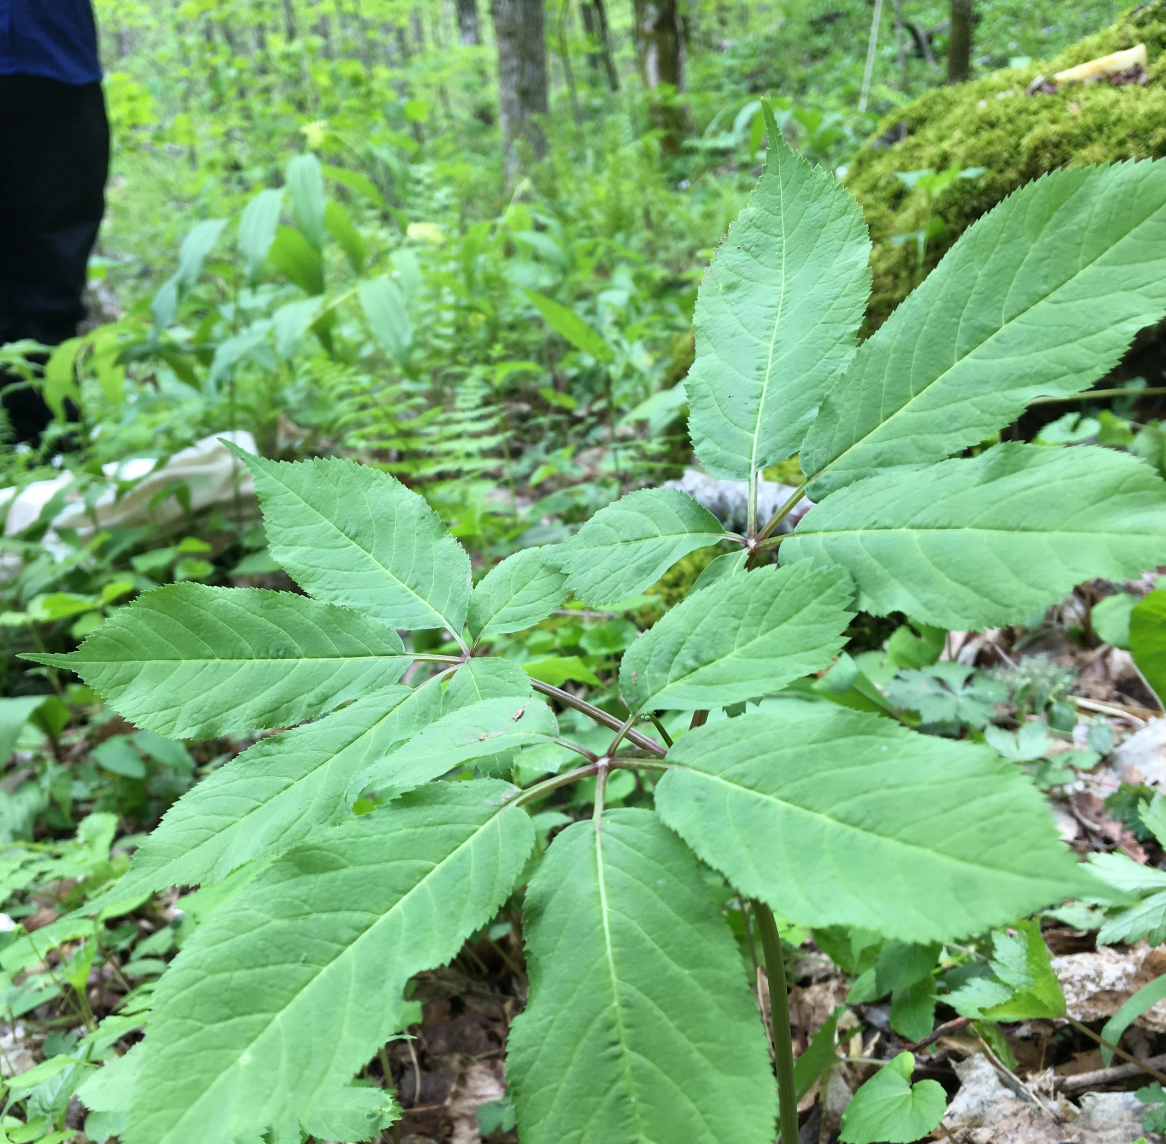

Slide 7
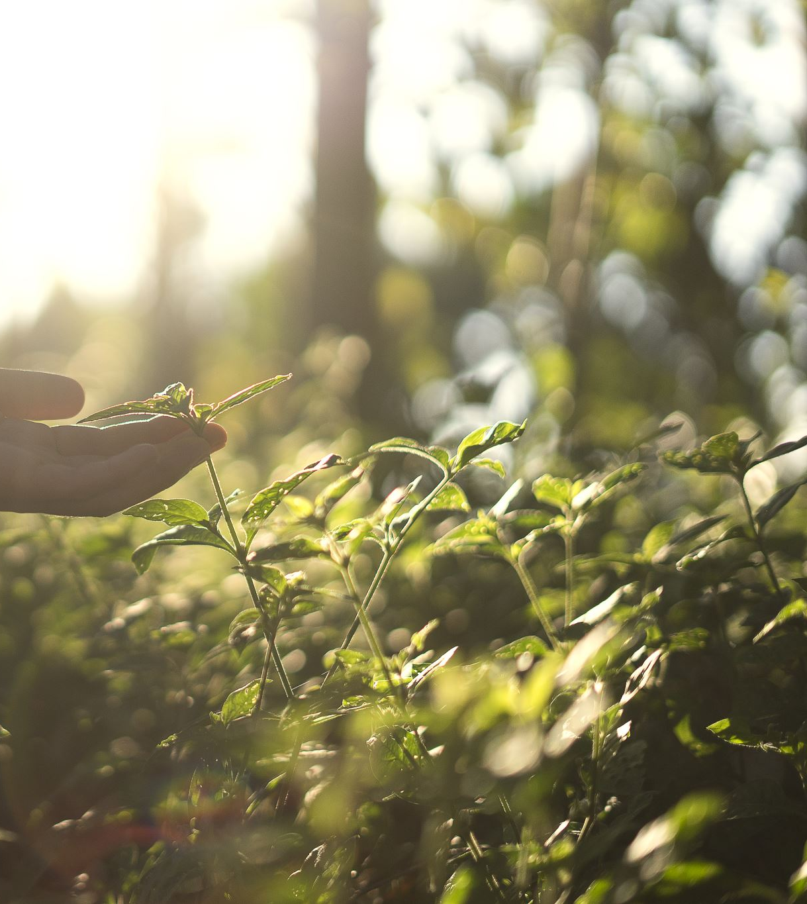
Master Participating Agreement
Forest Service Shall:
Value and respect Traditional Ecological Knowledge (TEK) of the Cooperator’s and all Indigenous people. No information will be shared, presented, or published without the explicit authorization of the Tribal Nations.
Undertake, encourage, and facilitate research that leads to sustainable management of culturally significant plants, their habitat and the products provided.
Provide research and subject matter experts on the use of culturally significant plants, including nutrition, health and wellness outcomes as well as the active management of plant communities such as sustainable harvest and prescribed fire.

