Slide 1

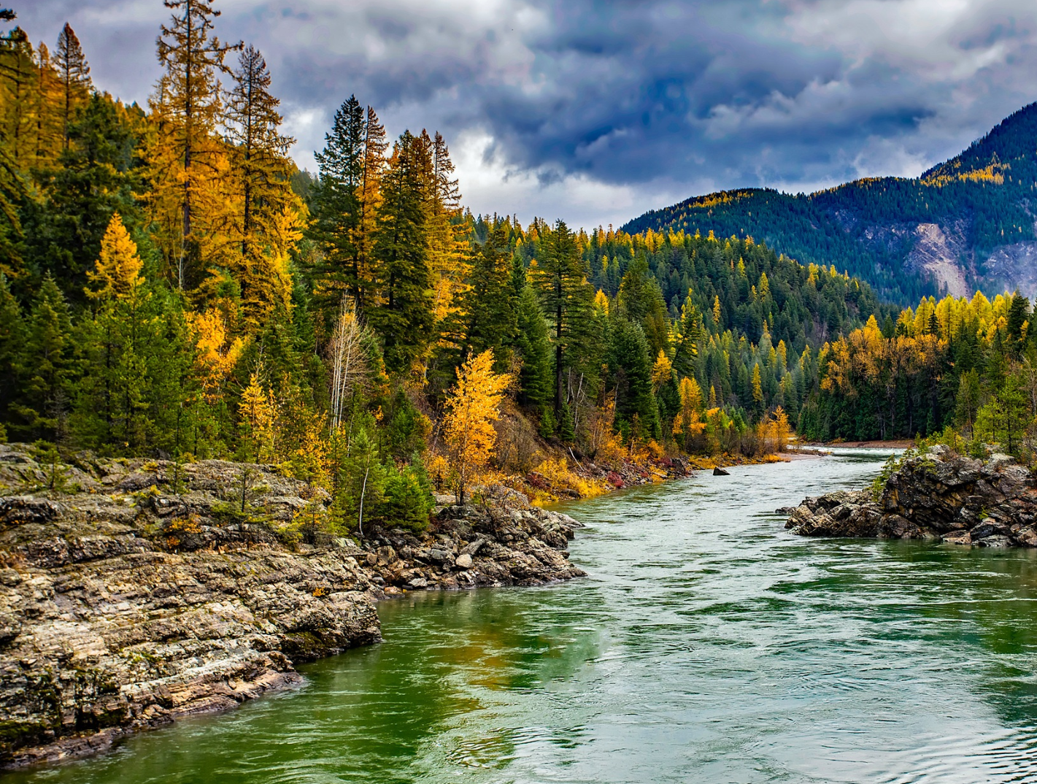

Luce Indigenous Knowledge Fellowship
2026 Stage 1 Application Q&A
Monday, April 14, 2025
2-3pm MDT
Notes:
Good afternoon and welcome to the Q&A webinar for the Stage 1 application of the Luce Indigenous Knowledge Fellowship.
First Nations is happy to announce the Luce Fellowship for a seventh year and I hope this will answer any questions you may have about the fellowship opportunity or application process to determine if it’s the right fit for you to apply. Before we jump in, I want to introduce myself - my name is Abi Whiteing. Blackfeet and I’m the Director of Native Arts Language and Knowledge. I’m joined by my colleagues Sabrina Walker, AJ Garcia and Marsha Whiting, who will be helping to support the webinar and answer questions.

Slide 2

Webinar Format
Please remain muted throughout the presentation
Please enter your questions in the chat and they will be answered in the Q&A at the end of presentation
If you are experiencing any technical difficulties, please message the host
The webinar is being recorded and will be available on our website
Thank you!
Notes:
Before we get started I want to briefly go over the webinar format. First, all attendees will be muted throughout the webinar to minimize background noise.
Second, if you have a question at any time you can type your question into the Question box. You can open the question box from the bottom on your Zoom screen by clicking on the Q&A button. We will have time in the middle and at the end of the webinar for Q&A but I welcome you to ask questions at any time during the webinar and we will get to it before the end of the webinar.
If you run into issues with audio or have a slow internet connection, you can adjust your options in the Audio Settings and call in using your phone instead of listening over your computer. You can also use the Chat option send a message to everyone in the webinar, including all attendees and panelists. For accessibility, you can enable a transcript by clicking the “Live Transcript” at the bottom of your Zoom screen.
We will share this PPT and a link to the audio with participants next week. You will get an email with the information.

Slide 3

01
Overview of Fellowship Partners
WEBINAR AGENDA
02
Fellowship Program & Experience
03
Walk-through of online application process
04
Question & Answer

Slide 4
Important Dates*
Date | Activity
April 23, 2025 | Deadline to apply for exemption to online application system. Please email grantmaking@firstnations.org to request.
April 30, 2025 | Stage 1 applications are due at 5:00 p.m. MDT.
On or before July 7, 2025 | Notifications sent regarding the status of Stage 1 applications. Up to 100 applicants will be invited to submit a Stage 2 application.
July 30, 2025 | Deadline for Stage 2 application and required attachments. Q&A webinar will be held prior to the Stage 2 deadline.
On or before September 22, 2025 | Notifications sent regarding status of Stage 2 applications. 20 candidates will be invited for in-person interviews
October 20-23, 2025 | Interviews are anticipated to occur in-person with the Advisory Committee in Albuquerque, NM. First Nations will cover all travel and accommodation expenses for semifinalists.
On or before November 14, 2025 | Candidates will be notified of final selections.
January 1, 2026– December 31, 2027 | Fellowship period for Cohort 7 fellows.
*Dates are subject to change.

Slide 5
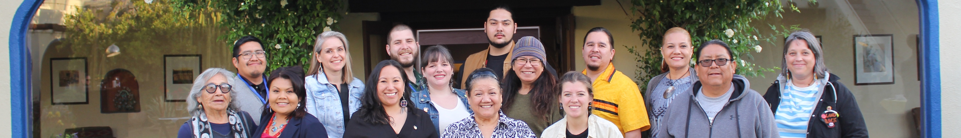
Fellowship Partners & Background
Established in 1980, First Nations Development Institute is a Native nonprofit that works to restore Native American control and culturally-compatible stewardship of assets – be they land, human potential, cultural heritage or natural resources – and to establish new assets for ensuring the long-term vitality of Native American communities.
Established in 1936, the Henry Luce Foundation is a private independent foundation that seeks to enrich public discourse by promoting innovative scholarship, cultivating new leaders, and fostering international understanding.
In 2019, First Nations Development Institute (First Nations) in partnership with the Henry Luce Foundation launched the Luce Indigenous Knowledge Fellowship to honor and support Native knowledge holders and knowledge makers as they work to further Indigenous knowledge creation, dissemination and perpetuation in Indigenous communities.
For more information about each organization please visit:
www.firstnations.org and www.hluce.org
Notes:
First Nations is a Native-led nonprofit organization founded in 1980 and based in Longmont, CO. We have satellite offices in New Mexico and California. We currently have more than 50 staff members. Our national grantmaking program began in 1993. mid-year 2022, we have successfully managed 2,702 grants totaling $54.7 million to Native American projects and organizations in 44 states, the District of Columbia, and U.S. Territory American Samoa. Our partners include tribal programs, rural and urban Native-led nonprofits and grassroots community organizations with fiscal sponsors.
I also want to acknowledge the Henry Luce Foundation, our partner in supporting and developing this innovative program. The Luce Foundation is a private independent foundation that seeks to enrich public discourse by promoting innovative scholarship, cultivating new leaders, and fostering international understanding. This is one of the first large investments targeting support of Native people and indigenous knowledge.
First Nations and the Luce launched the program with the intent to support Native knowledge holders and knowledge makers that embody exceptional creativity, progressive and critical thinking, and the potential to significantly move forward their field in ways that will ultimately lead to broad, transformative impacts for Indigenous communities.
We are honored to be a partner with the Henry Luce Foundation to support and invest in Indigenous knowledge holders and knowledge makers.

Slide 6

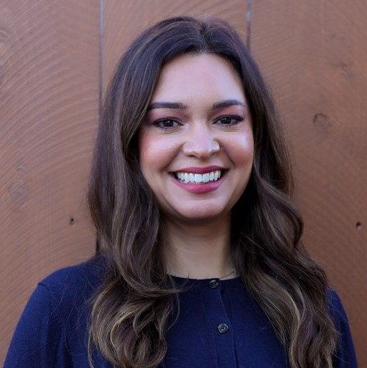
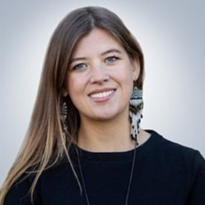
Luce Indigenous Knowledge Fellowship
Project Team
Abi Whiteing
Sabrina Walker
Blackfeet
Director of Native Arts Language and Knowledge
Tlingit
Program Officer

Slide 7
Fellowship History
This fellowship program officially launched in 2019 and the first cohort was awarded in January 2020. Due to the pandemic, the second cohort began their fellowships in May 2021 and subsequent cohorts returned to a January start date, with the sixth cohort beginning on January 1, 2025.
History to Date
March 2019: Inaugural Advisory Committee first convened.
June 2019: First application launched, receiving over 550 applicants.
January 2020: First fellow cohort began with on in-person convening and two virtual.
March 2025: All Fellow Gathering was held at Gila River Indian Community (Six Cohorts total).
Notes:
This will be the seventh cohort of the Luce fellowship, with a start date on January 1, 2026

Slide 8
Advisory Committee
First Nations and the Luce Fellowship are guided by an Indigenous Advisory Committee who provides guidance and recommendations during the fellowship selection process.
Advisory committee members are selected based on their deep experience within Indian Country, Indigenous knowledge fields and expertise, and experience as (or working with) Native knowledge holders and knowledge makers.
Similar to the fellowship cohort, the Advisory Committee also represents a diversity of tribes and knowledge areas.

Slide 9

Fellowship Purpose and Goal
The goal of the fellowship is to support exceptional leaders, knowledge holders and knowledge makers who are doing noteworthy work to advance Indigenous knowledge and knowledge systems in diverse fields.
The fellowship is intended to support individuals who are working to make broad, transformative impact and change in their diverse knowledge fields and within Indigenous communities.
More specifically, the fellowship is designed to support the growth, development, knowledge and networks of Native knowledge holders and knowledge makers. This fellowship will provide knowledge producers with the resources to match their existing knowledge, passion and drive to achieve their personal and/or community goals.
This fellowship is open to experienced leaders from a wide range of fields including, but not limited to agriculture, food systems, youth leadership development, natural resource management, climate change, economic development, journalism, language and cultural revitalization, traditional and contemporary arts.
Notes:
This fellowship intends to support Native knowledge holders and knowledge makers engaged in meaningful work that benefits Indigenous people and communities in either reservation and/or urban settings. These fellowships support the work of Native knowledge holders and knowledge makers as they significantly advance their work and spark transformative change in their communities. In this sense, community is broadly defined and can include your Native community, knowledge community, etc.
The fellowship is a two-year, self-directed enrichment program designed to support the process of growth, development, knowledge and networks of Native leaders and thinkers. This unique and exciting new fellowship will seek to support emerging and experienced leaders in a wide range of fields, including western and traditional knowledge areas.

Slide 10
Guiding Selection Criteria
KNOWLEDGE
EXPERIENCE
POTENTIAL
VISION
Candidates must be actively engaged in the creation, dissemination and/or perpetuation of Indigenous and/or Western knowledge. They must have a cultural grounding and connectedness to community.
Candidates must be engaged in relevant work that seeks to grow and advance knowledge. They must demonstrate a record of success of working and collaborating with Indigenous people and communities, and preserving and perpetuating Indigenous knowledge systems.
Candidates must demonstrate continuing promise in their field of endeavor. They must embody exceptional creativity, progressive and critical thinking, and the potential to significantly move forward their field in ways that will ultimately lead to broad, transformative impacts for Indigenous peoples.
Candidates must clearly articulate how the fellowship will support or accelerate their work. They must develop a unique plan of action that details their vision for preserving and perpetuating Indigenous knowledge in either reservation and/or urban community settings.
Notes:
The fellowship selection process is guided by 4 overarching criteria, which are knowledge, experience, potential and vision. Ideal candidates will embody these four main areas. When reviewing applications, First Nations and a team of reviewers will look for each of these criteria to be addressed. Applicants should discuss how they have are actively engaged in the creation, dissemination and/or perpetuation of knowledge, their cultural grounding and connectedness to their community, their record of success in working with and collaborating with Native communities, their creativity, progressive and critical thinking and potential to move forward their knowledge field, and their unique plan of action for preserving and perpetuating knowledge.

Slide 11
Fellowship Eligibility
Tribally-affiliated with a Native American, Alaska Native or Native Hawaiian community*
Actively engaged in the creation, dissemination and/or perpetuation of knowledge in your field
Experience or expertise within the knowledge field/area you are pursuing
At least 18 years old
U.S. citizen or permanent resident
Applicants may self-apply or individuals may nominate others for the fellowship.
Notes:
*tribally-affiliated does not mean enrolled and descendants are welcome to apply. We do not require proof of affiliation in the application and rely on your honest self-identification. Applicants from Native communities in U.S. territories are also welcome to apply.
I’ll talk more about nominations on the next slide.

Slide 12
Nominations
Nominators will use the same online application form as those who self-apply.
Nominators should work collaboratively with the individual they are nominating.
Nominees must fill out a Consent Form indicating they have granted permission for the application to be submitted and that they agree to the terms of the fellowship program.
Consent Form must be attached to the submitted application to be considered complete.
This form is available on the RFP page and within the online application in the Attachments Tab.
Notes:
We understand that some Indigenous people may not identify themselves as knowledge holders, knowledge makers, culture producers, etc. Since this may be contrary to community beliefs on ownership of knowledge and recognizing leaders.
So individuals can nominate their family, friends, neighbors or colleagues for this fellowship opportunity. To do this, a nominator must work collaboratively with the individual they wish to nominate to complete all application materials. Before applying on behalf of another individual, you must contact the nominee in advance to fully discuss the parameters and guidelines of the fellowship.
The nominee will need to sign a Consent Form that is available when you log into the online system (or on our fellowship website under eligibility) . This form just indicates that the individual has agreed to work with the nominator to complete the application, and that they have read and agrees to the fellowship terms.

Slide 13
Fellowship Experience
The fellowship period is January 1, 2026 to December 31, 2027.
The $75,000 award is released in several installments throughout the fellowship period.
FELLOWSHIP AWARD
FELLOW WORK
Fellows will work in their respective knowledge fields and communities toward their overarching vision and goals.
In person convenings will be held and designed in collaboration with fellows during the course of the fellowship with the intent to create a collaborative cohort of connected Indigenous knowledge holders to advance Indigenous knowledge and knowledge systems for community benefit.
COHORT GATHERINGS
Fellows have access to $5,000 in additional support for resources or professional development to grow their capacity as knowledge holders and knowledge makers.
ADDITIONAL SUPPORT

Slide 14
Use of Fellowship Funds
The goal of this fellowship is to provide flexible funding. It is intended to allow emerging and experienced knowledge holders and knowledge makers to determine their own goals, and decide how their funds are best used to make a positive impact in their communities.
Applicants do not have to design or complete a project to be eligible or selected.
Generally, the fellowship may be used for a wide range of costs including: living expenses, tuition, conference registration, equipment, travel and childcare, etc.
The fellowship itself cannot be redirected to another person or organization. You can still use funds to support use of consultants and honoraria to elders, etc.
The fellowship funds are considered taxable income. Fellowship recipients are responsible for all related taxes resulting from this award.
Notes:
The goal of this fellowship is to provide flexible funding to selected fellows as they seek to create or disseminate knowledge in their respective field. It is intended to allow emerging and experienced knowledge holders and knowledge makers to determine their own goals, and decide how their funds are best used to make a positive impact in their communities. Generally the fellowship can be used for a wide range of costs. However, the fellowship cannot be redirected to another person or organization. The fellowship is considered taxable income.

Slide 15
Application Process
First Nations typically uses a two-stage process when a high volume of applications are anticipated. The Stage 1 form consists of an abbreviated application form. The Stage 2 application allows for a full proposal.
Stage 1 Application Form – Due Thursday, April 30 at 5:00 p.m. MDT
Consists of: 1) Applicant contact information, 2) Two brief essays, and 3) Resume/CV/Biographical Sketch
Additional information required for nominations: Nominator’s contact info, Consent Form
Stage 2 Application Form – approximately 100 applicants will be invited to submit a full proposal in early July
Consists of: 1) Expansion on Stage 1 essays, 2) Use of funds statement, 3) Acknowledgement of required convenings and potential date conflicts, 4) Three letters of reference, 5) One photo, and 6) Up to three additional supporting documents
20 candidates will be selected from the Stage 2 applicant pool for interviews with the Advisory Committee. After interviews, 10 fellows will be selected for the 2026 fellowship cohort.
Notes:
The goal of this fellowship is to provide flexible funding to selected fellows as they seek to create or disseminate knowledge in their respective field. It is intended to allow emerging and experienced knowledge holders and knowledge makers to determine their own goals, and decide how their funds are best used to make a positive impact in their communities. Generally the fellowship can be used for a wide range of costs. However, the fellowship cannot be redirected to another person or organization. The fellowship is considered taxable income.

Slide 16
Stage 1 Application – Pages 1 & 2
Contact Information & Knowledge Area
Contact and demographic information for the applicant and nominator (if applicable) and primary knowledge area.
Statement of Community Impact:
In 500 words (3,000 characters) or less, please share more about your personal and/or professional work as it relates to your knowledge field and Indigenous communities. Please make sure to address how you have been actively engaged in the creation, dissemination and/or perpetuation of your knowledge area and how your work supports Indigenous peoples and communities.
Vision for Fellowship Period:
In 500 words (3,000 characters) or less, please describe the personal and/or professional goals you hope to achieve during the fellowship. Please make sure to address any plans for creating, disseminating, and/or perpetuating knowledge within your community or to Indigenous peoples at large. Please include clear and specific goals for how the fellowship will support your work to advance your leadership or further contributions to your community and/or knowledge field.
Notes:
Ask for all your demographic and contact information. In the application, applicants will be asked to respond to two short essays. These statements are designed to yield more insight about applicants’ community knowledge, experience, potential and vision. In addition to aiding with the selection process, these essays are intended to help applicants expand on their personal and professional background and share their vision for the fellowship year.
Note: You do not need to design or complete a project to be eligible or selected. But you should have clear and specific goals in mind for how the fellowship will support or advance your work.
For example: You’re already doing this work in the community and your aim is to continue that work. But this fellowship will help you reach a larger audience, partner with another group, etc. How will this fellowship help further your work?

Slide 17
Stage 1 Application – Page 3
Resume/CV/Biographical Sketch:
All applicants must submit a detailed, up-to-date resume, CV or biographical sketch that summarizes their background in their knowledge field(s) and experience working with Indigenous people and communities in either reservation and/or urban settings.
Consent Form (Required for Nominations):
Nominators submitting applications on behalf of another individual must upload a signed consent form from the nominee. This form indicates that the nominee consents to working with the nominator to complete the fellowship application. It also indicates that the nominee has reviewed and agreed to the terms of the fellowship.
Notes:
Attachments must be uploaded as PDF files.

Slide 18
Online Application System
All applicants must complete the Stage 1 application, including submission of all necessary attachments, no later than Thursday, April 30, 2025 at 5:00 p.m. Mountain Daylight Time.
Should you encounter any technical issues please contact grantmaking@firstnations.org ASAP and prior to the deadline.
Please allow for up to 4 business days for Grantmaking to respond to support requests.
To access the online application system, you must go to First Nations’ website and go to the online RFP page for this opportunity: https://www.firstnations.org/rfps/luce-indigenous-knowledge-fellowship-2025/
Notes:
Online application system walk-through

Slide 19
Online Application System
Some of our most rural and remote applicants may have limited access to high-speed Internet. Any exceptions to use of the online system must be made on or before April 23 in advance of the deadline by submitting an email request to grantmaking@firstnations.org.
Please include your name, contact information, and indicate you are applying for the fellowship program. If you do not have access to email you can call our office at (303) 774-7836 and ask to speak with a member of the Grantmaking Department.
Notes:
Applications submitted outside of the online system take extra processing time and may cause delays in the selection process.

Slide 20

Contact Information
Program Questions
Technical Support
Email: NALK@firstnations.org
Phone: (303)-774-7836
Ask for the NALK team
Email: grantmaking@firstnations.org
Phone: (303) 774-7836
Ask for the Grantmaking team
For more information about the Fellowship program and history,
please see the fellowship project page at: https://www.firstnations.org/projects/native-intellectual-leadership-fellowship-program/

Slide 21
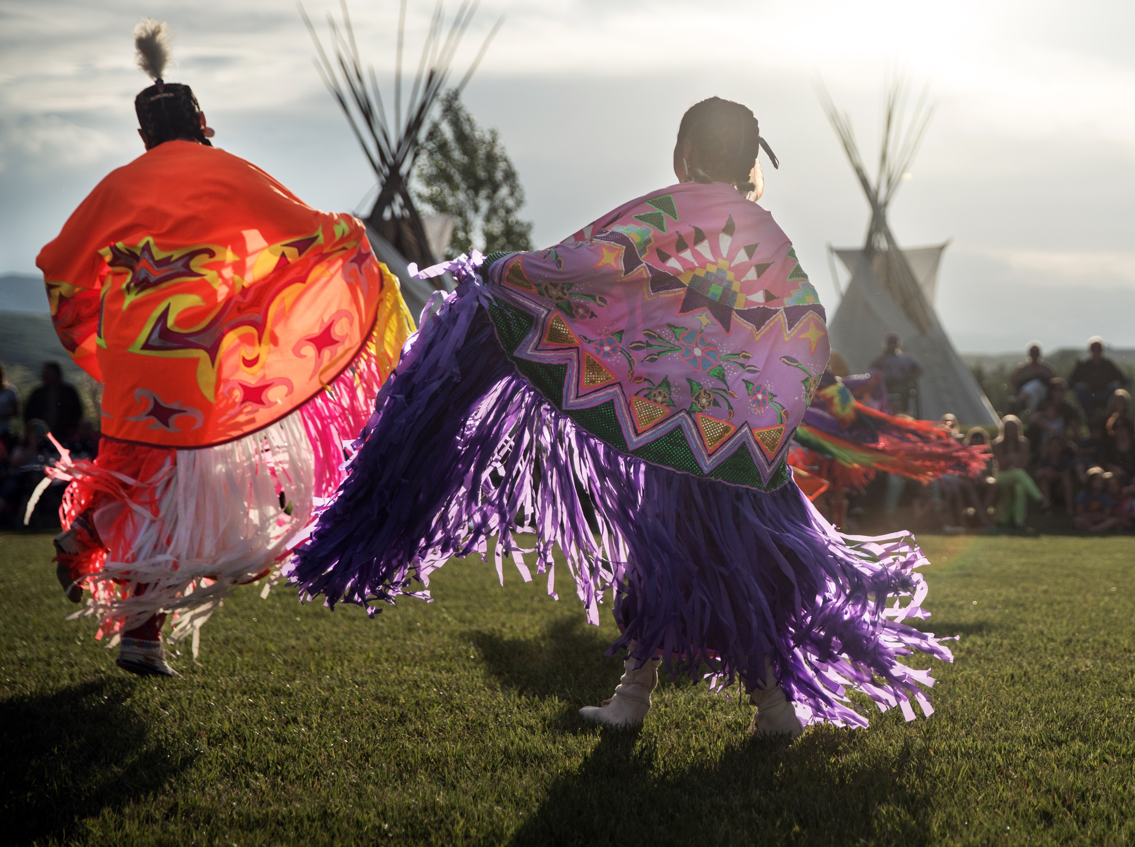






QUESTIONS?
NATIONAL HEADQUARTERS
First Nations Development Institute 2432 Main Street
Longmont, CO 80501
CONTACT
Tel: 303.774.7836
Fax: 303.774.7841 info@firstnations.org
CONNECT
firstnations.org
fndi303
First Nations Development Institute
FirstNationsDevelopmentInstitute
@FNDI303

