Slide 1

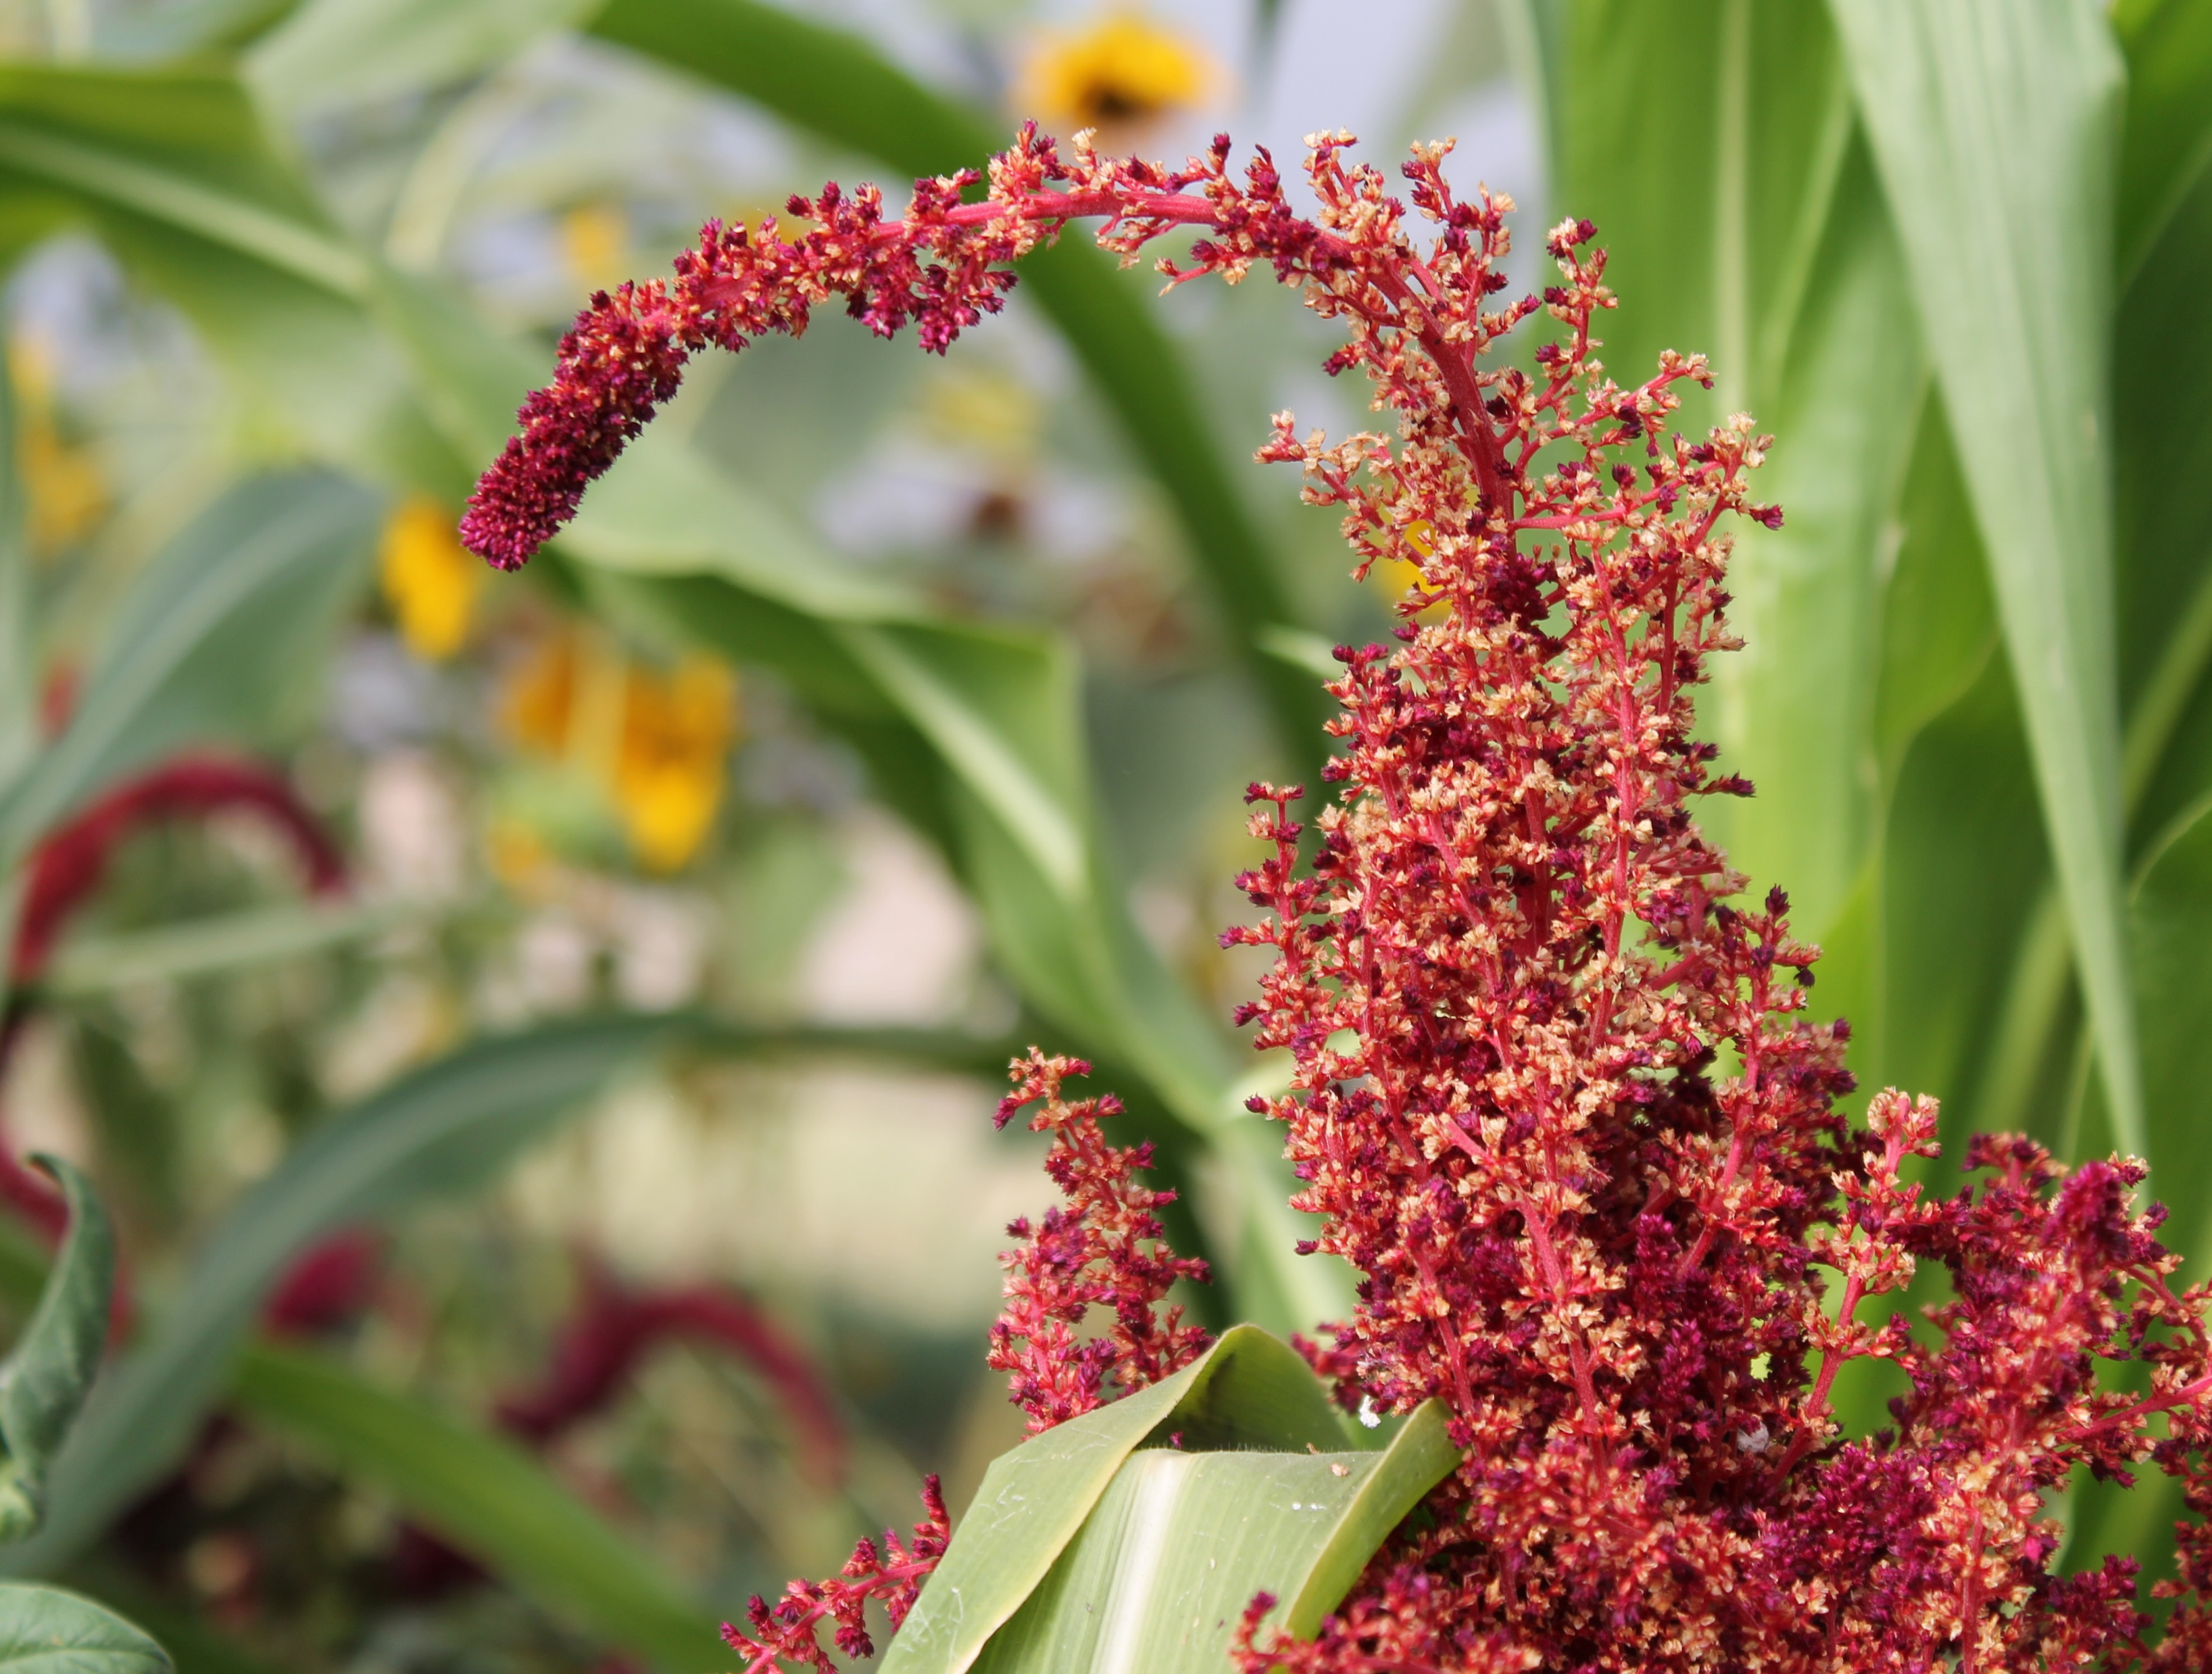

STEWARDING NATIVE LANDS PRESENTS
CONSERVATION EASEMENTS AND THE TRIBAL FEE-TO-TRUST PROCESS
June 23, 2026

Slide 2

WEBINAR MANAGEMENT
If you have questions, please type them in the question box.
They will be addressed during the Questions section.
All attendees will be muted throughout this webinar.
This webinar is being recorded.

Slide 3
First Nations’ mission is to uplift and sustain the lifeways and economies of Native communities through advocacy, financial support, and knowledge sharing.

Slide 4

OUR STRATEGIES
DIRECT FINANCIAL SUPPORT THROUGH GRANTMAKING
TECHNICAL ASSISTANCE & TRAINING
CONVENINGS & WEBINARS
RESEARCH ON BEST PRACTICES & MODELS
COALITION BUILDING & FELLOWSHIPS
ADVOCACY

Slide 5
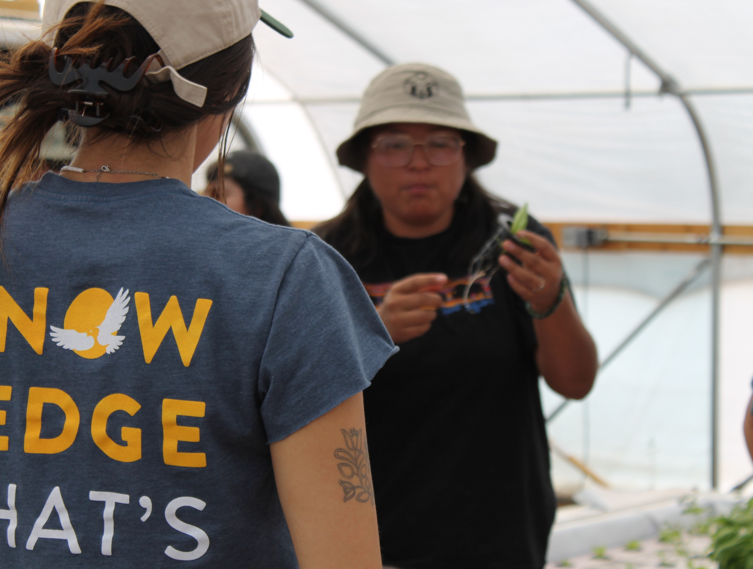

MISSION
The mission of the Stewarding Native Lands program is to invest in and center Native peoples in the stewardship of their lands for a generous future.

Slide 6






STRATEGIC FOCUSES
Climate
Addressing ongoing and anticipated impacts of climate change to preserve lands and cultural lifeways.
Community Pathways
Upholding traditional knowledge systems.
Environmental Sovereignty and Justice
Protecting communities and lands from harmful practices, projects, and policies.
Woven Lands
Creating new models, investments, and other tools to secure and expand Native ownership and stewardship over tribal homelands.
Stewardship
Sustainably managing and restoring lands for our communities and future generations.

Slide 7

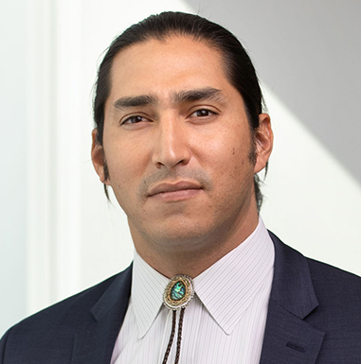

PRESENTERS
CURTIS BERKEY
BERKEY WILLIAMS, LLP
COREY HINTON
DRUMMOND WOODSUM
THOMAS LINZEY
CENTER FOR DEMOCRATIC AND ENVIRONMENTAL RIGHTS

Slide 8
Tribal Land Conservation and the Federal Fee-to-Trust Process
Curtis G. Berkey
Berkey Williams LLP
3750 Lakeshore Avenue
Oakland CA 94610
(510) 548-7070
cberkey@berkeywilliams.com

Slide 9
1. What are the Options for Tribes to Protect Conservation Values on the Land They Own?
A. Legal Encumbrances
i. Conservation Easement:
An easement agreement that restricts the owner’s use to activities that do not impair the conservation values, such as cultural places and landscapes, wildlife habitat, open space and natural landscapes.
Can be held by Indian tribes (most states), federal or state agencies or nonprofit land trusts.
“Runs with the land”.
ii. Restrictive Covenants in Deed:
A provision in a deed that limits the owner’s use of the property.
May or may not run with the land.
iii. Irrevocable Offer to Dedicate:
Public agency may require this agreement with an Indian tribe when public funds are used to purchase land with significant conservations values that the tribe is required to protect.
The tribe agrees to certain use restrictions to protect conservation values.
If the agreement is violated, the public agency “accepts” the offer. Upon acceptance of the Offer, the public agency is automatically granted fee title to the land.

Slide 10
1. What are the Options for Tribes to Protect Conservation Values on the Land They Own?
B. Rights of Nature Easements
i. Rights of Nature / Kapu & Kānāwai:
Recognizes that ecosystems and species have legal rights that can be enforced in tribal and other courts.
Some landowners have used conservation easements to recognize the legal rights of ecosystems and species on their land.
Such rights can be enforced by the landowner and the easement holder against violators.
ii. Tribal Laws and Ordinances
Rights of Nature laws have been adopted by at least 10 tribes. Three such ordinances are legally enforceable.

Slide 11
2. Why Would an Indian Tribe Wish to Transfer its Land to the United States to be Held in Trust on its Behalf?
a. The land becomes “Indian Country” for federal and state jurisdictional purposes.
b. Specifically, trust status means:
i. Various tax exemptions apply to the land (for example, state/local tax property tax exemptions, state income tax exemptions for tribal members working on tribal lands, etc.).
ii. Primacy of federal and tribal governmental jurisdiction over the land in the areas of law enforcement/public safety, environmental regulation, land use and business regulation, among others.
iii. Non-applicability of state law to tribal government and tribal member activity on trust lands (limited applicability of state law to non-tribal members).
iv. Increased eligibility for federal funding programs located on tribal lands in the areas of health area, roads/transportation, environmental quality, public safety, and others.
v. Trust lands may not be sold or transferred without federal approval.

Slide 12
3. What Steps Does the BIA Follow to Take Land Into Trust? (25 C.F.R Part 151)
a. There are 16 steps the BIA will follow:
STEP 1 Review of Written Request or Application
i. Federally recognized Indian Tribe
ii. Under federal jurisdiction in 1934, year of IRA
STEP 2 Encode Fee-to-Trust System of Record
STEP 3 Respond to Incomplete Request/Application
STEP 4 Site Visit and Certificate of Inspection & Possession (CIP)
STEP 5 Preparing Preliminary Title Opinion (PTO)
STEP 6 Preparing Notice of Application (NOA)
STEP 7 Environmental Compliance Review
STEP 8 Comments to Notice of Application
STEP 9 Clearance of PTO objections before Notice of Decision (NOD)
STEP 10 Prepare Analysis & Notice of Decision (NOD)
STEP 11 Preparing the Publication Notice Steps Continued
STEP 12 Preparing Final CIP
STEP 13 Acceptance of Conveyance
STEP 14 Final Title Opinion and Recordation
STEP 15 Recording at Land Titles and Records Office
STEP 16 Completed Application Packet

Slide 13
3. What Steps Does the BIA Follow to Take Land Into Trust? (25 C.F.R Part 151)
b. In making the decision, the BIA will give “great weight” to 8 factors:
i. Establishing a tribal land base or protecting tribal homelands.
ii. Protecting sacred sites or cultural resources and practices.
iii. Establishing or maintaining conservation or environmental mitigation areas.
iv. Consolidating land ownership.
v. Reducing checkerboarding.
vi. Acquiring land lost through allotment.
vii. Protecting treaty or subsistence rights.
viii. Facilitating tribal self-determination, economic development or Indian housing.

Slide 14
4. What are the Requirements for the Bureau of Indians Affairs to Accept Land into Trust that is Subject to Conservation Use Restrictions?
a. This question will come up no later than Step 5, when the DOI Solicitor’s Office examines the title to the property to determine whether there are encumbrances in place. However, discussions about this issue should begin shortly after the application is submitted.
b. A conservation easement, deed restriction, or other restriction on use for conservation purposes will be treated as an encumbrance on the title to the land.
c. Because these are encumbrances, the BIA and its lawyers will primarily ask two questions:
i. Does the encumbrance interfere with the intended use of the land by the Tribe?
Are there land use plans, tribal council resolutions or land management plans that would impede the ability of the tribe to use the land for the conservation purposes set out in the use restrictions? For example, for a conservation easement that protects buffalo habitat, does the tribe have a management plan that requires use of that land for an inconsistent purpose, such as cattle grazing?
ii. Does the encumbrance make the title to the land “unmarketable”?
This question is whether the conservation encumbrances would make it less likely that a hypothetical buyer would be willing to purchase the land. A use restriction that narrows the class of potential buyers would generally not make the title unmarketable. Rather, unmarketable titles would involve, for example, unpaid mortgages or taxes, breaks in the chain of title due to
missing or defection deeds, boundary disputes, and errors in recorded documents.

Slide 15
5. Can a Federally Recognized Indian Tribe and its Conservation Partner be Assured that the Conservation Restrictions May Be Enforced Following Transfer of the Land to the United States in Trust?
a. Those assurances cannot be given with 100% certainty as a matter of federal law.
b. Federally recognized Indian tribes can make enforceable land use legal commitments under tribal law, which typically require a limited waiver of sovereign immunity.
c. Conservation restrictions that are enforceable against an Indian tribe are unlikely to be disturbed by the United States.
d. The question is whether such use restrictions can be enforced against the United States upon the transfer of title to be held by the United States in trust on behalf of the original tribal owner.
e. As with sovereign Indian tribes, the United States is immune from lawsuits to enforce conservation restrictions or land use commitments unless that immunity is voluntarily waived.

Slide 16
6. What Options May Help Ensure Enforcement of Conservation Commitments?
i. Tribal Council Resolution affirming intention to comply with conservation restrictions as beneficial landowner.
ii. Indemnification Provisions in a Conservation Easement.
Indemnification is the agreement of one party to accept liability for the actions of another party. It means to “make whole.”
Here, an Indian tribe could accept responsibility for compensating the United States or seeking to remedy violations of the conservation encumbrance on land the United States holds in trust.

Slide 17
6. What Options May Help Ensure Enforcement of Conservation Commitments?
iii. Provisions in conservation easement committing the Tribe and Grantee of Easement to negotiate similar provisions in an agreement with the United States.
Sample:
The Real Property may be transferred to an agency of the United States to be held in federal trust for the Tribe if the [insert entity] and the Tribe execute and record an agreement that provides substantially for all of the following:
1) The Real Property shall be held and used, consistent with [conservation protections/use restrictions/etc.] and shall be administered in accordance with applicable federal law.
2) The Real Property shall be held, used, occupied, sold, leased, and conveyed subject to the rights and obligations contained in the agreement, which shall be covenants running with the land that are binding on and inure to the benefit and burden of the parties.
3) Any subsequent transfer of the Real Property shall be subject to the written approval of the [insert entity], which shall not be unreasonably withheld.
iv. Does the possibility that violates of conservation use restrictions in a conservation easement on trust land might expose the United States to liability for breach of trust give Tribes and conservation organizations leverage to prevent federal violations of the conservation easement?

Slide 18
7. How Can an Indian Tribe Protect Conservation Values on Land Already Held by the United States in Trust?
a. Conceptually, either the United States as fee owner, or an Indian tribe as beneficial owner under the trust may granting a conservation easement on trust land to protect conservation values.
b. Conservations easement are “encumbrances” on land that require approval by the Bureau of Indian Affairs under 25 U.S.C. § 81.
c. BIA does not have special regulations applicable to conservation easements on trust land so the standards for approval are uncertain.
d. The BIA will likely require provisions to allow for enforcement, which typically means the Tribe as beneficial owner of the land will have to consider a waiver of its sovereign immunity.
e. If the United States refuses to waive it sovereign immunity for enforcement purposes, it is likely that the potential conservation easement holder would not accept that responsibility.

Slide 19
QUESTIONS

Slide 20




COMMUNICATIONS
ACCESS THE WEBINAR RECORDING AND RESOURCES IN FIRST NATIONS KNOWLEDGE CENTER
FOLLOW US ON SOCIAL MEDIA
fndi303
First Nations Development Institute
FirstNationsDevelopmentInstitute
@FNDI303

Slide 21
CONTACT
Toli Tate
ntate@firstnations.org

Slide 22



THANK YOU
NATIONAL HEADQUARTERS
First Nations Development Institute 2432 Main Street
Longmont, CO 80501
CONTACT
Tel: 303.774.7836
Fax: 303.774.7841 info@firstnations.org
CONNECT
firstnations.org
fndi303
First Nations Development Institute
FirstNationsDevelopmentInstitute
@FNDI303

