Slide 1

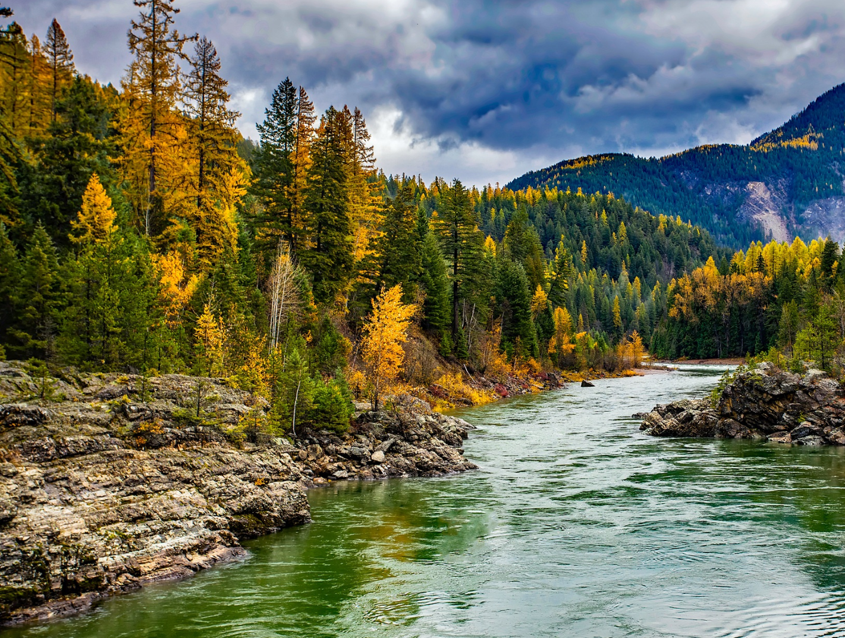

STEWARDING NATIVE LANDS PRESENTS
Indigenous stewardship of national forests

Slide 2

WEBINAR MANAGEMENT
If you have questions, please type them in the question box.
They will be addressed during the Questions section.
All attendees will be muted throughout this webinar.
This webinar is being recorded.

Slide 3

First Nations’ mission is to uplift and sustain the lifeways and economies of Native communities through advocacy, financial support, and knowledge sharing.

Slide 4

The Mission of the Stewarding Native Lands program is to invest in and center Native peoples in the stewardship of their lands for a generous future.

Slide 5
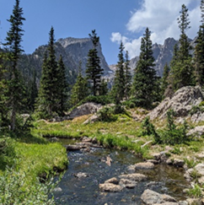
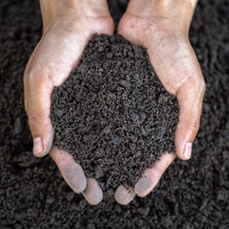
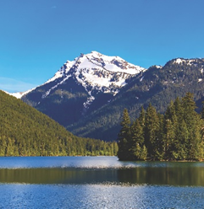
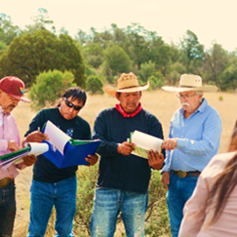
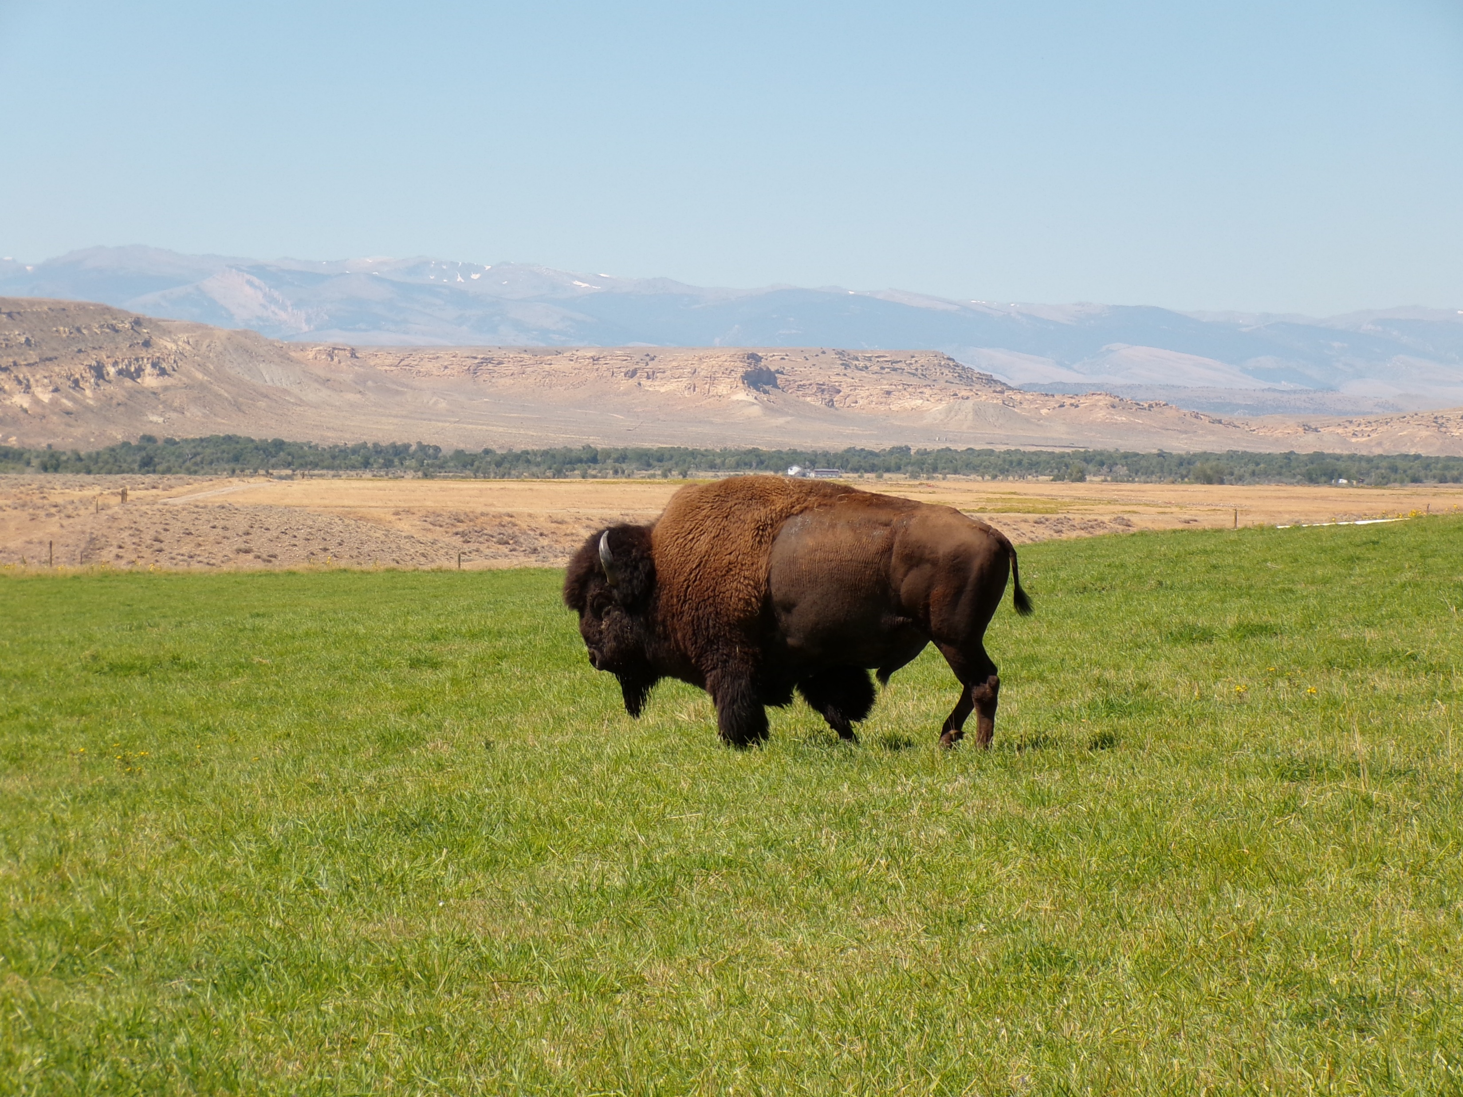
SNL INITIATIVES
ENVIRONMENTAL SOVEREIGNTY & JUSTICE
STEWARDSHIP
CLIMATE
COMMUNITY
PATHWAYS
WOVEN
LANDS
Protecting communities and lands from harmful practices, projects, and policies
Restoring healthy relationships between people and land
Addressing ongoing and anticipated impacts of climate change to preserve lands and cultural lifeways
Upholding traditional knowledge systems
Creating new models, investments, and other tools to secure and expand Native ownership and stewardship over tribal homelands

Slide 6
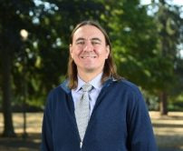
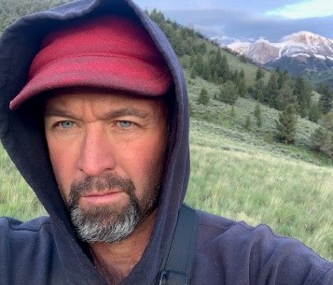
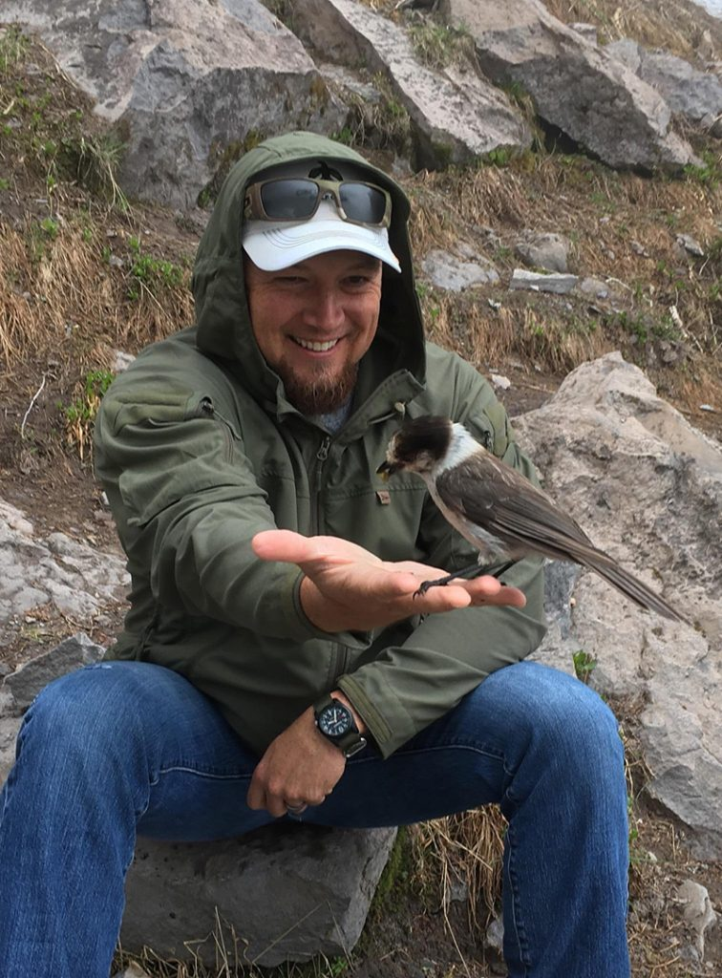
PRESENTERS
Monte Mills
University of Washington School of Law
Martin Nie
W.A. Franke College of Forestry and Conservation at the University of Montana
Tommy Cabe
Eastern Band of Cherokee Indians Natural Resources Department

Slide 7
QUESTIONS

Slide 8




COMMUNICATIONS
ACCESS THE WEBINAR RECORDING AND RESOURCES IN FIRST NATIONS’ KNOWLEDGE CENTER
FOLLOW US ON SOCIAL MEDIA
fndi303
First Nations Development Institute
FirstNationsDevelopmentInstitute
@FNDI303

Slide 9

CONTACT
MARY ADELZADEH
madelzadeh@firstnations.org
TOLI TATE
ntate@firstnations.org

Slide 10



THANK YOU
NATIONAL HEADQUARTERS
First Nations Development Institute 2432 Main Street
Longmont, CO 80501
CONTACT
Tel: 303.774.7836
Fax: 303.774.7841 info@firstnations.org
CONNECT
firstnations.org
fndi303
First Nations Development Institute
FirstNationsDevelopmentInstitute
@FNDI303

